Slide 1
Pioneer paws
Pets Are Worth Saving

Slide 2
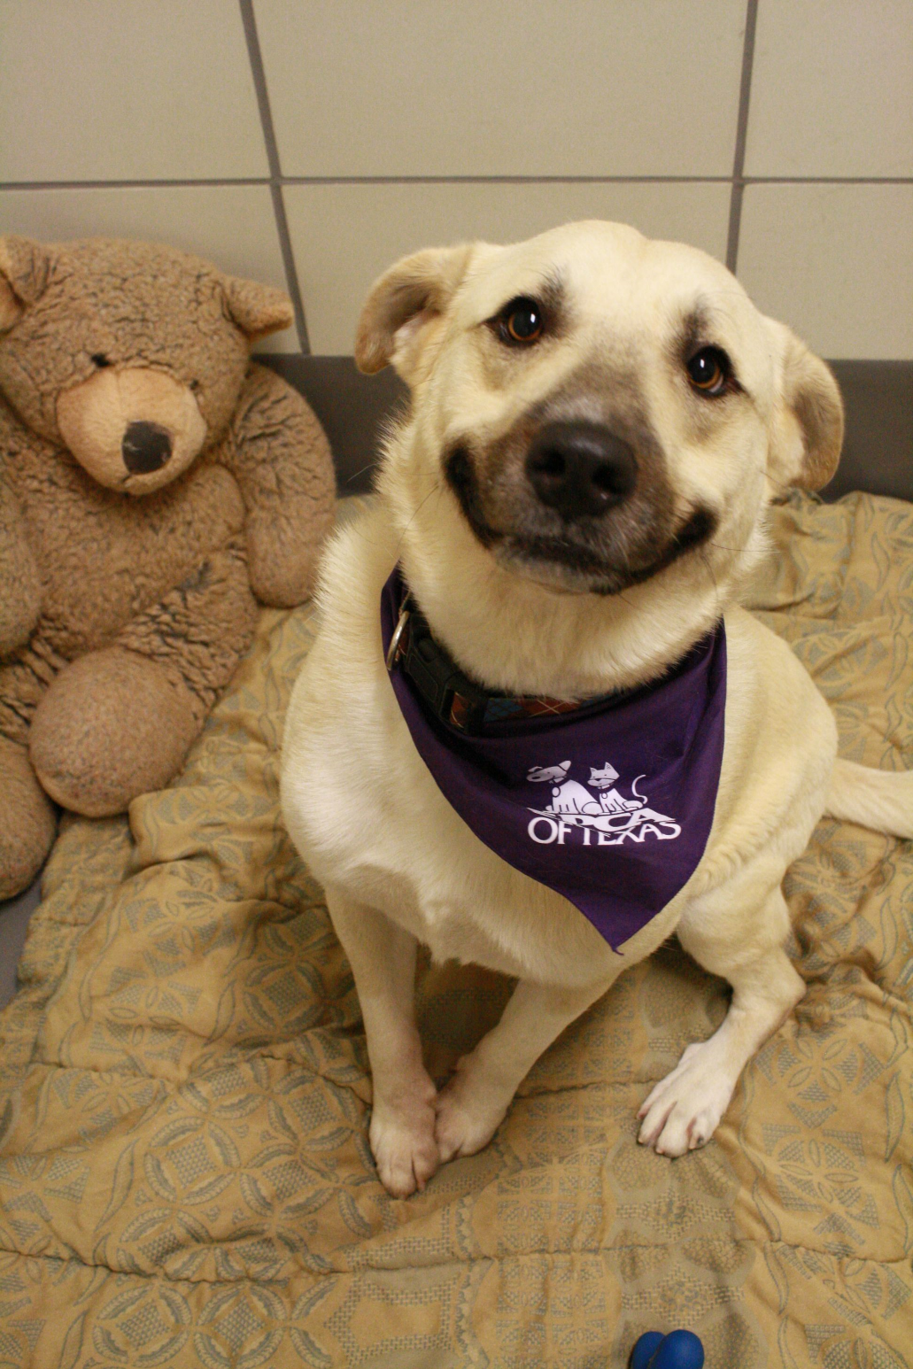

Slide 3
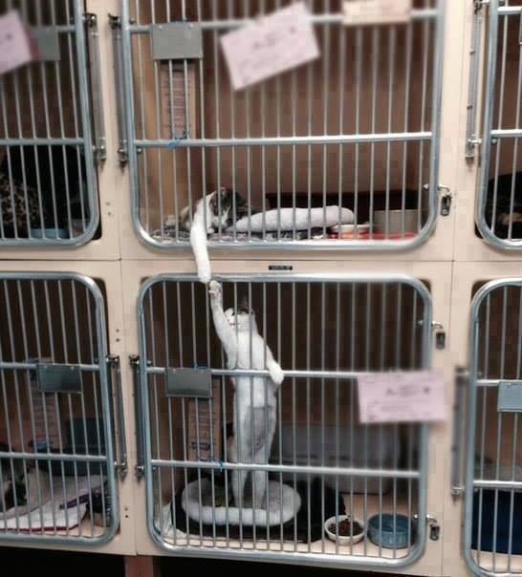

Slide 5
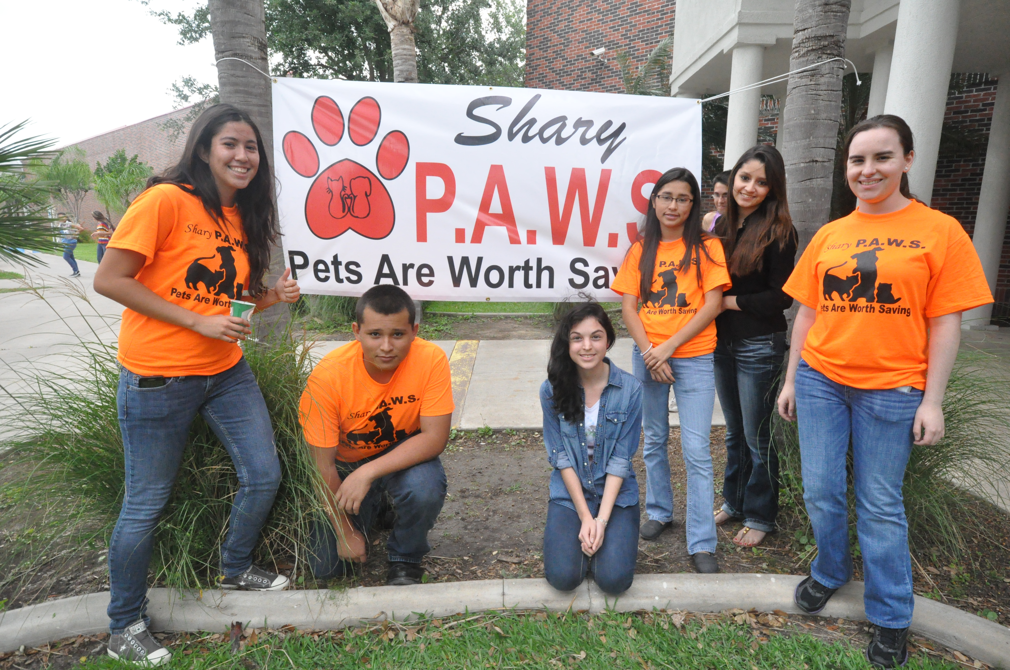

Slide 6
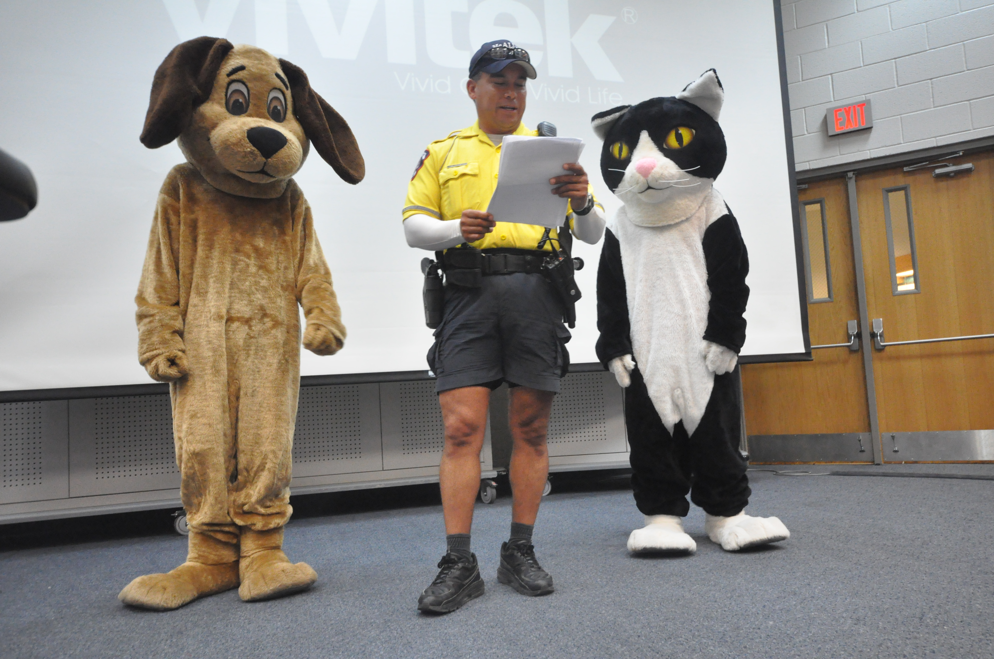

Slide 7
OPPORTUNITIES WITH PIONEER PAWS
Volunteering with live animals at Palm Valley Animal Shelter
Fundraisers and events at Pioneer High School
T-shirts, T-shirts and more T-shirts
Spreading awareness to the community about:
Signs of animal abuse and neglect
Paths to adoption and fostering of pets

Slide 8
Agenda for September 15th
Welcome
How to become a member
-signatures from parents, principal, and student
-$20.00 (10 for membership fee/10 for yearly dues)
Which day to meet???
Need flyers for advertisement
Ideas for fundraisers throughout the year
Upcoming events

