Slide 1
APES
INTRODUCTION TO
AP ENVIRONMENTAL SCIENCE

Slide 2
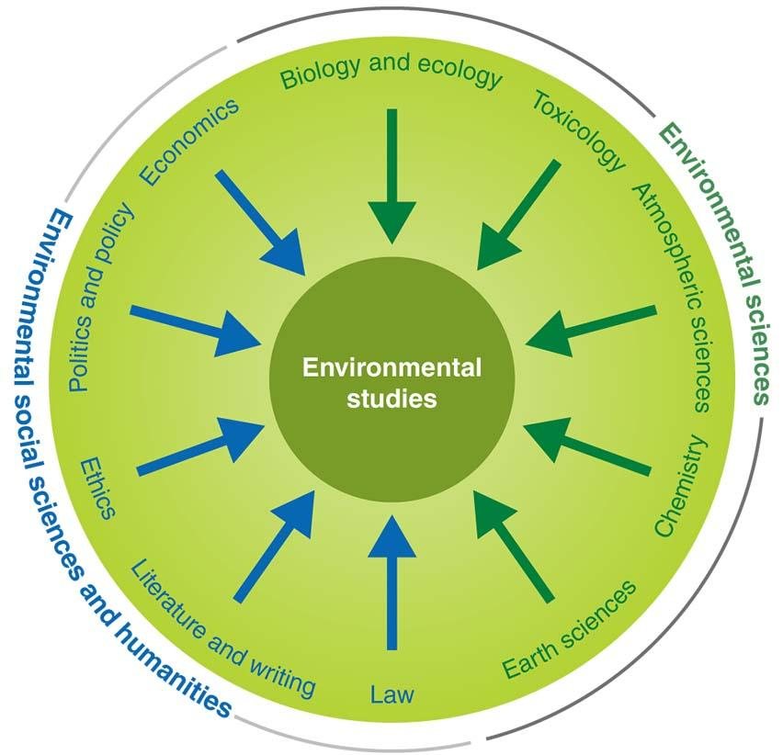
Environmental Studies
Includes additional subjects
Environmental policy
Economics
Literature
Ethics
Understanding Environmental
Sciences can help us become
aware of the impact and
consequences of human
activities on our Earth’s ecosystems.

Slide 3
The cod itself is a system
The predator-prey relationship between two fish is a system
Ocean currents and their effects on fish populations is a system
Human activities and laws are part of a larger system
Ultimately, all four of these systems not only coexist, but constantly interact.
Systems Vary in Size

Slide 4
Environmental Science is the study that
looks at interactions among human
Systems and those found in nature
Fracking can cause changes to
a nearby well of drinking water

Slide 6
The Scientific Method
The scientific method is an objective method used to explore the natural world and predict the outcome of certain events, processes, or changes.
Observing and questioning
Forming a hypothesis (*and forming a Null Hypothesis that says there is no significance between two variables by which the researches tries to disprove)
Testing the hypothesis
Collecting and Analyzing the data
Developing a Conclusion

Slide 7
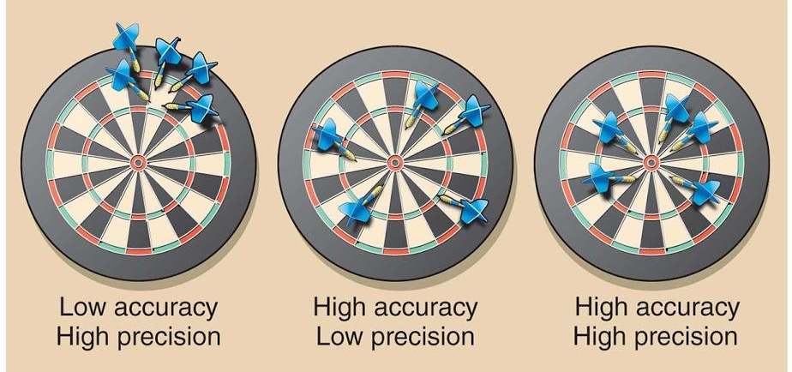
Precision & Accuracy
When collecting data, results should be precise and accurate.
Precision- how close to the repeated measurements of a sample are to one another
Accuracy- how close a measured value is to the actual or true value

Slide 8
Interpreting Results & Disseminating Findings
Interpreting results- results are interpreted using the two main types of reasoning
Inductive reasoning is the process that starts with a specific fact or observation that leads to a general statement. (Example: a scientist is studying a species of bird and makes a statement about all birds of that species.)
Deductive reasoning is the process of applying a general statement to specific facts or situations. (Example: We know that air pollution kills trees. Someone sees a dead tree and says it’s due to air pollution)

Slide 9
The Chlorpyrifos Investigation
In the 1990s, scientists suspected that organophosphates (chemicals used in insecticides) might have serious effects on the human central nervous system.
ADHD, Cerebral Palsy, Birth Defects, etc.
One of these chemicals, chlorpyrifos, was among the most widely used pesticides in the world.

Slide 10
Using the Scientific Method
Question: Do organophosphate pesticides have detrimental effects on the central nervous system?
Hypothesis: Chlorpyrifos causes neurological disorders and negatively affects human health.
Researchers also proposed a null hypothesis because the original hypothesis would be hard to prove conclusively.
Null Hypothesis: “Chlorpyrifos has no observable negative effects on the central nervous system.”

Slide 11
Conducting a Controlled Experiment
Scientists designed the experiments with 2 groups of rats. The first was the experimental group (group exposed to chlorpyrifos). The second group was the control group, a group that experiences the same conditions as the experimental group, except for the single variable under study.
Results: Researchers found that the rats exposed to chlorpyrifos had much lower levels of the enzymes in their brains
**A natural experiment with human exposure to chlorpyrifos resulted in low birth weights and mental abnormalities

Slide 12
Matter and Mass
Matter is anything that occupies space and has mass.
Mass of an object is a measurement of the amount of matter it contains.
All matter is composed of atoms.
An element is a substance that cannot be broken down into smaller components
Molecules have more than one atom, compounds have more than one element.

Slide 13
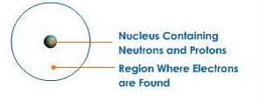
Structure of an Atom
Every atom consists of two major components: a nucleus surrounded by electrons (negative charge).
The nucleus of an atom contains protons (positive charge) and neutrons (neutral charge).
The number of protons in a particular atom is called the atomic number.
Atoms have isotopes, which are atoms of the same element with different amounts of neutrons.

Slide 14
Radioactivity
The nuclei of isotopes can be stable or unstable. Radioactive isotopes undergo radioactive decay.
Radioactivity is an important topic in Environmental Science because it is a source for energy and the process is used for carbon dating, which can be used to determine an organism's age or approximate date of death.

Slide 15
Chemical Reaction and the Conservation of Matter
Chemical Reaction- occurs when atoms separate from molecules or recombine with other molecules
N2 + O2 → 2NO
Conservation of Matter- states that matter cannot be created or destroyed; it can only change form

Slide 16
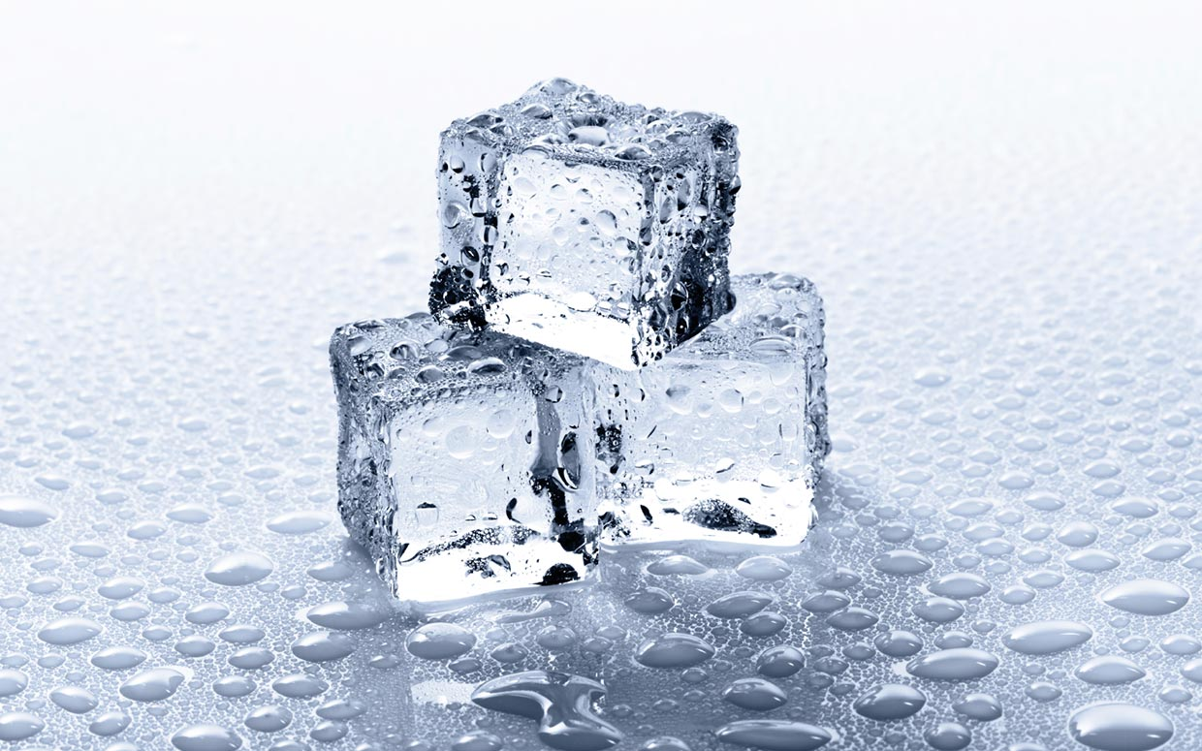
Properties of Water
*Water (H2O) is a polar molecule that covalently bonds and forms a Hydrogen Bonds between other water molecules
*Surface Tension- results from the cohesion of water molecules
*Capillary Action- occurs when adhesion of water molecules to a surface is stronger than cohesion between the molecules
Boiling- 100℃ (212℉)
Freezing- 0℃ ( 32℉)

Slide 17
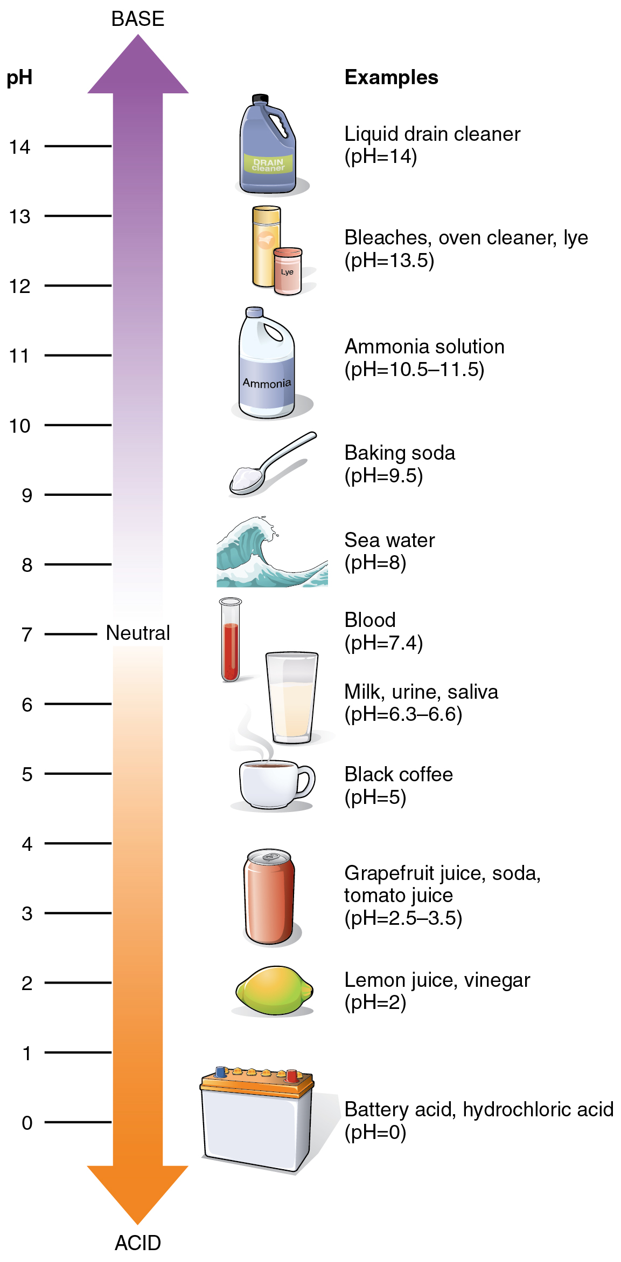
Acid/Bases
Acid- a substance that contributes hydrogen ions to a solution
Base- a substance that contributes hydroxide ions to a solution
pH- indicates the relative strength of acids and bases in a substance

Slide 18
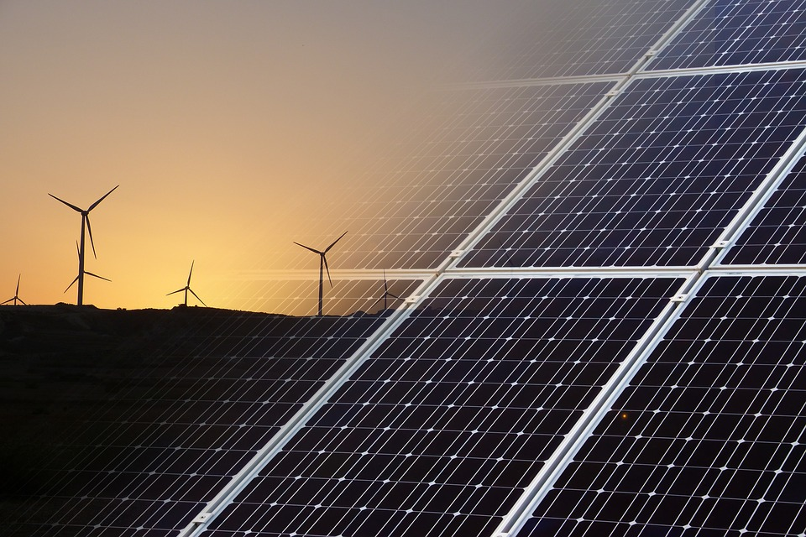
Energy
Energy is the ability to do work, or transfer heat.
A basic unit of energy is a joule. A joule is the amount of energy used when a 1 watt light bulb is turned on for 1 second.
Power is the rate at which work is done: energy=power X time and power= energy/time
Forms of energy can be interchangeable and converted into one another. Potential energy, kinetic energy, light energy, chemical energy, and sound energy are all important energy forms in the environmental sciences.

Slide 19
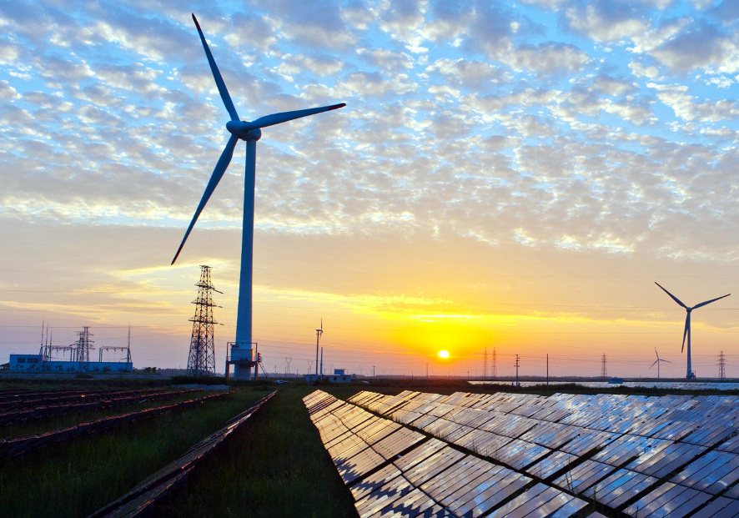
Energy (Cont.)
Electromagnetic energy is also a form of energy that's important that includes, but not limited to, visible light, ultraviolet light, and infrared energy, which we perceive as heat.
Electromagnetic radiation is carried by Photons, massless packets of energy that travel at the at the speed of light and can move even through the vacuum of space.
Many stationary objects contains a great deal of potential energy-energy that has been stored but not yet released.
Kinetic energy is the energy of motion.

Slide 20
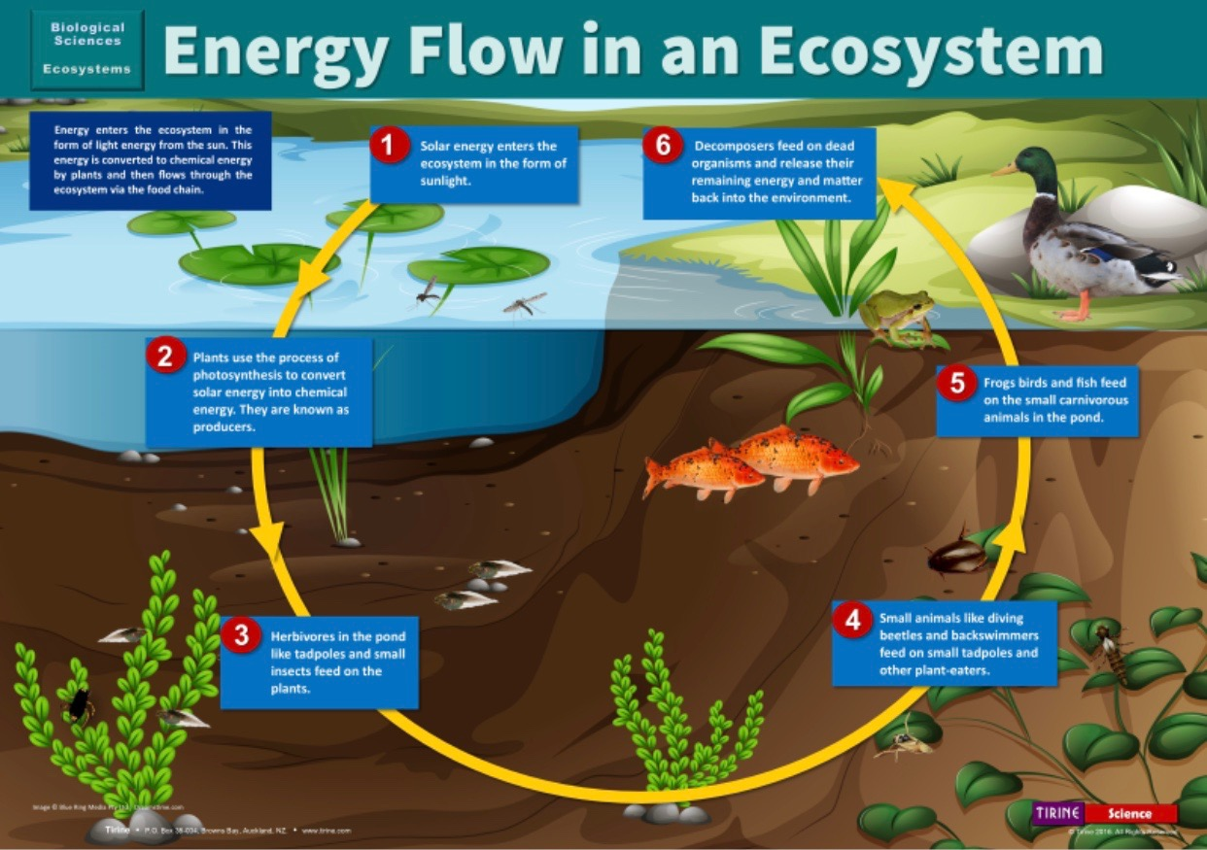
Matter and energy flow in the environment
In order for scientist to even understand a system, they have to study the whole system functions and not just pieces of it.
Studying the system allows scientist to determine how matter and energy flows in the environment.

Slide 21
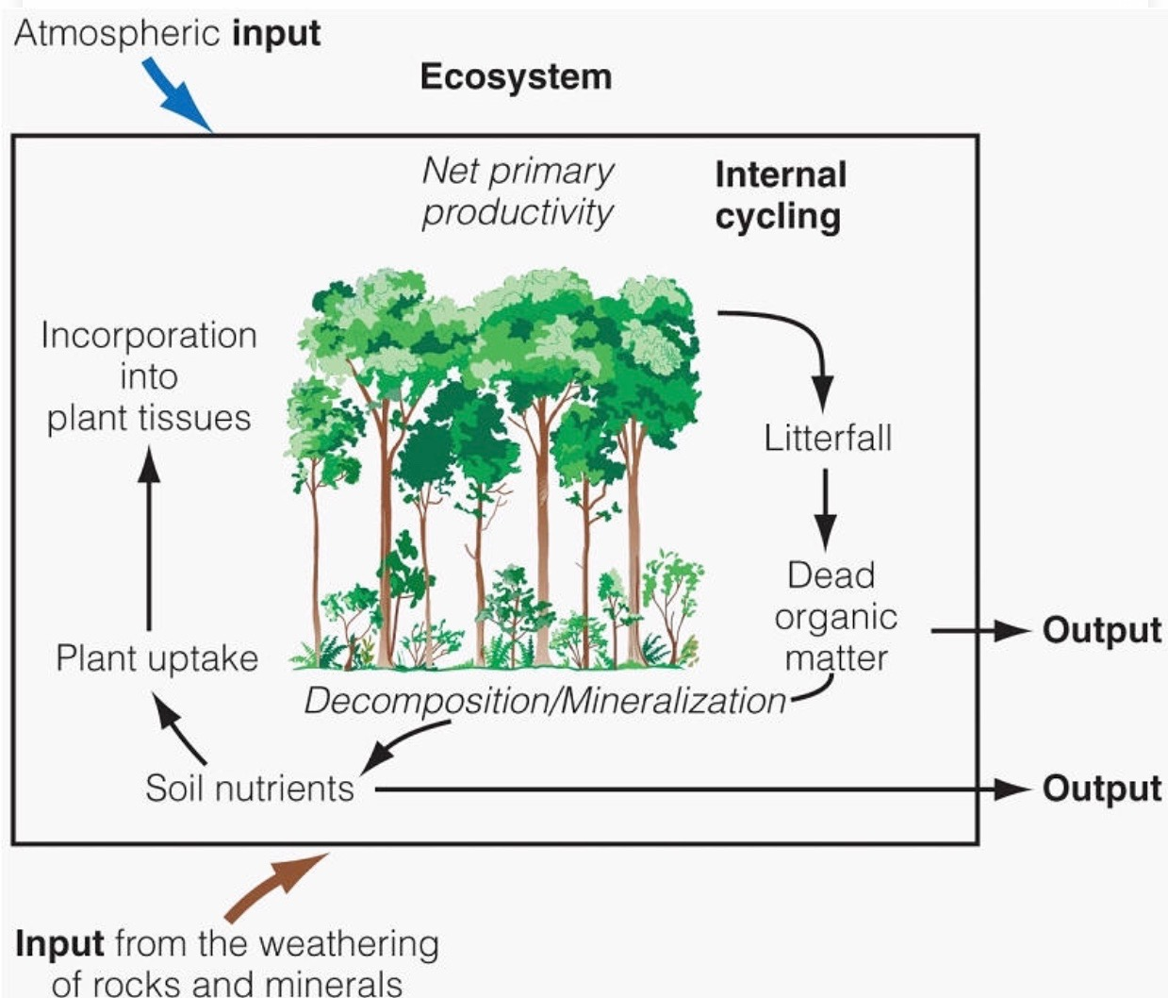
Inputs and Outputs
Inputs, which are additions to a given system
Output, are losses from the system
Scientist who study systems often conduct a system analysis, and are able to identify, the inputs,outputs, and changes in the system under various condition
For instance, the mono lake
-the input is water and salt
-output is that water would be evaporated from the lake and the Brine Shrimp removed by migrating birds.
-leads to a terminal lake that gets saltier every year.

Slide 22
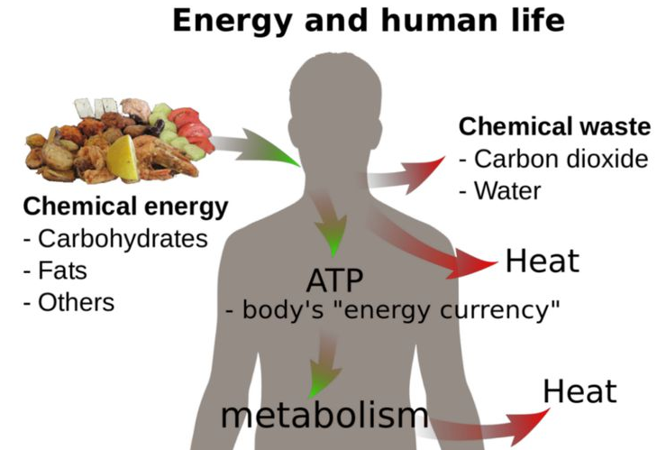
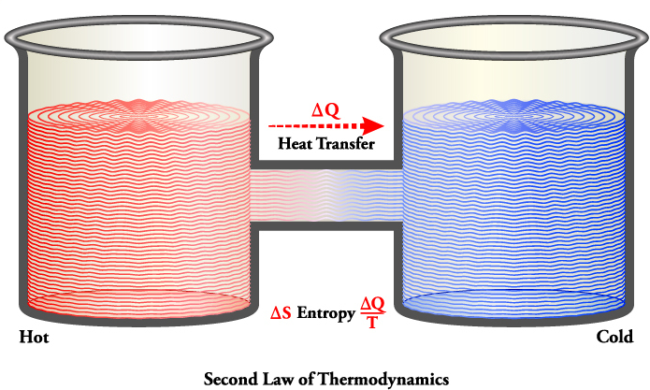
Law of T. describe how energy behaves
The First law of Thermodynamics state that energy is neither created nor destroyed, but it can change from one form to another
The Second law of Thermodynamics tells us that when energy is transformed, the quality of energy remains the same, but its ability to do work diminishes.

Slide 23
Law of T. describe how energy behaves
Energy Efficiency is the ratio of the amount of energy expended in the form you want to the total amount of energy that is introduced into the system.
Scientists estimate that only 16% of the energy used in the United States ends up performing useful work. The remaining 84% is either unavoidably wasted because of the second law of thermodynamics (41%) or unnecessarily wasted (43%).

Slide 24
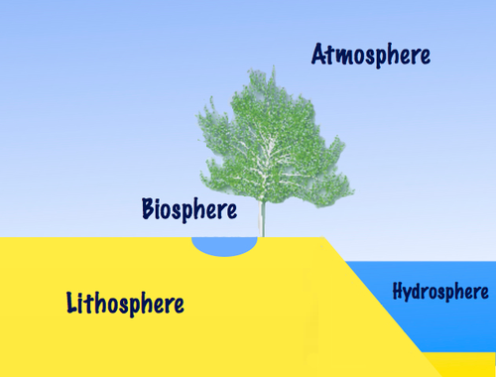
EARTH’S INTERACTIVE COMPONENTS
GEOSPHERE = makes up the Earth’s
interior (rock)
ATMOSPHERE = makes up the gases
surrounding Earth (air)
HYDROSPHERE= makes up the areas
of water
BIOSPHERE = makes up all the living
things within the other
parts
GEOSPHERE
EARTH IS AN INTEGRATED SYSTEM OF 4 INTERACTING COMPONENTS

Slide 25
Sustainability
The ability of a specified system to survive and function over time
* Natural capital refers the land, air, water, living organisms and all formations of the Earth's biosphere that provide us with ecosystem goods and services needed for survival and well-being.
* An environmentally sustainable society meets basic needs of its people without degrading the natural capital that supplies their ecological services.

Slide 26
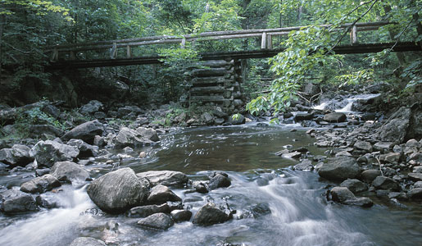
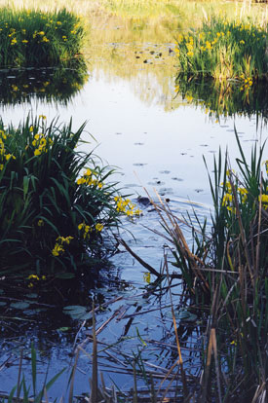
Earth Resources
Renewable | Non-Renewable | Potentially Renewable
Direct solar energy | Fossil fuels | Fresh air
Winds, tides, flowing water | Metallic minerals (iron, copper, aluminum) | Fresh water
 | Nonmetallic minerals (clay, sand, phosphates) | Fertile soil
 |  | Plants and animals (biodiversity)

Slide 27
Four Global Environmental Problems
1. Over Population
2. Pollution
3. Global Warming
4. Loss of biodiversity

Slide 28
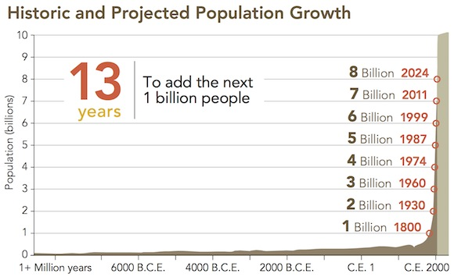
POPULATION GROWTH

Slide 29
Pollution
Anthropogenic means “having its origin in the influence of human activity on nature”
Pollution is any ANTHROPOGENIC FACTOR that is added to our air, water, soil, or food by which threatens the health and survival of humans and/or other living organisms

Slide 30
Global Warming
Global Warming is an increase in the temperatures of the Earth caused by people polluting our air with harmful greenhouse gases
EXAMPLE: Burning fossil fuels ( oil, natural gas , and coal) has caused increases in global carbon dioxide
CO₂ blocks infrared radiation and therefore traps heat in the atmospheric
Results in displacement of plants, rise in sea level, changes in climate and weather

Slide 31
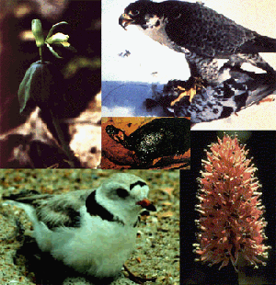
Loss of Biodiversity
Increasing populations increases resource consumption which converts forests, wetlands, etc. into agricultural and urban development which then leads to loss of ecosystems which results in loss of biodiversity
Biodiversity is needed for the sustainability of natural systems that provide crops (food) and medicine development.

Slide 32
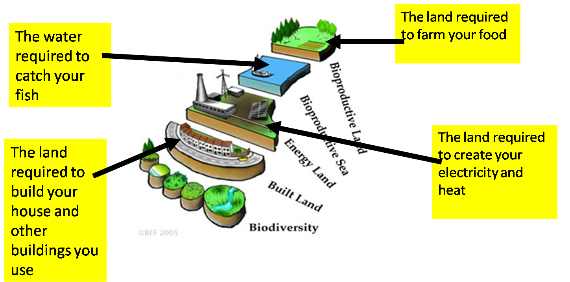
It is a measure of how much biologically productive land and water
(cropland, grazing land, forest and fishing grounds) is required to produce all the resources (food, timber, building materials, fuel, water) an individual or a population consumes and to absorb the waste they generate.
The measuring units used in Ecological Footprints are in global HECTARES (gHa)
Ex. A hectare of land includes it’s “bio-productive capacity” (from nutrient cycling, energy production, etc.)
A hectare = 2.5 acres (1 hectare is 2 complete football fields with end zones)

Slide 33
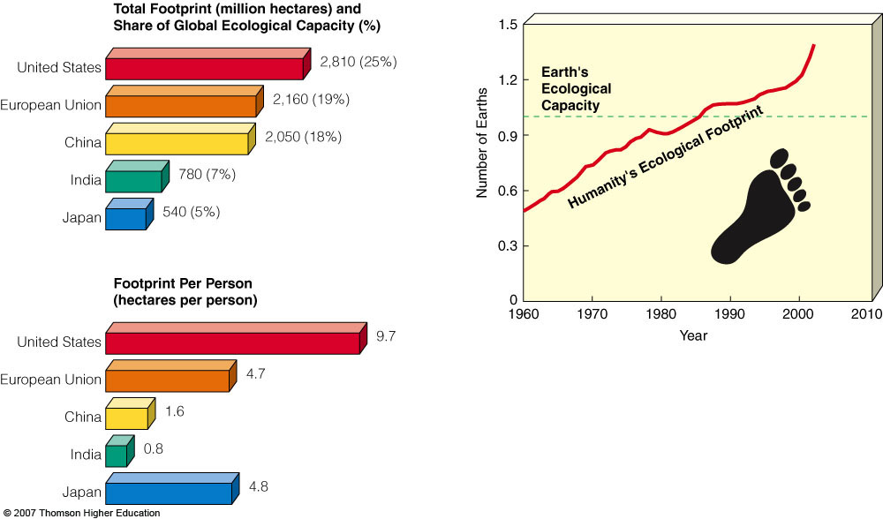
Our Ecological Footprint
Current estimates indicate that humans are over-shooting the Earth’s carrying capacity (bio-capacity) by 25-50%
To sustain the current carrying capacity, we need 1¹/₂ Earths!

Slide 34
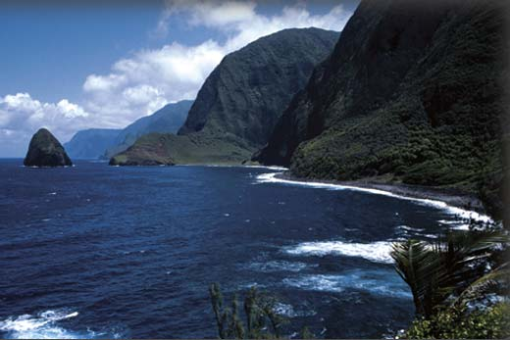
THE “COMMONS” – RESOURCES SHARED BY ALL
AIR
WATER
LAND
OCEANS
NATIONAL PARKS

Slide 35
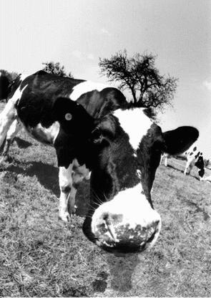
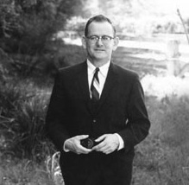
What is the “Tragedy of the Commons”?
ARTICLE: published in 1968 by Garrett Hardin.
CONCEPT: a shared resource in which any given user reaps the full benefit of his/her personal use, while the losses are distributed amongst all users. Result? Tragedy of resources.
CLASSIC EXAMPLE: excessive cows on shared pasture overgraze and degrade the land
Individuals are motivated only by personal gain of wealth while degrading environment
Is of concern because it may convert potentially renewable resources into nonrenewable resources

Slide 36
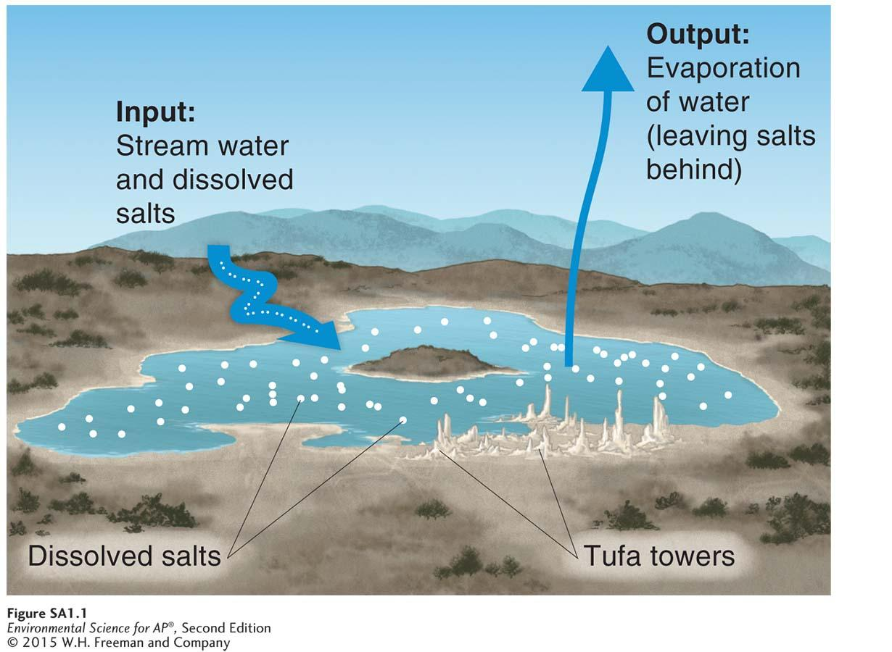
Case Study: California’s Mono Lake
Terminal lake that picks up salt and minerals
Once the water evaporates, minerals are left behind
Mono brine shrimp and Mono Lake alkali fly larvae feed on algae and are then preyed on by birds
Birds depend on the lake for food and use it as a stopover

Slide 37
Our Impact on the Mono Lake
In 1913, a plan was formed to redirect water away from Mono Lake and Owens Lake
By 1930, a 44,000 ha salt flat remained, one of the largest sources of windblown dust
Major threat to humans because the dust contains large amounts of arsenic and lowers visibility
In 1941, an aqueduct extended to draw water from the streams feeding Mono Lake
Depth of the lake dropped 25 ft and salt concentration to twice than that of the ocean
Salinity killed algae, which killed the shrimp, birds stayed away

Slide 38
Recovery of the Mono Lake
1994, environmentalists reduce the amount of water diverted, and try to refill 2/3s of it
2013, brine shrimp are thriving and birds return to the lake
Today residents are trying to reduce consumption
Because of these acts, the Mono Lake ecosystem is being restored
Proves that human activity, the lives of other organisms, and abiotic factors are all connected
Shows that what may seem like a small change can impact the environment in a big way

Slide 39
The Florida Everglades and Our Impact
5,000,000 ha, with 400,000 ha being a subtropical wetland.
Large amount of species diversity; some are endangered.
Dramatic population growth introduced changes to the region:
Flood control, dams, and irrigation decreased water flow by 30%.
Fertilizer heavy with phosphorus contaminated water, causing cattail overgrowth.
Native life is being choked out due to water tampering.

Slide 40
Can We Save It?
The Comprehensive Everglades Restoration Plan of 2000:
Increasing water flow into the region.
Reducing incoming pollutants.
Developing strategies for dealing with future problems.
To increase water flow:
Create new water storage facilities to redirect 6.4 billion liters back into the ecosystem.
2009: Florida purchased 29,000 ha for water flow restoration from Lake Okeechobee to the Everglades.
Reducing pollutants:
Engineers have built more than 21,000 ha of artificial upstream to help clean water.
This has reduced phosphorus concentrations in run off.

Slide 41
Planning for the Future- an Adaptive Management Plan
Adaptive Management Plan- a plan that provides flexibility so that managers can modify it as changes occur.
Restoring the Everglades or other natural occurrences can have unexpected consequences:
EX: Global warming can change freshwater levels.
EX: Public and Private property limitations
During this process, adjustments must be applied adaptively to help the population and the environment.

