Slide 1
EOC

Slide 2
Category 1:
BIOCHEMISTRY
CELLS
CELL TRANSPORT
VIRUSES

Slide 3
4A - S

Slide 4
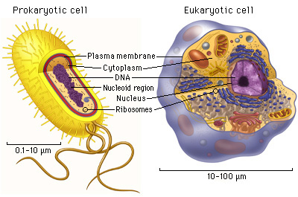
4A-S
Flagella

Slide 5
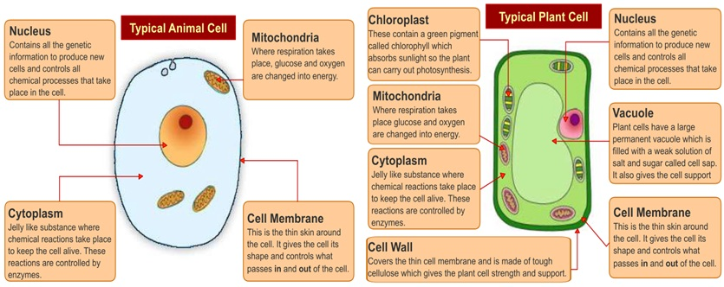
4A- S CELLS

Slide 6
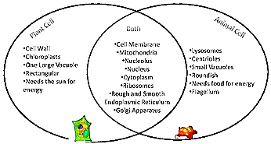
4A-S
PLANT CELL VS ANIMAL CELL
PLANT CELL
BOTH
*cell membrane
*nucleus
*mitochondria
*ribosomes
*ER
*golgi bodies
*cytoplasm
ANIMAL CELL
Cell wall
Green chloroplasts
Large central vacuole
Uses sunlight energy
Rectangular shape
Small vacuoles
Uses food energy
Centrioles
Lysosomes
Roundish shape

Slide 7
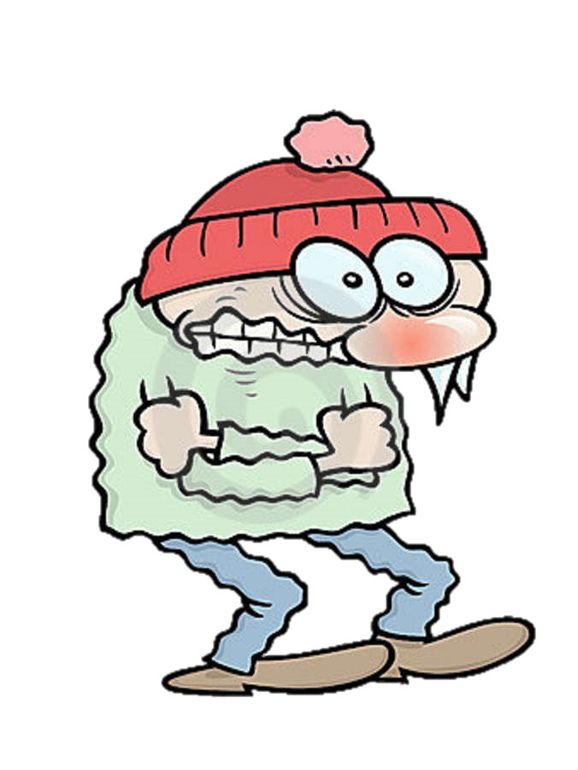
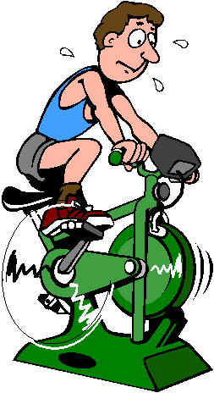
Homeostasis
4B-R
https://www.youtube.com/watch?v=6fhbbFd4icY
Maintaining constant internal balanced environment
We sweat when we are hot to cool our body down
We shiver to produce muscle heat when we are cold

Slide 8
PLASMA MEMBRANE - CELL MEMBRANE - GATE KEEPER
4B-R
(BILAYER)
https://www.youtube.com/watch?v=owEgqrq51zY
Fluid Mosaic Movement

Slide 9
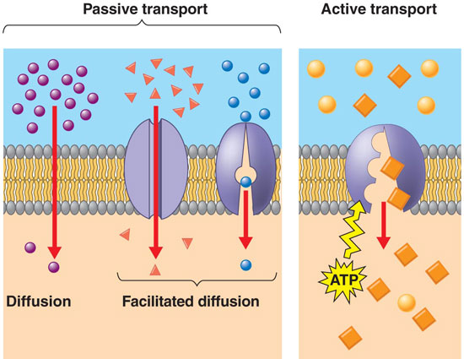
4B- R -------TYPES OF CELLULAR TRANSPORTS
Protein pumps,
Diffusion,Osmosis,Facilitated Diffusion

Slide 10
4B-R
OSMOSIS = is diffusion of water molecules through the cell membrane.
**there are 3 solutions that can affect the direction of osmosis
Outside cell:
(High solute/Low water)
Inside of cell:
(Low solute/ High water)
Outside cell:
(same solute/same water)
Inside of cell:
(same solute/ same water)
Outside cell:
(Low solute/High water)
Inside of cell:
(High solute/ Low water)

Slide 11
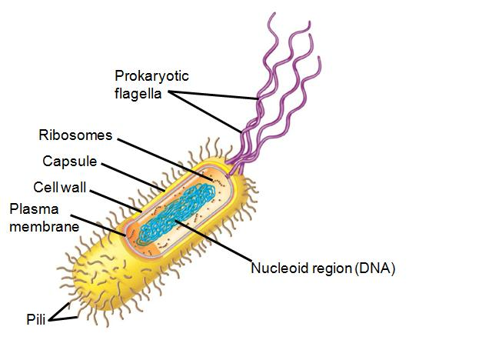
4C -R
BACTERIAL CELL VS VIRUS
CAPSID=
OUTER PROTEIN COAT
Nucleic
Acid
(DNA/RNA)

Slide 12
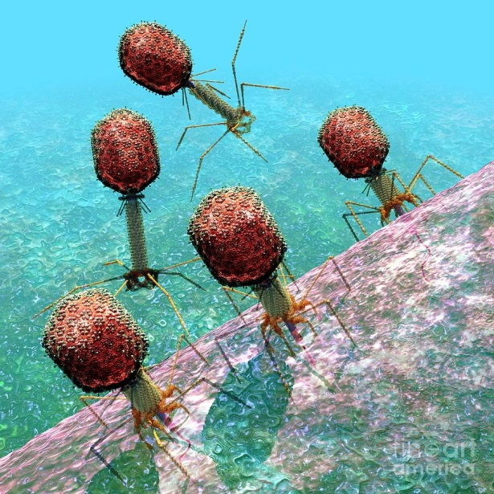
4C-R
Virus REPLICATION
LYTIC CYCLE =
* RAPID (FAST) CYCLE
1 – 7 DAYS
Releases more viruses which destroys the host cell by LYSIS (cell bursting)
LYSOGENIC CYCLE =
* LONG (SLOW) CYCLE
1 – 10 YEARS
Virus Nucleic Acid (Prophage) remains dormant as host cell divides before entering Lytic cycle
VIRUSES ARE PATHOGENS because they must use a living host cell to replicate which results with disease.

Slide 13
4C-R
Vaccine= contain pieces of weak viruses that are used to activate the response of the body’s immune cells in order to fight off real viruses with antibodies
****Vaccines CAN NOT treat viral infections
****Antibiotics CAN NOT treat viral infections either
Vaccines CAN ONLY prevent viral infections

Slide 14
5A-R
M

Slide 15
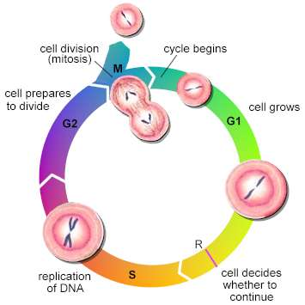
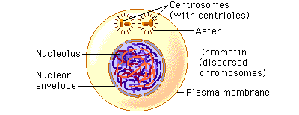
5A-R
INTERPHASE
G1 = new daughter cell grows and
produces organelles
S = DNA is replicated which forms copies
of the chromosomes
G2 = cell completes its growth and
prepares for mitosis
INTERPHASE = CELL GROWS
Checkpoint

Slide 16
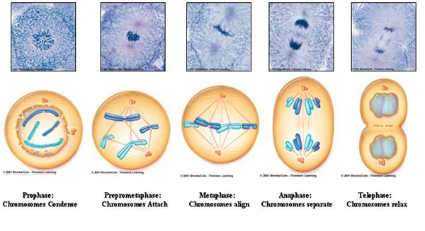
5A-R
MITOSIS = NUCLEAR DIVISION
OF BODY CELLS
https://www.youtube.com/watch?v=pOsAbTi9tHw

Slide 17
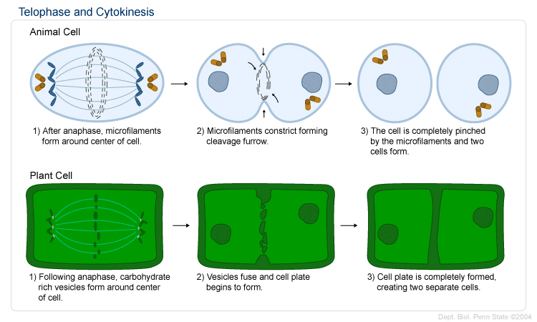
5A-R
CYTOKINESIS = WHEN CYTOPLASM DIVIDES THE PARENT CELL
AFTER TELOPHASE
*** 2 IDENTICAL DAUGHTER CELLS ARE FORMED

Slide 18
5C-s

Slide 19
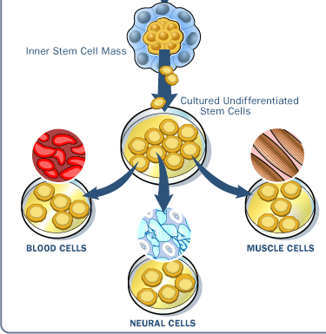
Cell Specialization
5B-s
SAME DNA!!!
DIFFERENT GENES ACTIVATED( TURNED ON )
by enzymes to form
different cell types
https://www.youtube.com/watch?v=I8uXewS9dJU

Slide 20
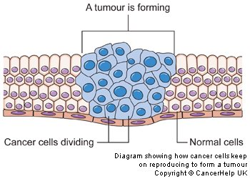
CANCER= UNCONTROLLED CELL DIVISION
5D-s

Slide 21
9A- R
Biomolecules are mainly made of
Carbon, Hydrogen, Oxygen, Nitrogen
(C, H, O, N)
with carbon
*POLYMERS= many monomers

Slide 22
9A-R
monomer
polymer
monosaccharide
carbohydrates
lipids
proteins
Nucleic acids

Slide 23
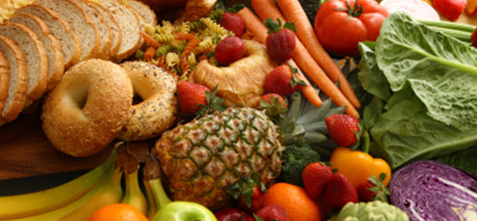
9A-R

Slide 24
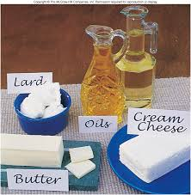
9A-R

Slide 25
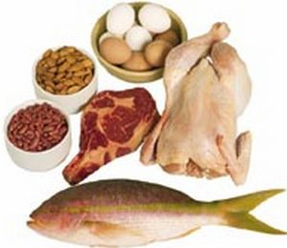
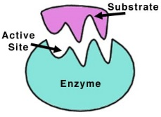
9A-R
O
meats

Slide 26
9A-R

Slide 27
9D - S
removes water to combine molecules
adds water to break down molecules

