Slide 1
EVOLUTION & TAXONOMY
UNIT

Slide 2
EVOLUTION IS:
a change in the traits of a species over a long period of time. Evolution shows that all organisms have descended from a common ancestor.
ANCIENT HORSE
MODERN HORSE
SPECIES IS:
a group of organisms of the same kind that can interbreed(mate)
WHY DOES A SPECIES EVOLVE ?
They evolve in order to
adapt to changes in their environment
GENECTIC VARIATION IS VITAL FOR THE SURVIVAL OF A SPECIES BECAUSE IT ALLOWS FOR ADAPTATION TO OCCUR

Slide 3
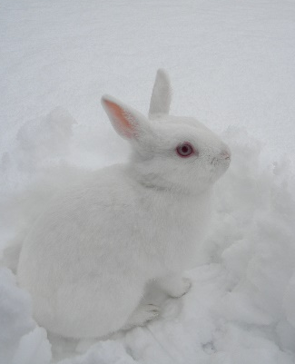
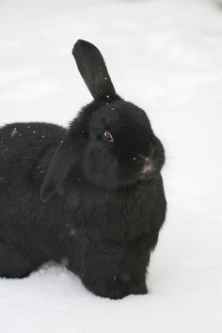
a genetic trait in an organism that increases its chance of surviving in their environment.
ADAPTATION IS:
HOW DO ADAPTATIONS OCCUR?
They occur because of genetic variations due to mutations and from the recombination of genes during crossing over of meiosis
EXAMPLE OF AN ADAPTATION: white fur rabbit in a snowy environment.

Slide 4
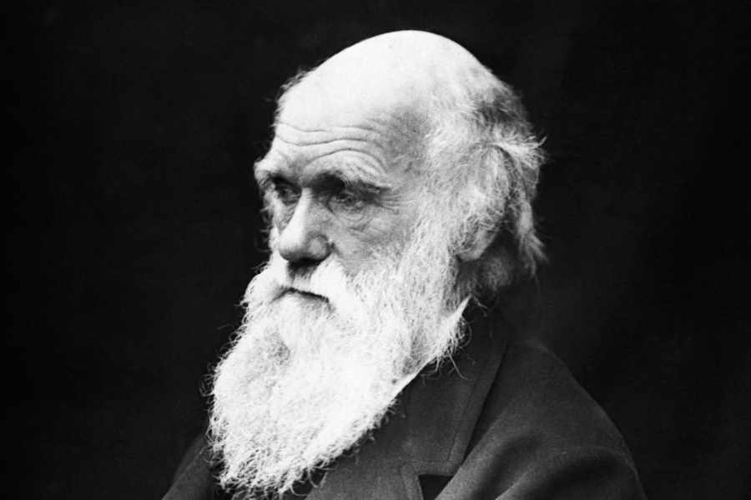
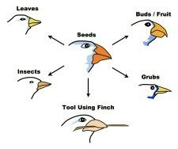
CHARLES DARWIN
Is the “FATHER OF EVOLUTION”
who proposed that evolution of species occurs due to natural selection (the environment selects)
DARWIN STUDIED GALAPAGOS ISLAND FINCHES
Darwin noticed sub-species of finches with different beak shapes adapted for the
food in their island

Slide 5
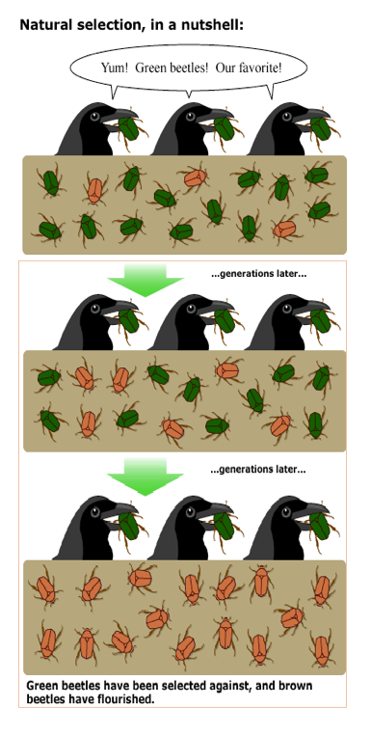
NATURAL SELECTION:
process by which organisms that are better adapted (have favorable traits) to their environment will survive, reproduce, and pass on favorable traits
Example # 1- Wood Beetles
Dark colored wood beetles are eaten because they taste better than the light colored beetles.
Example # 2- Peppered Moths
During the Industrial Revolution, Natural Selection favored dark peppered moths over the light peppered moths in areas of heavy pollution that darkened the tree barks.
Light colored wood beetles increase in the population, generation after generation
Dark Peppered Moths increased during the Industrial Revolution

Slide 6
ARTIFICIAL SELECTION or SELECTIVE BREEDING
Artificial Selection = intentional breeding for certain traits that humans favor in a species
Example # 1
Dog breeder will breed dogs with selected traits.
1875
1975
2005
------------------------------------------------------------------------------------------------------------------------------------------------------
Example # 2
Farmers have changed the corn plant to produce selected traits
1. CORN VARIATIONS
2. SEED OF FAVORABLE CORN SELECTED
3. GENERATIONS OF REPEATED PROCESS
4. NEW SPECIES OF CORN OVER TIME

Slide 7
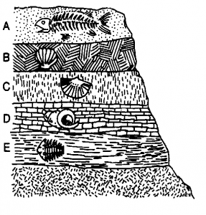
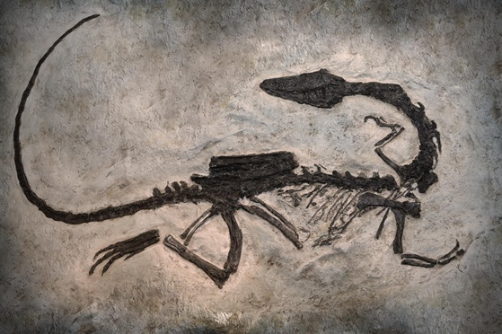
EVIDENCE OF EVOLUTION… FOSSIL RECORDS
Scientist who study fossils analyze its age, location and what the environment was like when the organism it came from was alive. Fossil records show transitions between species. Ex) an extinct primitive bird of the Jurassic period is a transitional link between reptiles and modern birds.
YOUNGEST
rock layers are toward the top
OLDEST
rock Layers
Are at the bottom
FOSSIL RECORDS CAN BE USED AS A
TIME LINE OF HOW LIFE HAS EVOLVED

Slide 8
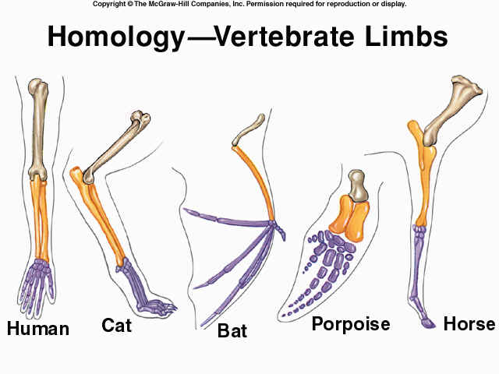
Evidence for Evolution…..Anatomical Homologies Similar body structures that exist between different species can be identified as a link to a common ancestor. Homologies are similar in structure (shape) but not necessarily in function (job)

Slide 9
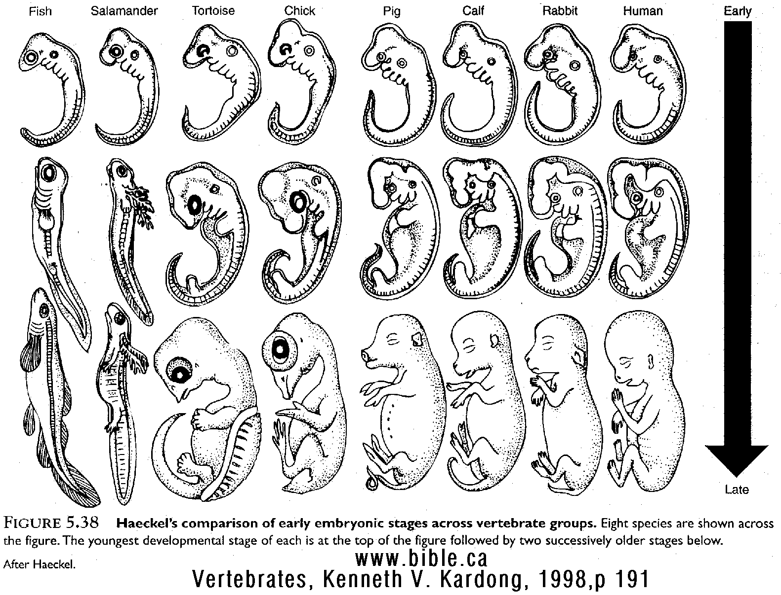
EVIDENCE OF EVOLUTION…EMBRYOLOGY HOMOLOGIES
By studying the similarities between embryo development of different species, we can see similar origins of a common ancestor
EMBRYOS=
Early development stage of animals

Slide 10
EVIDENCE OF EVOLUTION…MOLECULAR HOMOLOGIES
Molecular Homologies can be observed by studying the DNA or Protein Amino Acid sequences of different species.
If two different species are closely related, the DNA/ Amino Acid sequences that code for a common protein should be very similar.
If two different species are distantly related, then there will be more differences in their DNA/ Amino Acid sequences.

Slide 11
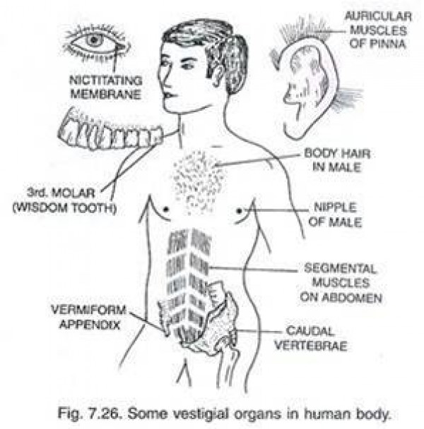
Evidence for Evolution…..Vestigial Structures Vestigial structures are organs or remnants of organs that have no function in an organism, but they come from a common ancestor that did need that structure.

Slide 12
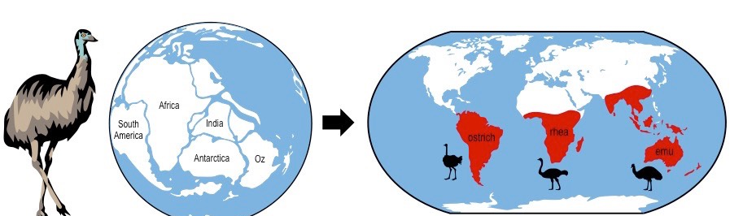
Evidence for Evolution…..Biogeography Analysis The study of past and present geographical distribution of a species is referred to as Biogeography Analysis. If the environment changes or a population moves to a different environment, then the population is forced to adapt to the different conditions.

