Slide 1
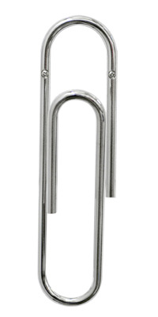
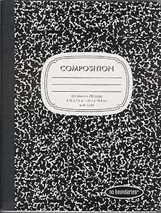
Student Name _______________________________ Block _____________ Date _________________________
English II
2019-2020
Mrs. Ballesteros
Remind Text Alerts
Contact Me
Sign up for class text alerts to receive updates on homework, tests, quizzes, and other important due dates. Download the Remind 101 App to be able to chat with me for help.
Text the number 81010, and compose a message with your class code below.
1
sballesteros@sharylandisd.org
Download the Remind App
1st Block: @ 1Fall19
2
(956) 271-1600 ext. 3145
2nd Block: @2Fall2019
Remind 101 App
5th Block: @5Fall19
3
Grades
Required Class Materials
Eraseable Pens (blue, black, red)
Pencils
Erasers
Highlighters (5 different colors)
Scissors
Glue sticks
Tape with dispenser
Thin post-it tabs for marking pages
1 package of college-ruled notebook paper
1 composition book
M
A
J
O
R
Tests, Research, papers, projects/presentations, essays, etc.
M
I
N
O
R
Daily work, journals, homework, quizzes, etc.
60%
40%
Extra credit: 1 box of tissues and a bottle of hand-sanitizer!
*
Rules &
& Expectations
Grades are available on
Skyward.
It is your responsibility to keep track of your progress in this class. Please ask questions and/or come to tutoring as often as possible. You may also e-mail me at any time with any questions or concerns you have. Do not wait until the last minute!
If you do not have a student login, you can get one from the library.
1 BE RESPECTFUL
Refrain from talking, and direct your attention to the teacher or student who is sharing information.
Stay awake and participate in class discussions.
Take care of classroom materials, and pick up after yourself.
Be positive and helpful.
2 BE RESPONSIBLE
Get to class BEFORE the bell rings, and begin working on bell work.
Come to class prepared (composition book, homework, supplies).
Keep all notes and assignments until you are advised to recycle them.
Cell phones must be silenced and placed in a backpack unless given permission to use for academic purposes. Any cell phone that is visible and/or in use without permission will be turned in to the front office.

Slide 2
Attendance & Late-Work Policy
1
You are allowed four absences per nine week period. On the fifth absence, credit for the course is LOST, and students must attend Saturday school to regain the credit.
3
Make Up Work: If you are absent, you may make up work if it is an EXCUSED ABSENCE ONLY. Any missing assignment will be entered as a ZERO until it is turned in and an excuse is submitted to the office.
Late Work:
If you did not turn in an assignment on time, you have THREE days to do so, with an attached penalty of 10 points off per day.
Pre-AP students may NOT turn in late MINOR work and only have TWO days to turn in late MAJOR work, with a penalty of 15 points off per day.
2
If you are absent, it is your responsibility to find out what you missed and see the “While You Were Out” bulletin board for copies of handouts.
4
Policies & Consequences
Plagiarism
4
Cell phone
violations
1st offense:
Confiscation with documented warning. Student may pick up device at the end of the day.
2nd offense:
24-hour confiscation,
parent pick-up, and $15.00 fine
3rd offense:
48-hour confiscation,
parent pick-up, and $20.00 fine
4th offense:
48-hour confiscation, parent pick-up, and $25 fine
(No EXCEPTIONS)
What it is –
How to avoid it -
Plagiarism is defined as taking a person’s ideas and/or writings and passing them off as one’s own. Students who plagiarize will be given a ZERO for the assignment, and behavioral consequences may occur if the student is a repeat offender.
Behavior Issues
1st offense:
Warning
2nd offense:
Documented teacher/student
Conference
3rd offense:
Documented parent communication
4th offense:
Office referral
*Note: an extreme offense will result in an automatic office referral.
Deadlines:
Part of your success in this class depends upon adhering to assigned deadlines. With that said, I understand that sometimes, LIFE HAPPENS! You must come talk to me or email me about extenuating circumstances in advance in order to receive an extension. You may not come in five minutes before class, without your assignment, expecting an extension.
Plagiarism includes...
1
Turning in someone else’s work as your own
2
Copying someone’s work and
turning it in as your own or allowing someone else to copy your work
3
Failing to correctly cite a source
The teacher will notify administrators and contact parents if cheating is suspected.
The student will be given a ZERO for that particular assignment or test.
English II Contract Agreement
I have read and understand the rules and expectations for English II. I acknowledge that it is my responsibility to contact my teacher if I have any questions or concerns.
Date _______
Students involved in cheating may be excluded from any/all school activities if administrators so choose.
X _______________________
STUDENT SIGNATURE
X __________________________
PARENT SIGNATURE

