Slide 1
Sharyland Pioneer High School Freshmen Orientation
Presented by: Counseling Department

Slide 2
Block Scheduling
What is Block Scheduling?
Block scheduling is a change in the daily schedule structure. The curriculum will be presented with a different time format, which will be less stressful and more productive for the student. Block scheduling will give students the opportunity to learn subject matter in greater depth.
How is the block schedule different from the current schedule?
The daily schedule will consist of four (4) ninety (90) minute blocks and one (50) minute block.
How much time will students have between each block?
Students will have seven (7) minute passing periods.
How many credits can a student earn each school year?
Depending on the level of courses, students can earn six to nine (6-9) credits per year, for a total of twenty-four to thirty-six (24-36) credits over four years in high school.
Will students be able to participate in athletics or band for four (4) years?
Yes…but must PASS CLASSES CONSISTENTLY AND BE IN GOOD ATTENDANCE.
Will students be able to do both athletics AND band for four (4) years?
Yes…but must PASS CLASSES CONSISTENTLY AND BE IN GOOD ATTENDANCE.

Slide 3
TERMs and Semesters
Fall (Aug-Dec) Spring (Jan-June)
Term I Term 2
SM 1/SM2 SM 3/SM 4
Part A/Part B Part A/Part B
.5 cr/.5 cr= 1.0 cr .5 cr/.5 cr= 1.0 cr
Note: This is a typical example. 50 minute classes and yearlong courses are
on a 2 semester credit system awarding 1 credit at end of year.

Slide 4
What might your schedule look like?
Fall (Aug-Dec) Spring (Jan-June)
English I (90) .5 cr English I (90) .5 cr
Spanish I E (90) 1.0 cr World Geo Pre-AP 1.0 cr
Basketball (90) 1.0 cr Basketball (90) 1.0 cr
Algebra I (50) .5 cr Continuation of Alg I (50).5 cr
BUSIM1 (90) 1.0 cr Biology (90) 1.0 cr
At the end of the school year, you will have
completed 6-9 credits of high school requirements.
A student will need to complete 6 credits to be
promoted to Sophomore status.

Slide 5
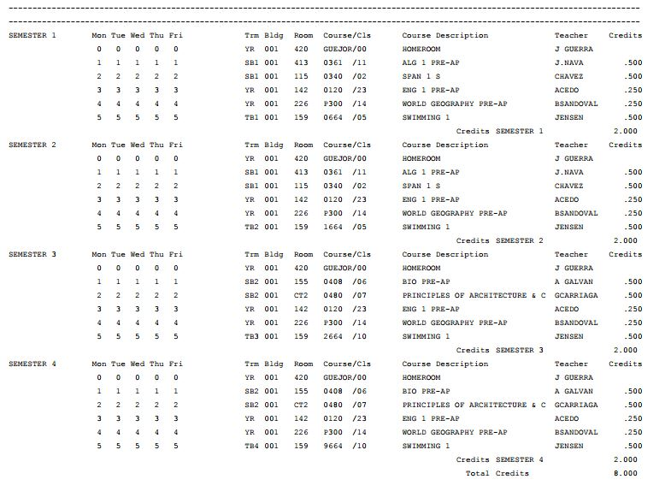
What your actual schedule would look like…
Term 1
Term 2

Slide 6
Averaging Policy
The student must have a semester grade
of at least a 65 to qualify for the averaging of two semesters.
The average of both semesters must be a 70 or higher for credit to be earned.
Averaging policy does not apply for lost credits due to attendance.

Slide 7
Loss of Credit-Attendance Policy
A student will automatically lose credit for their classes if they miss more than 4 days in a nine week period whether or not the absences are excused. Upon return of an absence, a student has only 3 days in which to submit an excuse to the attendance office, otherwise the absence will remain unexcused.
If the absences are excused, a student will be given the opportunity to attend Saturday schools for every additional day they missed. Deadlines do apply.
If the absences are unexcused, a student will lose credit for the classes and will not be able to make them up by attending Saturday schools.
Students will be given the opportunity to turn in an “Appeal Letter” if there are extenuating circumstances.

Slide 8
Credits needed to be PROMOTED
10th grade 6 credits
11th grade 12 credits
12th grade 18 credits

Slide 9
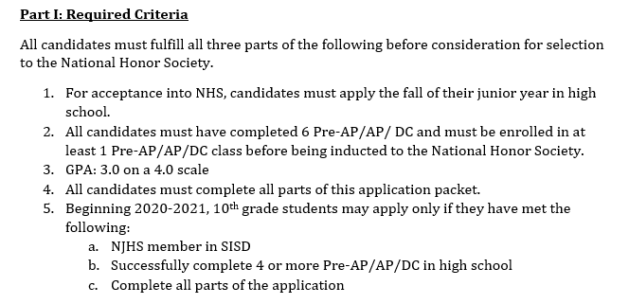
National Honor Society
This MAY BE INCREASING!!!

Slide 10
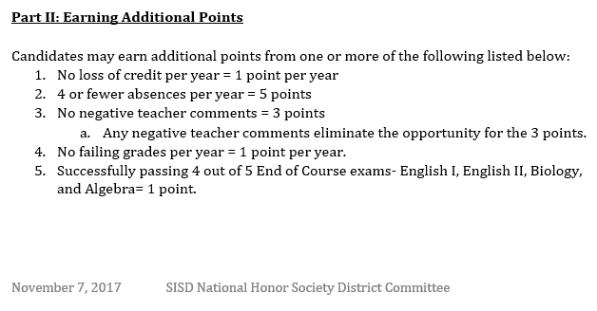
National Honor Society cont.

Slide 11
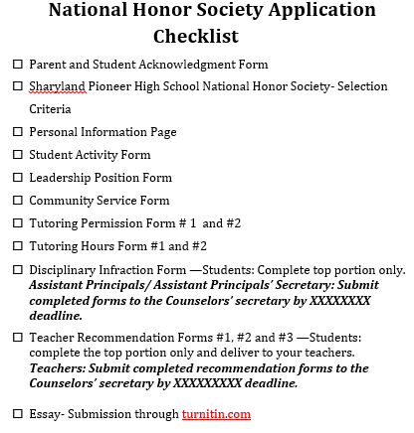

Slide 12
GPA(Grade Point Average)
Only the core classes are calculated into the Grade Point Average……..
English
Math
Science
Social Studies
Courses taken in Junior High, Summer School, AEP, Credit By Exam, PLATO or off campus programs are not calculated into the GPA

Slide 13
Level of Courses
CP College Prep
Pre-AP Pre Advanced Placement
(level to prepare for AP)
H Honors
DC Dual Credit
AP Advanced Placement

Slide 14
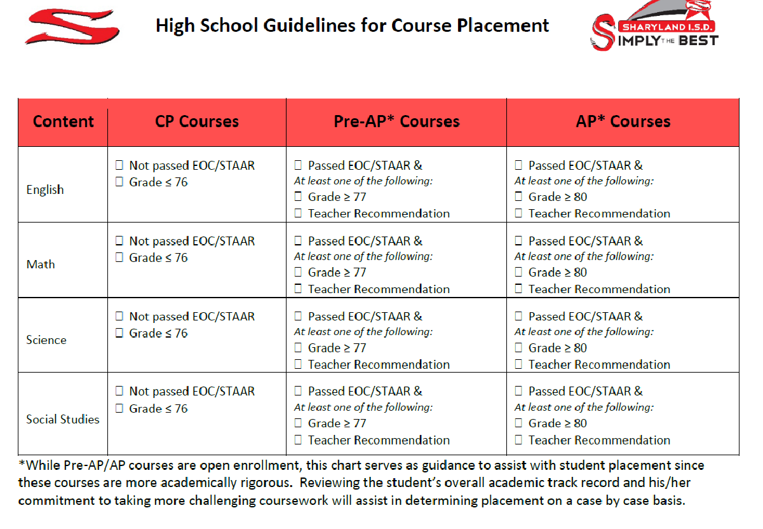

Slide 15
Important Reminders about Advanced courses
Pre-AP, Dual and AP English courses may have a required summer reading list
AP courses, including Math, Science, Social Studies and Foreign Language may have a required summer assignment
Pre-AP and AP courses have a contract, outlining the level of commitment and exit criteria, which must be signed when classes begin
For additional details on summer assignments, visit the high school website under Academic tab.

Slide 16
Graduation Program
Foundation High School Program
Beginning with the 2014-2015 school year, the state adopted a new graduation plan known as the Foundation High School Program.
The program consists of 22 credits with the opportunity to earn 4 additional credits (for a total of 26 credits) in one of the endorsement areas. In addition, a student may earn the Distinguished Level of Achievement as well as Performance Acknowledgments by completing certain additional requirements.

Slide 17
State Graduation Requirements
Foundation High School Program
Without endorsements
22 credits
Foundation High School Program
With one or more endorsements
26 credits
Foundation High School Program
Distinguished level of Achievement
At least one endorsement
26 credits

Slide 18
Foundation High School Program without endorsements-22 credits
ELA – 4 Credits
(English I, English II, English III, and Advanced Course)
Math – 3 Credits
(Algebra I, Geometry, and Advanced Course)
Science – 3 Credits
(Biology, IPC or additional Advanced Course, Advanced Course)
Social Studies – 3 Credits
(World Geography or World History, U.S. History, Government, Economics)
LOTE (Language other than English) - 2 Credits
(In the same LOTE or Computer Programming Language)
Fine Arts- 1 Credit
Physical Education – 1 Credit
Electives- 5 Credits (to include Technology Application (1) and Professional Communication(.5))
Notes:
18

Slide 19
Foundation High School Program with endorsements-26 credits
ELA – 4 Credits
(English I, English II, English III, and Advanced
Course)
Math – 4 Credits
(Algebra I, Geometry, Algebra II and Advanced
Course)
Science –4 Credits
(Biology, IPC or additional Advanced Course,
Advanced Course and Advanced Course )
Social Studies – 3 Credits
(U.S. History, Government, Economics, World
Geography or World History)
LOTE (Language other than English) - 2 Credits
(In the same LOTE)
Fine Arts- 1 Credit
Physical Education – 1 Credit
Electives- 7 Credits (to include technology application and Professional Communication)
Curriculum requirements for one or more endorsements
1 Arts and Humanities
2 Business and Industry
3 Public Services
4 STEM
5 Multidisciplinary Studies
A student may earn a
Distinguished level of Achievement by successfully completing:
FHSP
Complete at least one endorsement
4 Credits in Science
4 Credits in Math, to include Algebra II

Slide 20
A student may earn a Distinguished level of Achievement by successfully completing:
FHSP
At least one Endorsement
4 credits in Science
4 credits in Mathemathics, to include Algebra II
Notes:
20

Slide 21
And a student may earn Performance Acknowledgements
for outstanding performance:
In dual credit courses (12 hours or more with a grade of 3.0/4.0
In bilingualism and bi-literacy (Showing proficiency in English and a 2nd language)
On an AP test or IB exam (minimum score of a 3)
On the PSAT, the ACT-Plan, the SAT or the ACT, Commended on PSAT, College readiness score on Plan, 1250 on SAT, 28 on ACT
For earning a nationally or internationally recognized business or
industry certification or license.

Slide 22
Graduation Accolades!!
Distinguished Level of Achievement
Performance Acknowledgement

Slide 23
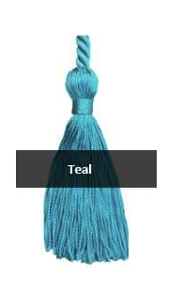
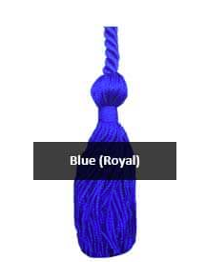
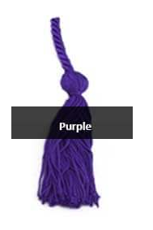
ENDORSEMENT Accolades!!
Arts
& Humanities
Business
&
Industry
Public Services
STEM
Multidisciplinary

Slide 24
SO WHAT IS AN ENDORSEMENT?
An endorsement is a career pathway.
Sharyland I.S.D. offers:
1. Arts and Humanities
2. Business and Industry
3. Public Service
4. STEM
5. Multidisciplinary Studies
An endorsement must be selected prior to entering the 9th grade.

Slide 25
Endorsement #1 Arts and Humanities
Includes courses directly related to:
Political Science
World Languages
Cultural studies
English Literature
History
Fine Arts

Slide 26
Endorsement #2 Business & Industry
Includes courses directly related to:
Accounting Hospitality & Tourism
Communications Architecture
Finance Construction
HVAC Graphic Design
Marketing Logistics
Agricultural science Welding
Automotive tech Database management

Slide 27
Endorsement #3 Public Service
Includes courses directly related to:
Health sciences and occupations
Education and training
Law enforcement

Slide 28
Endorsement #4 STEM
Includes courses directly related to:
Science
Technology
Engineering
Advanced Math
Algebra 2, Chemistry, and Physics are required courses for this endorsement.

Slide 29
Endorsement #5 Multidisciplinary Studies
Allows a student to select 4 advanced courses in one of the below areas:
Four advanced courses within one endorsement area or among endorsement areas that are not in a coherent sequence or
Four credits in each of the four foundation subject areas to include English IV, Chemistry and /or Physics or
Four credits in Advanced Placement or Dual

Slide 30
CTE Clusters by Endorsement
1. Arts & Humanities
-- No CTE based courses ---
2. Business & Industry
3. Public Services
4. STEM
5. Multidisciplinary Studies

Slide 31
Do you need help CHOOSING a CAREER CLUSTER?
Check out our Virtual CTE Tik Tok Tour
You can FOLLOW us on:
pioneer_CTE
pioneer_CTE
You will also be given a chance to explore and investigate
CAREERS and take an
INTEREST INVENTORY TEST
on a
VIRTUAL JOB SHADOW App
In YOUR GOOGLE ACCOUNT.

Slide 32
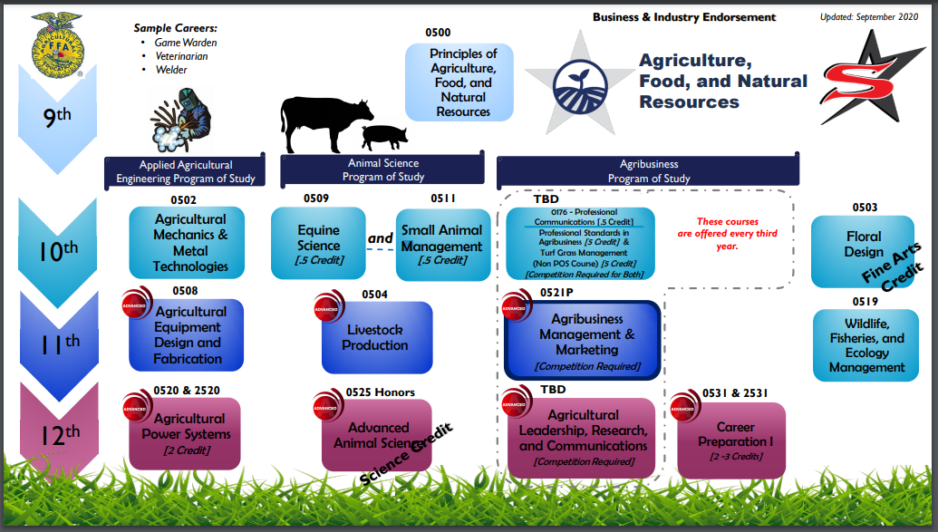
You can even EXPLORE our CAREER CLUSTERS
On our SHARYLAND ISD Webpage under CTE

Slide 33
Example of Freshman elective sheet with course numbers:
0202 Drawing I
0204 Portrait (Figure Drawing)
0208 Theatre Arts
0500 Principles of Agriculture, Food and Natural Resources
0480 Principles of Architecture and Construction
0691 Principles of Arts, A/V Technology & Communications

Slide 34
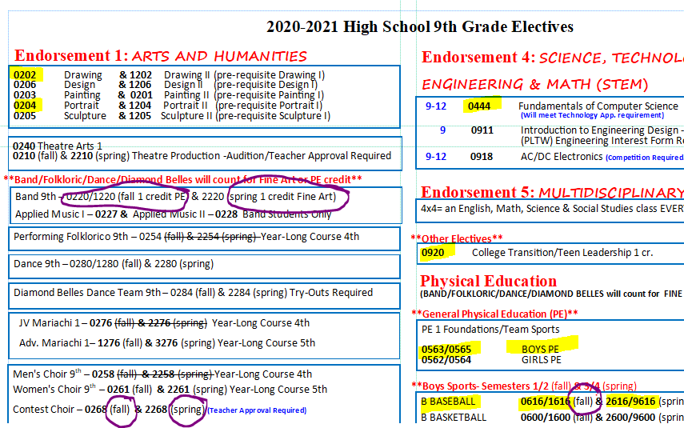
For a complete view, visit your 8th Grade Counseling Department google classroom and check out PIONEER HIGH SCHOOL INFO!!

Slide 35
One more thing!!! What does it mean to be COLLEGE READY???
To be COLLEGE READY means you will NOT need to take developmental classes in college and you can register for college level courses.
Ex. Having to take a Basic Algebra class in college before you can take College Algebra= LOSING TIME AND MONEY.
This is your goal. Meet ANY ONE of these.
TSIA2: ELAR: CRC 945-990 AND Essay 5-8 Or CRC 910-944 AND Diagnostic Level 5-6 AND Essay 5-8 AND MATH:CRC 950-990 Or CRC 910-945 AND Diagnostic Level 6 or
ACT: ENGLISH (19) and MATH (19) with a 23 composite or
SAT: EBRW (480) and MATH (530) with NO composite specified or
ENGLISH III EOC: 4000 and ALGEBRA II EOC: 4000

Slide 36
STAAR
State Of Texas Assessment Of Academic Readiness

Slide 37
What is STAAR?
State of Texas Assessment of Academic Readiness
STAAR course based assessments are:
Algebra I
Biology
English I
English II
U.S. History

Slide 38
Parent Orientation on
Understanding High School Graduation Requirements, Endorsements… and Course Request Process
Thursday, February 4th
10 a.m., 2 p.m. and 6 p.m.
Virtual Meeting
English and Spanish Sessions available.
Visit your 8th Grade Counselors Google Classroom for the links.
Topic: Pioneer High School Info

Slide 40
So let’s look at….
Filling out the
9TH Grade HIGH SCHOOL
Course Request form
Find the google form in your 8th Grade Counselors Google Classroom.
Topic: Pioneer High School Info

