Slide 1
BIOLOGY EOC
REPORTING CATEGORY : 3

Slide 2
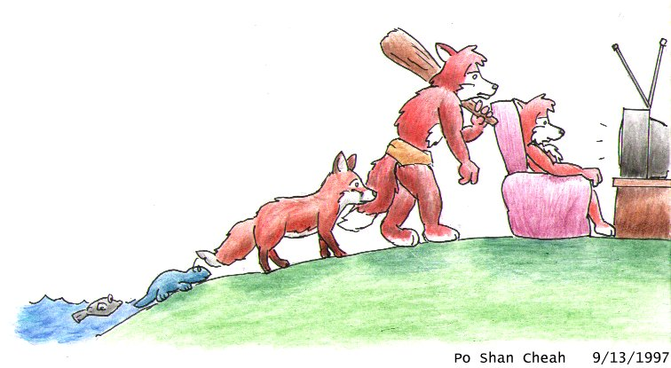
CATEGORY 3
EVOLUTION
CLASSIFICATION

Slide 3
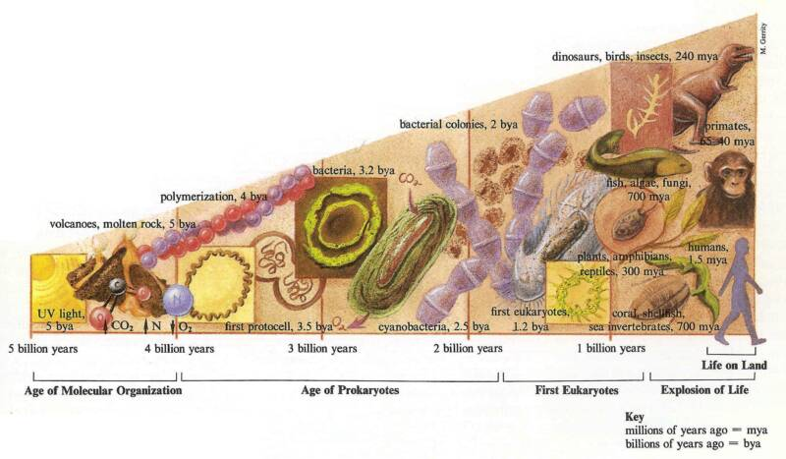
Evolution
7A- R
Change of organisms over time
Multicellular
eukaryotes
only
prokaryotes
only
molecules

Slide 4
Endosymbiotic Theory: explains how eukaryotic cells may have evolved from prokaryotic cells.
7G - S

Slide 5
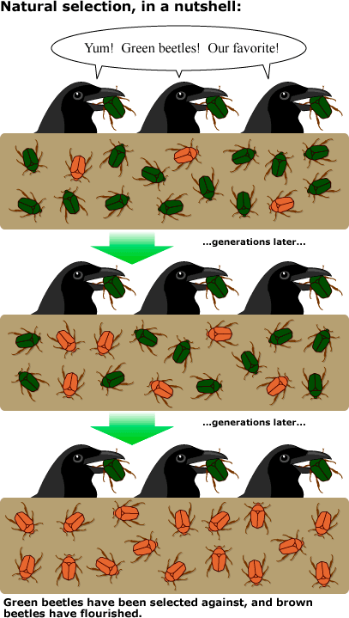
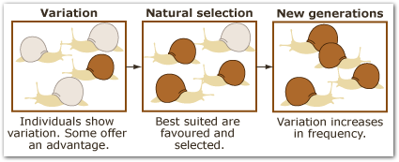
NATURAL SELECTION
7C - R
the process by which forms of life having traits that better enable them to adapt to specific environmental will tend to survive and reproduce in greater numbers than others of their kind, thus ensuring those favorable traits in succeeding generations.

Slide 6
EXAMPLE OF NATURAL SELECTION
7D - R

Slide 7
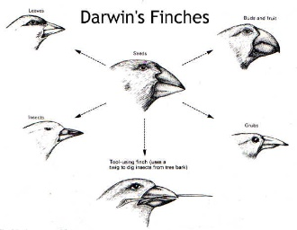
CHARLES DARWIN FATHER OF EVOLUTION
7E - R

Slide 8
COMMON ANCESTRY
EXAMPLES THAT DISPLAY COMMON ANCESTRY ARE:
* sharing similar DNA (genetic) with other organisms
* sharing similar body structures
* sharing similar classification groups

Slide 9
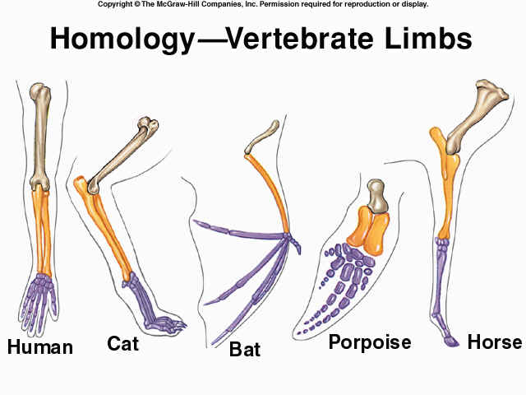
Evidence for Evolution: Homologous Structures
7A - R
Traits that are similar in different species because the species share a common ancestor.
Same structure,
different function

Slide 10
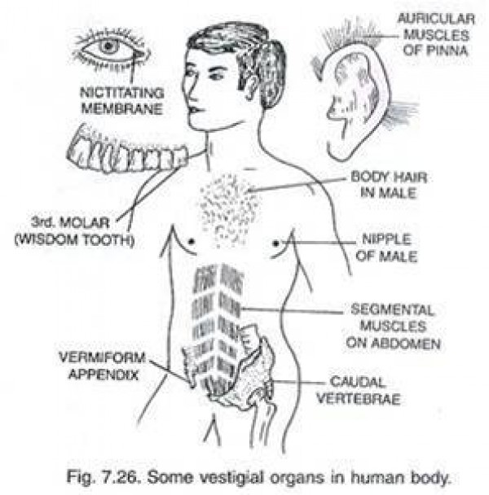
Evidence for Evolution: Vestigial Structures
7A - R

Slide 11
7A - R
EVIDENCE OF EVOLUTION…
MOLECULAR HOMOLOGIES
GENETIC (DNA OR AMINO ACID) SEQUENCES SHOW SIMILARITIES AMONG ORGANISMS.
EXAMPLE:
HUMAN GENOMES
AND
CHIMPANZEE GENOMES
ARE 99% IDENTICAL

Slide 12
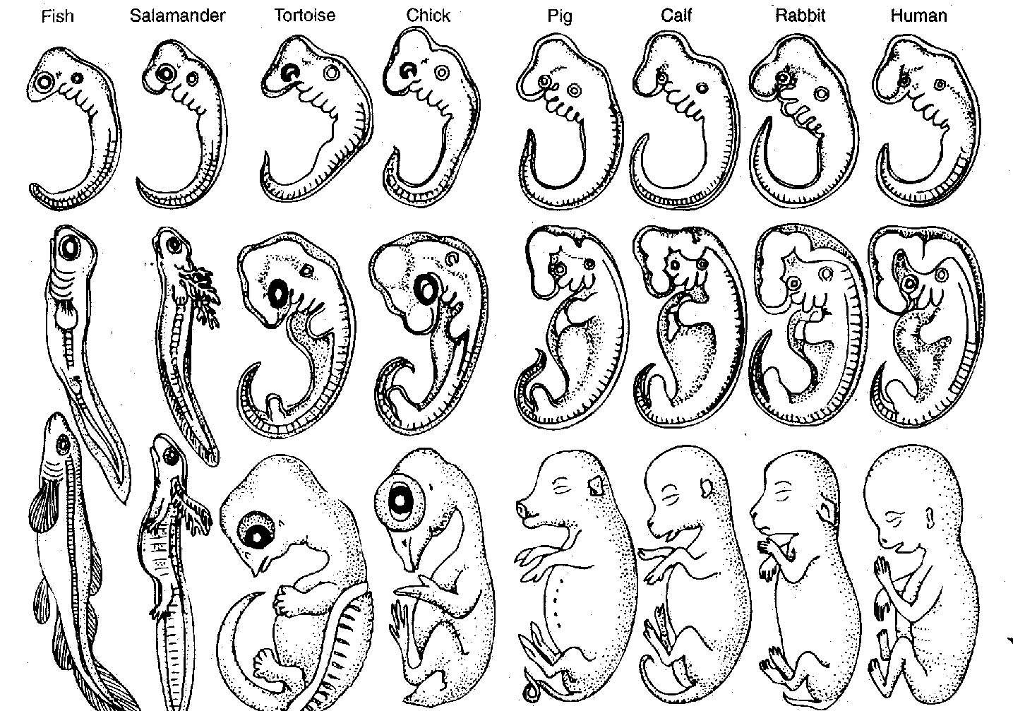
7A - R
EVIDENCE OF EVOLUTION…
EMBRYOLOGY HOMOLOGIES
EMBRYOS=
Early development stage of animals

Slide 13
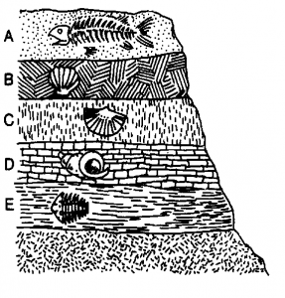
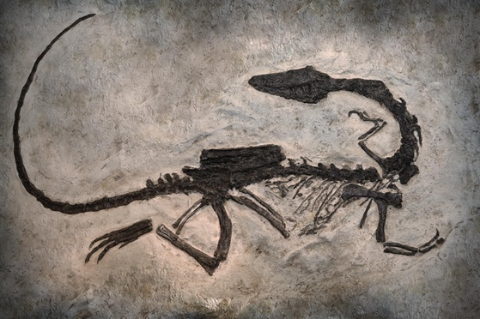
7B - S
EVIDENCE OF EVOLUTION…
FOSSIL RECORDS
YOUNGEST
OLDEST
FOSSIL RECORDS CAN BE USED AS A
TIME LINE OF HOW LIFE HAS EVOLVED

Slide 14
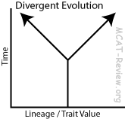
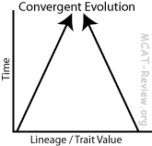
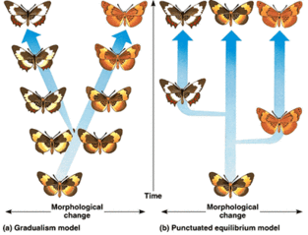
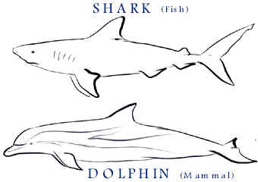
TYPES OF EVOLUTION
GRADULISM PUNCTUATED
DIVERGENT
CONVERGENT
Periods of no change, then rapid changes
Very slow changes

Slide 15
TAXONOMY: the system used by biologist to classify or group organisms
8A - S
Is based on similarities
Is used world wide
It provides scientific names
Is used to study organisms
Is used to identify evolutionary relationships

Slide 16
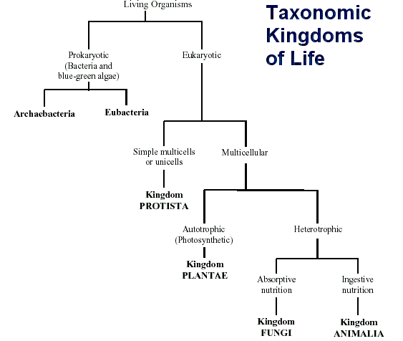
8C - S

Slide 17
8B - R
KINGDOM
CELL TYPE
ORGANISM TYPE
TROPH TYPE
DISTINCTION
6
K
I
N
G
D
O
M
S
Ancient bacteria,
Live in harsh environments
ARCHEA
Prokayote
Autotroph & Heterotroph
All unicellular
EUBACTERIA
Prokayote
All unicellular
True bacteria,
Live in normal environments
Autotroph & Heterotroph
PROTIST
Eukaryote
Most unicellular,
Few multicellular
Autotroph & Heterotroph
Odds and ends group,
Mostly found in water systems
Decomposers,
Cell walls made of Chitin
FUNGI
Eukaryote
Few unicellular,
Most multicellular
All Heterotroph
Producers, Non-motile
Cell walls made of Cellulose
PLANT
Eukaryote
All multicellular
All Autotroph
ANIMAL
All multicellular
All Heterotroph
Consumers, Motile
Most complex group
Eukaryote

Slide 18
Linnaeus’s System of Classification
8B - R
D O M A I N
DEAR
Kingdom
King
Phylum
Phillip
Class
Came
Order
Over
Family
For
Gets more specific
Genus
Good
SOUP
Species

Slide 19
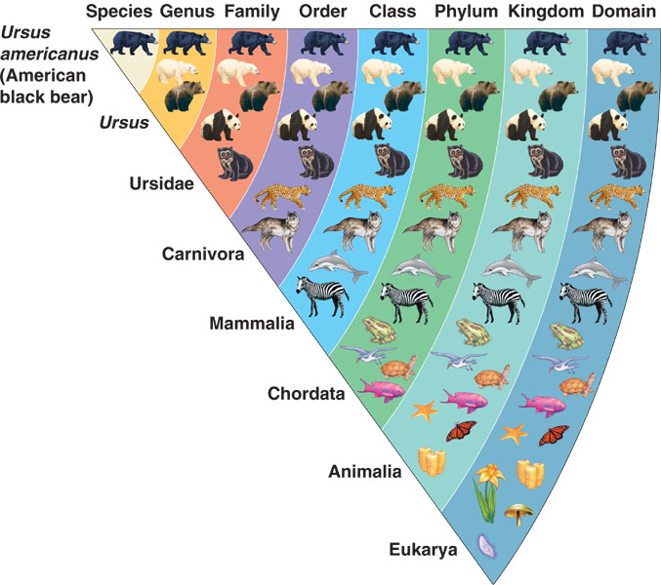
TAXONOMY OF THE AMERICAN BLACK BEAR
SCIENTIFIC NAME:
Ursus americanus
(GENUS & SPECIES)

Slide 20
Comparing organisms taxonomic levels
The olive baboon is most related to Humans since it shares 4 levels
The sea toad is the least related to Humans since it share only 1 level.

Slide 21
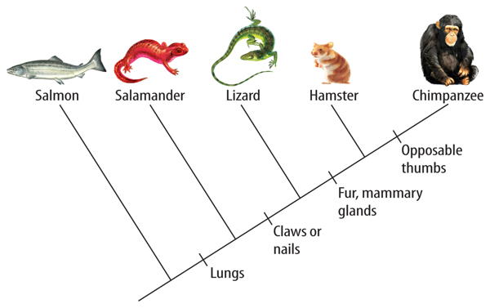
8A - S
CLADOGRAM
IS USED TO SHOW THE EVOLUTIONARY RELATIONSHIPS AMONG SPECIES
Least related to the chimp
Most related to the chimp

Slide 22
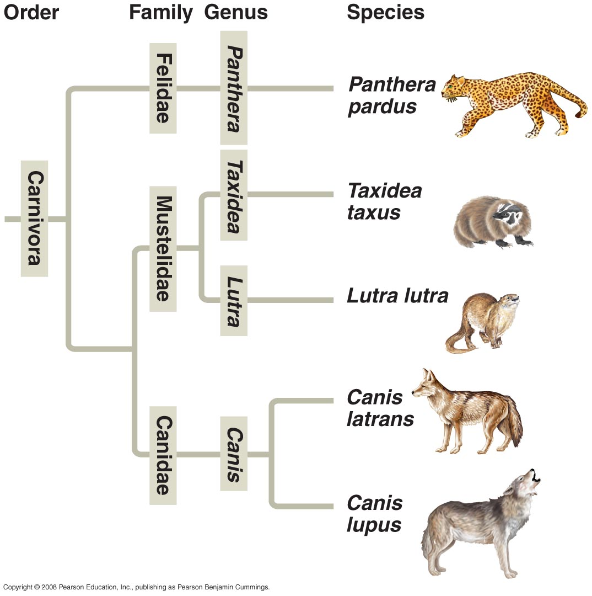
CLADOGRAM
8A - S
Which are most closely related?
Canis lupus & Canis latrans
or
Canis lupus & Lutra lutra

Slide 23
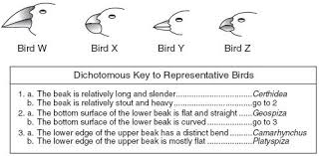
8A - S
DICHOTOMOUS KEY
BIRD W =
Geospiza
BIRD Z =
Camarhynchus

