Slide 1
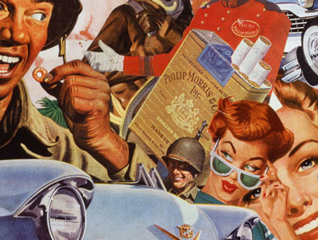
Early Cold War
1945-1963

Slide 2
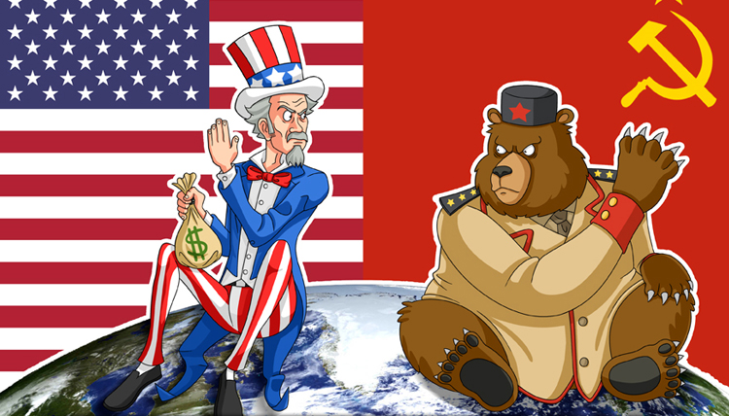
Early Cold War https://www.youtube.com/watch?v=ByvXINerE_k
1945-1989 time of intense competition of ideological (ideology) systems between the U.S. and U.S.S.R.
Their global competition led to frequent conflicts on every continent but never directly between the two powers because of Nuclear Weapons.
Joseph Stalin leader of U.S.S.R. led a brutal dictatorship with absolute control; took extreme measures to expand his belief of Communism.

Slide 3
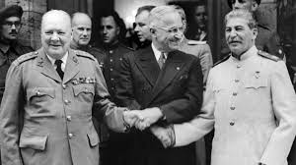
Cold War Begins
Yalta Conference “The Big Three” (Churchill, Stalin, Truman) met to plan the reorganization of Europe after WWII.
Agreed to: 1) Formation of United Nations. 2) Divide Germany into four occupation zones. 3) Hold free elections of liberated countries under German rule.
Potsdam Conference – serious differences began to emerge war crime trials, division of Germany.
https://www.youtube.com/watch?v=tLJKVVtiR3g

Slide 4
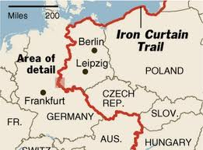
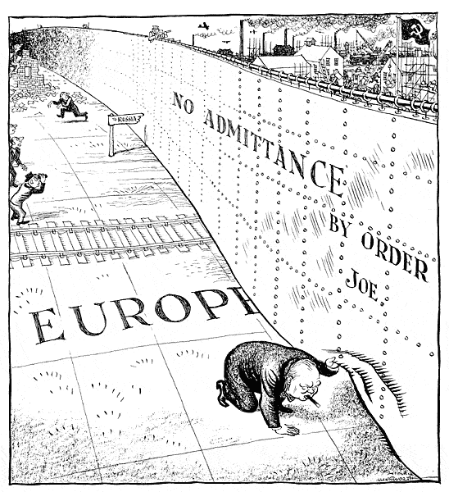
Communist Expansion
Countries in Europe liberated by the Soviet Union during WWII remained under Soviet occupation and Communist governments were put into power.
These countries turned to satellite states meaning they’re not under direct Soviet control, but had to remain Communist and friendly to the Soviet Union.
The “Iron Curtain” the satellite states separating Eastern Europe from the West.
https://www.youtube.com/watch?v=qAyXXepUgrE

Slide 5
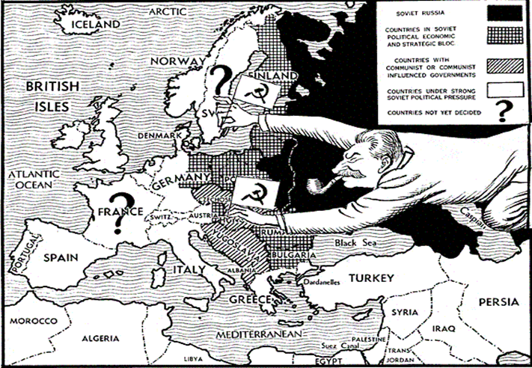
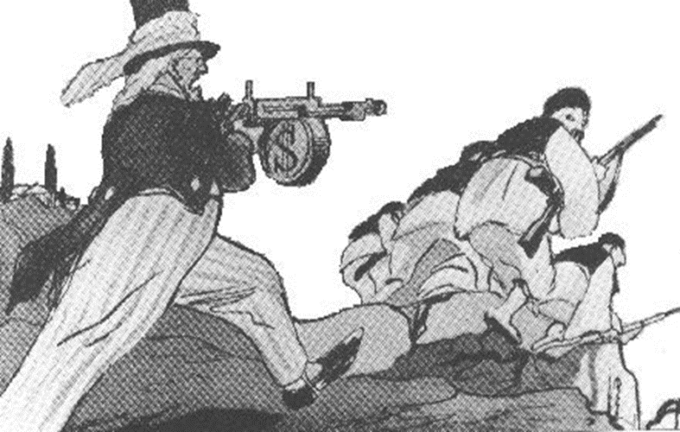
Foreign Policy of Containment
Americas foreign policy response to Soviet controlled Eastern Europe, wanted to stop the “spread” of Communism.
Truman Doctrine: Provided economic and military support for Greece and Turkey to resist communism and any other country resisting communism
Message: U.S. is committed to a policy of “containment” by resisting the global spread of communism.

Slide 6
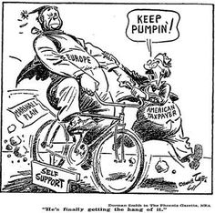
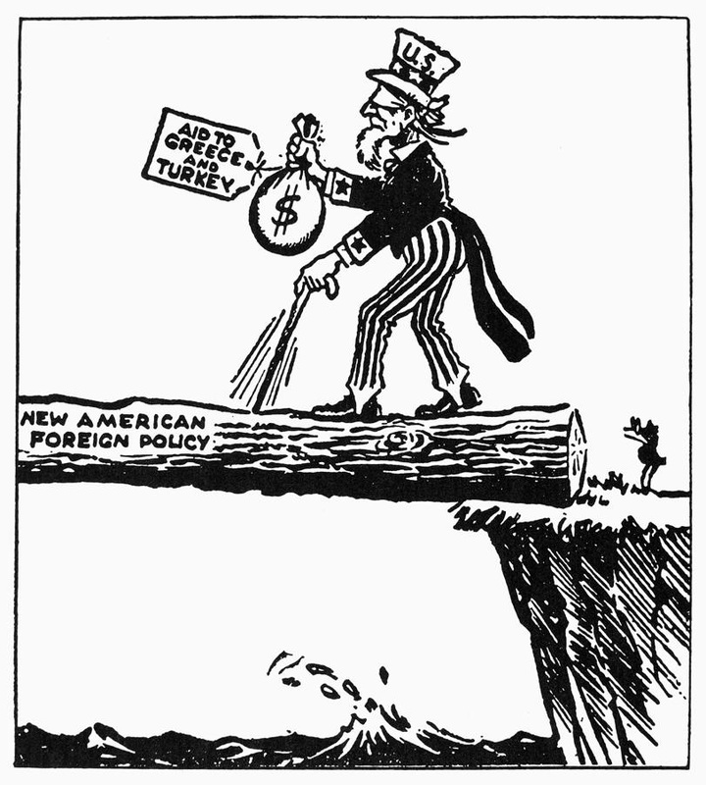
Marshall Plan
Purpose to provide aid to war torn countries in Europe to rebuild their economies. Cause: People who were desperate and miserable were often attracted to communism.
Was a success that benefited American economy and sped up European economic recovery after WWII.

Slide 7
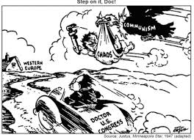
Political Cartoon about the Marshall Plan

Slide 8
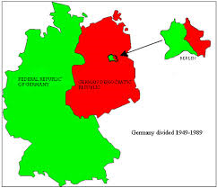
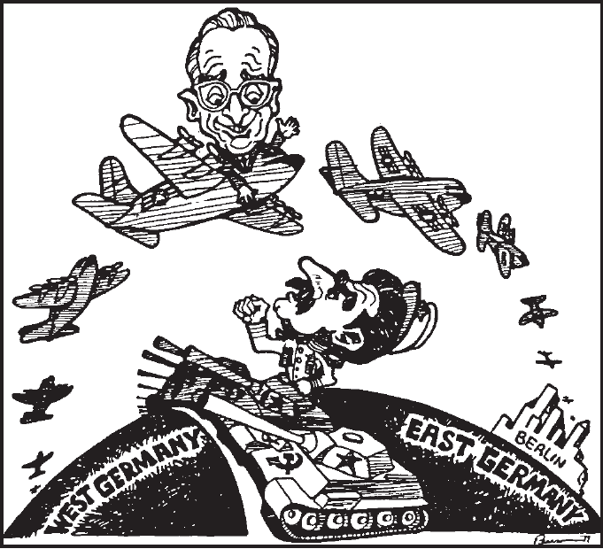
Divided Germany and Berlin Airlift
Germany and capital city Berlin split in 4 occupation zones.
When Democratic sides joined zones, the Soviets blockaded all roads and railways into West Berlin.
Resulting in 11 months of supplies airlifted into West Berlin. Showed Allies will not retreat out of Berlin or against Soviet aggression.
https://www.youtube.com/watch?v=OLnFntYkrwg

Slide 9
Checking Understanding
How did U.S. Foreign policy change from pre-WWII to post WWII?

Slide 10
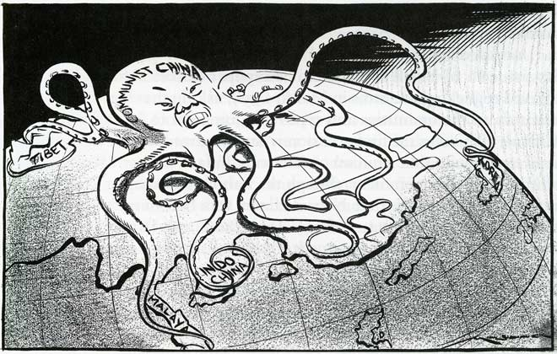
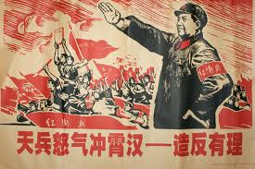
Communist China
1949 Communists take over China set up Communist Republic of China led by Mao Zedong.
Democratic Chinese flee to Taiwan.
China still Communist today and is one of our leading trading partners.

Slide 11
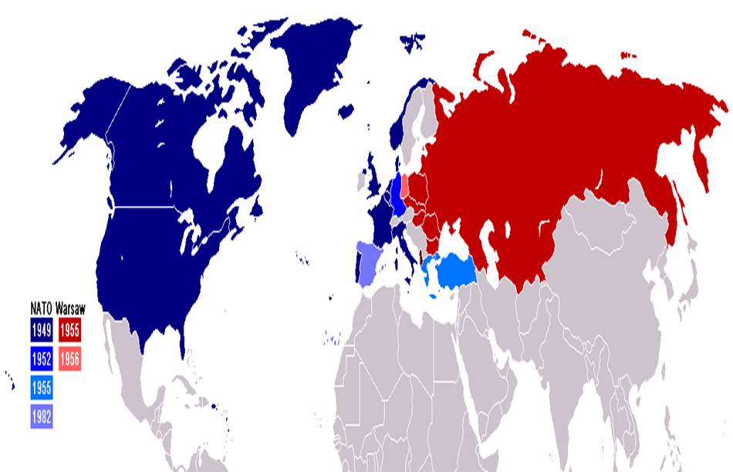
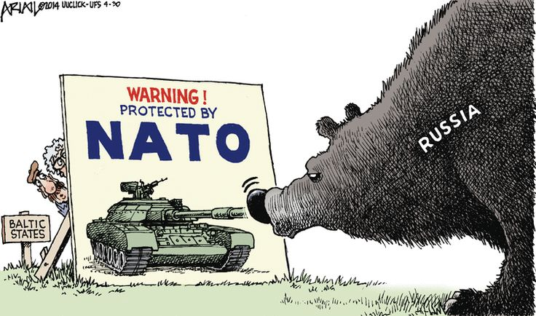
North Atlantic Treaty Organization (NATO)
In response to Cold War tensions U.S. helped form NATO for collective security against the Soviets.
Soviets responded with the Warsaw Pact.

Slide 12
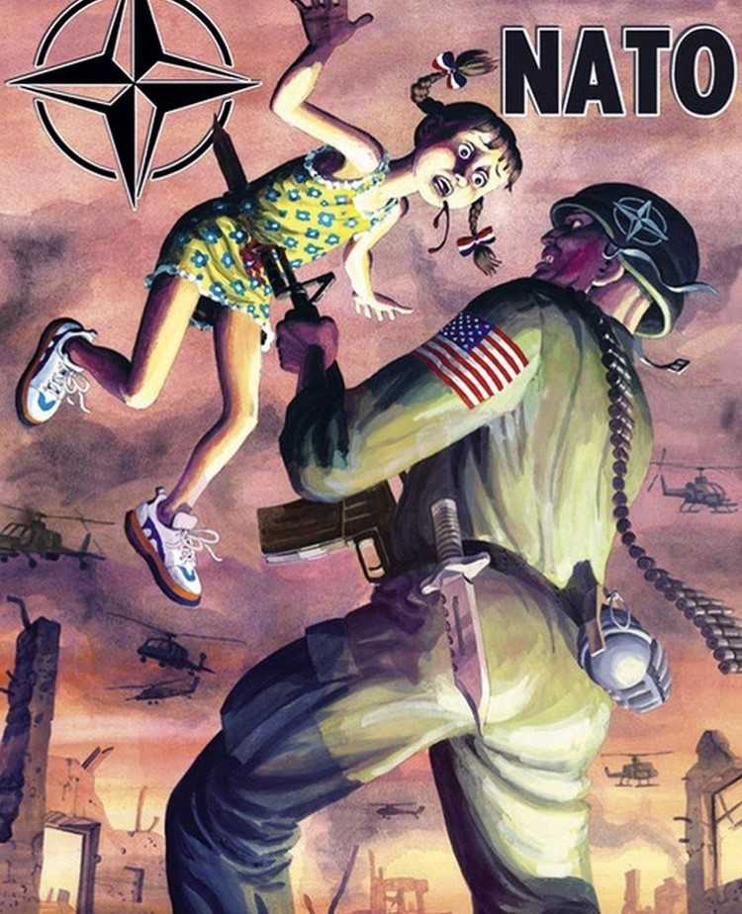
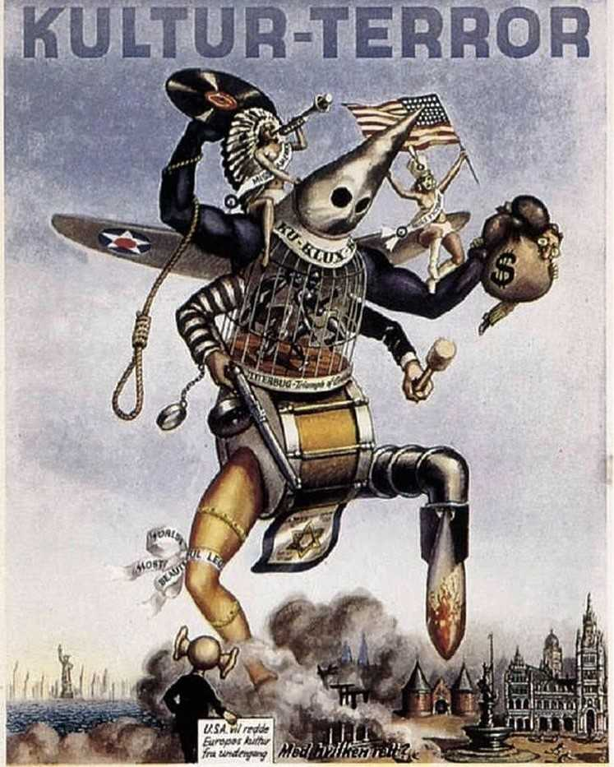

Slide 13
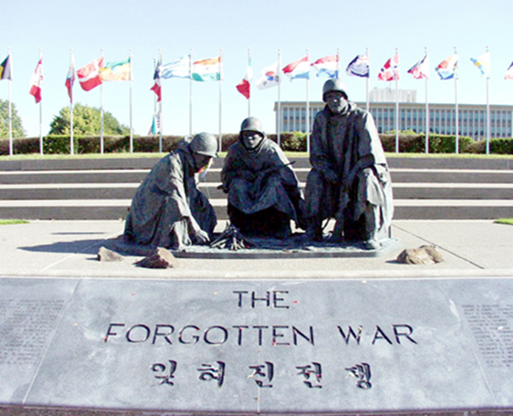
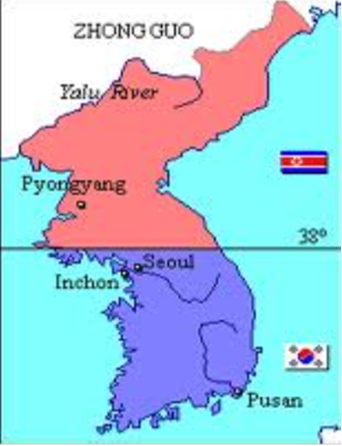
Korean War 1950-1953
https://www.youtube.com/watch?v=-X7nbwFxGRU
1950 N. Korea invades S. Korea to unify under Communist rule; Was the first real test of “containment” policy.
Douglas McArthur in charge of troops in Korea; Controversial firing by President Truman after wanting to escalate the war with the use of Atomic Weapons.
Outcome: Armistice signed 1953, Left Korea divided along 38 parallel. (demilitarized zone still there today).
https://www.youtube.com/watch?v=A6ekXbXpMPY

Slide 14
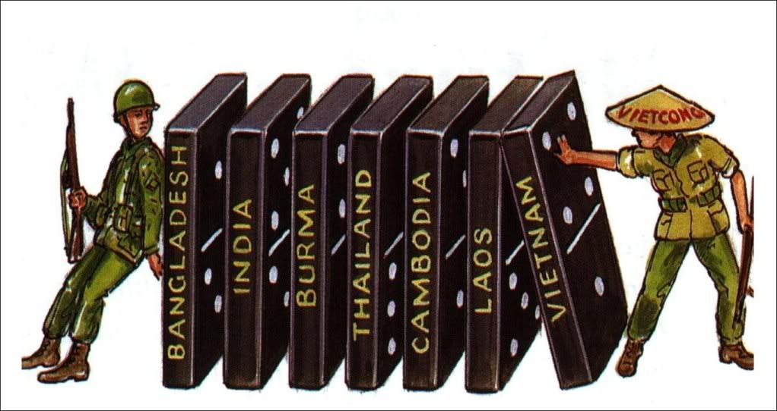
Vietnam
After driving the French out of Vietnam in 1954, the country was divided into North (Communist) and South (Democratic) Vietnam
President Eisenhower stressed the Domino Theory- belief that if Vietnam fell to communism, so too would the other nations of Southeast Asia.
By 1954 the U.S. was paying ¾ of France’s war costs.

Slide 15
Checking Understanding
Describe two challenges to Americas policy of “Containment” that arose during the 1950’s?

Slide 16
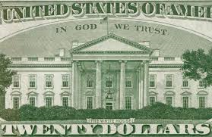
Separating Ideals
(Motto)“In God We Trust”
Added on the back of U.S. currency
Purpose: Separate ourselves from the godless Communists.

Slide 17
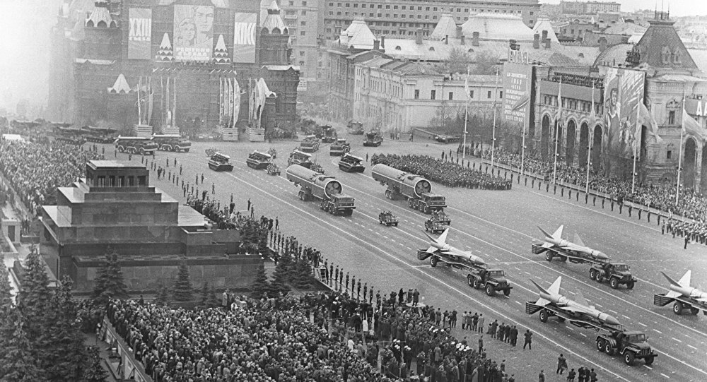
Arms Race
Competition to build the biggest and most technologically advanced military/arsenal.
1945- U.S. sole atomic power / 1949 - Soviets developed A-Bomb (nuclear)
1952- U.S. develops H-Bomb / 1953 – Soviets developed H-Bomb
Technology gap had greatly narrowed.
Massive Retaliation or M.A.D. could only be justified if a nations survival was at stake.
https://www.youtube.com/watch?v=xLRSmzGRLUk

Slide 18
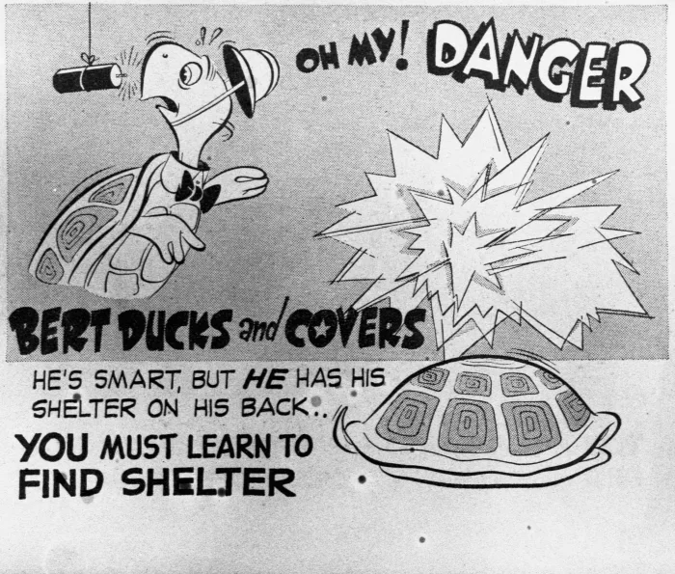
https://www.youtube.com/watch?v=Lg9scNl9h4Q

Slide 19
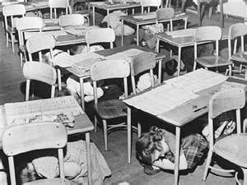
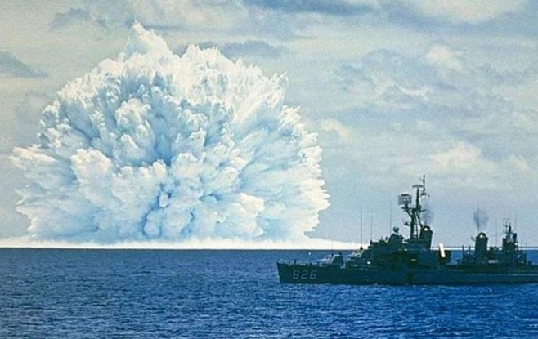
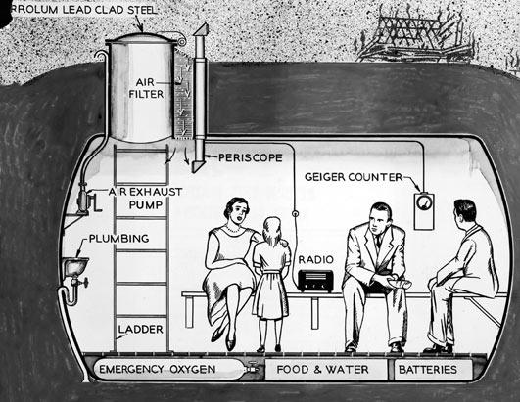
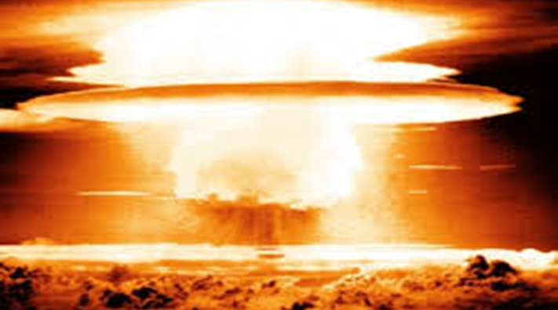

Slide 20
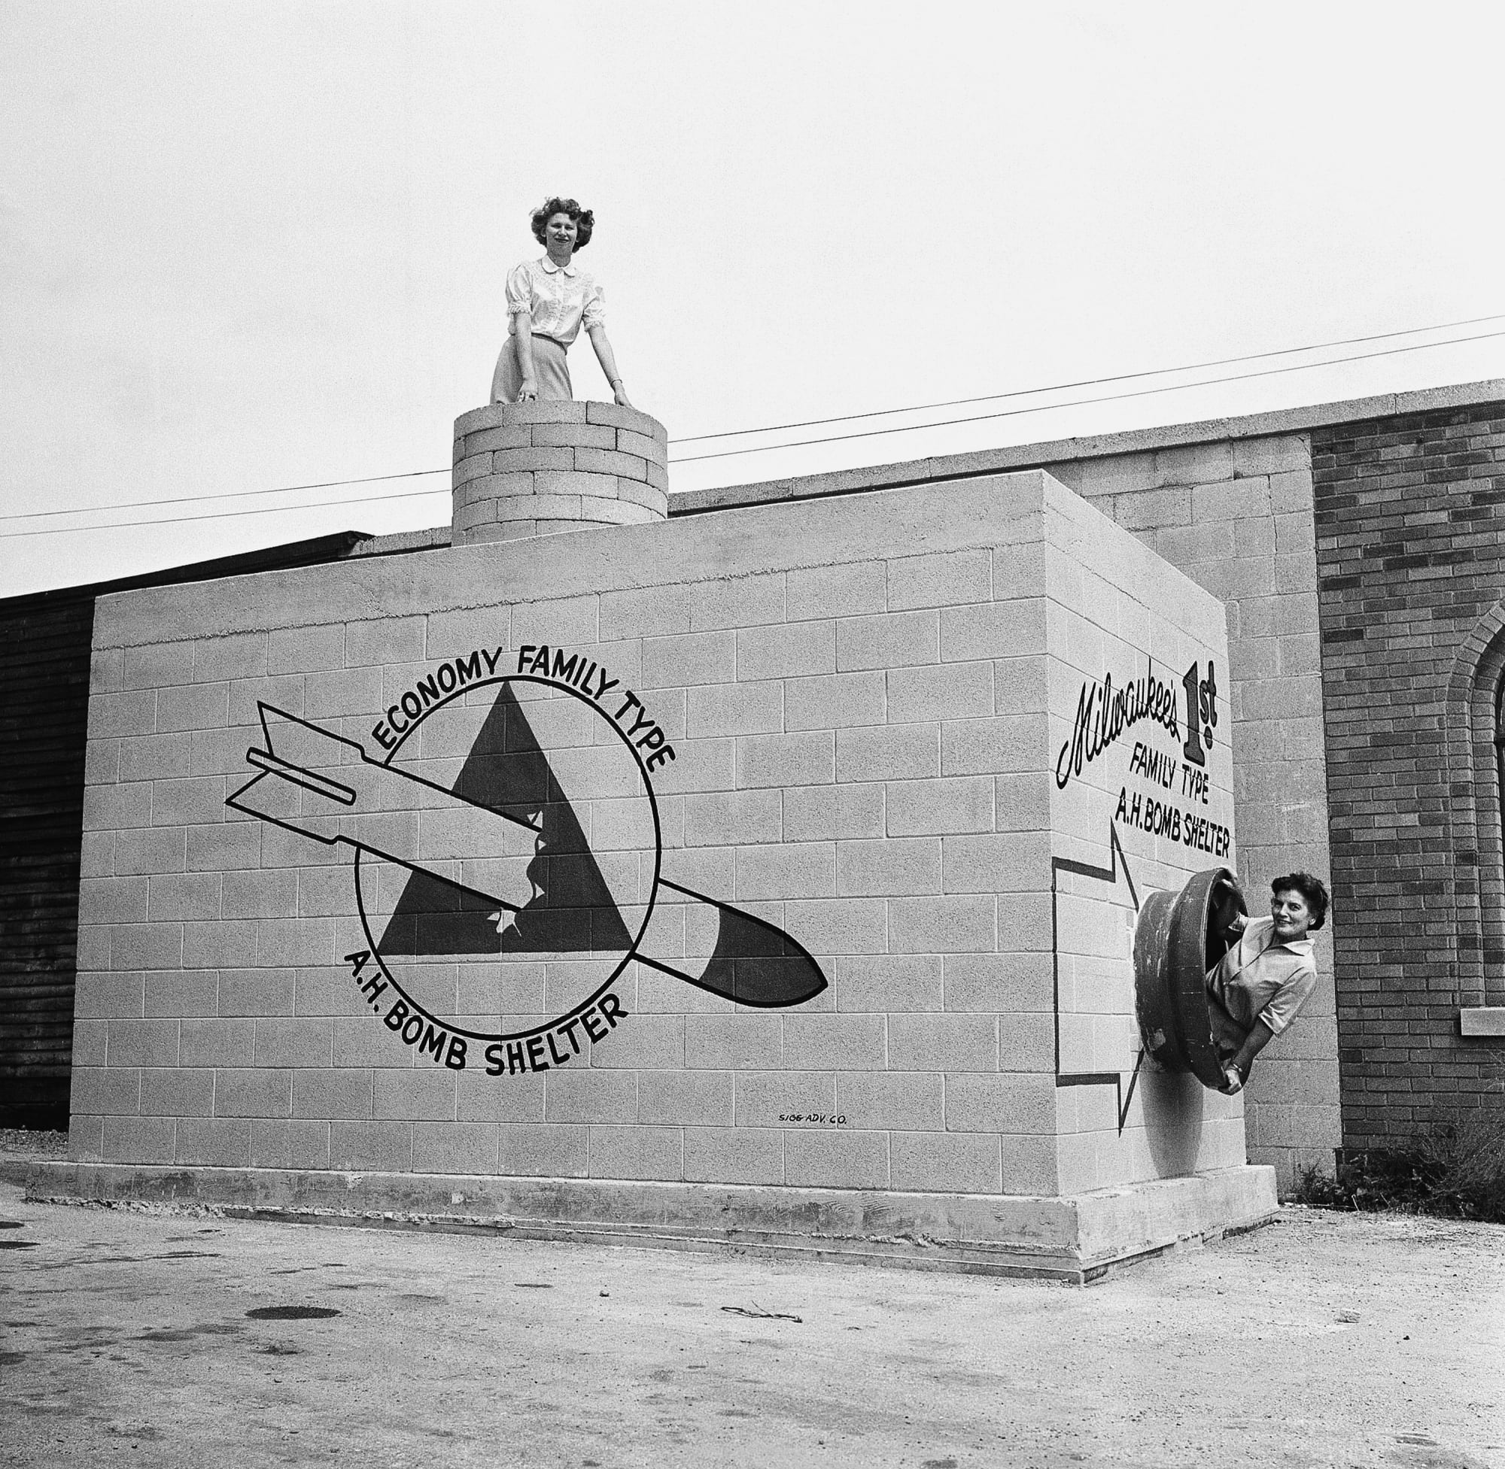
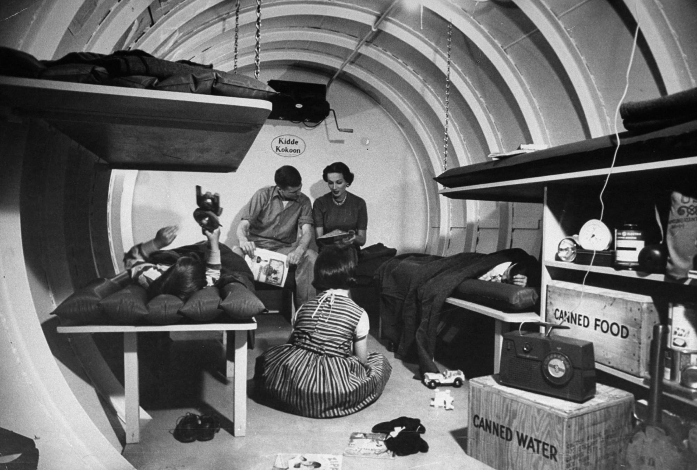
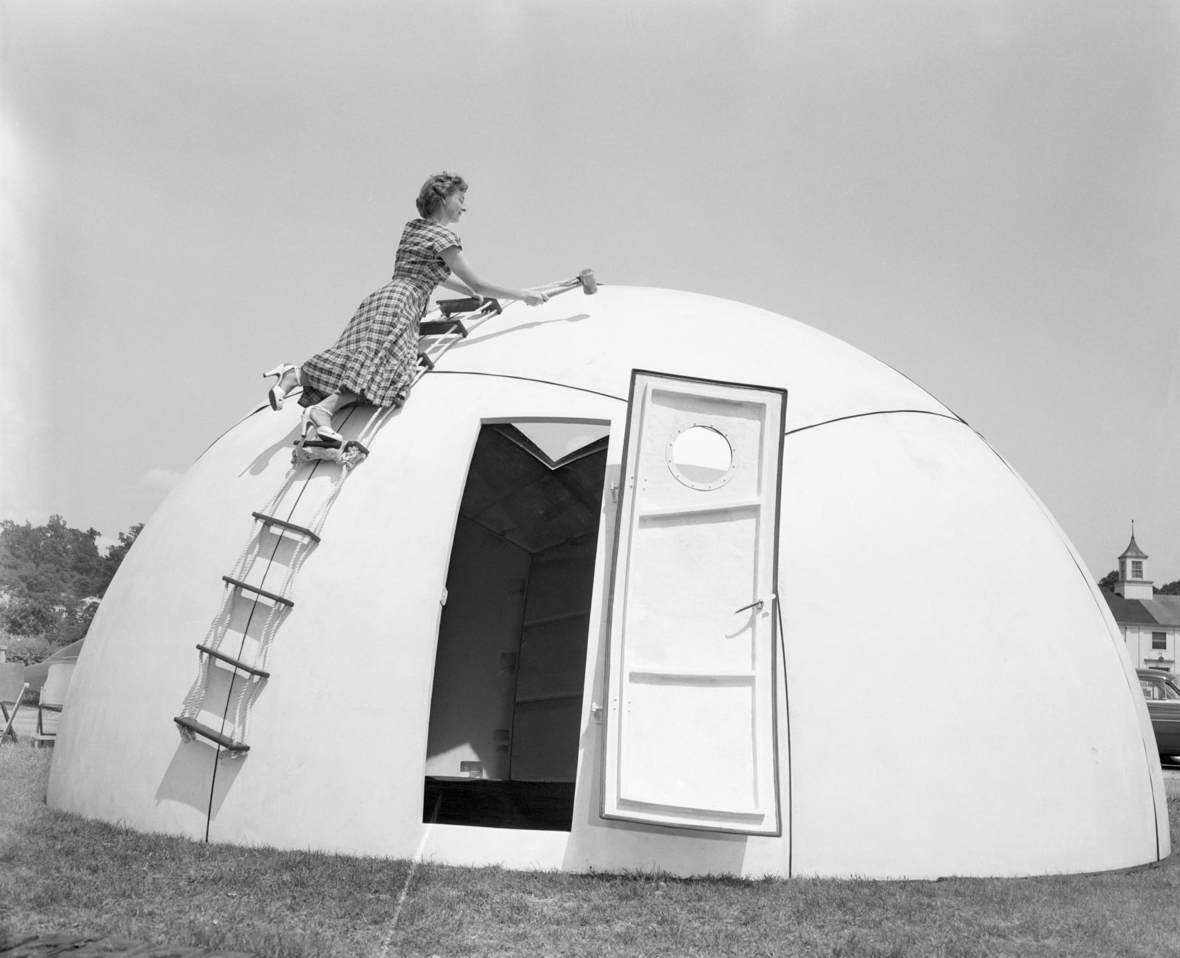

Slide 21
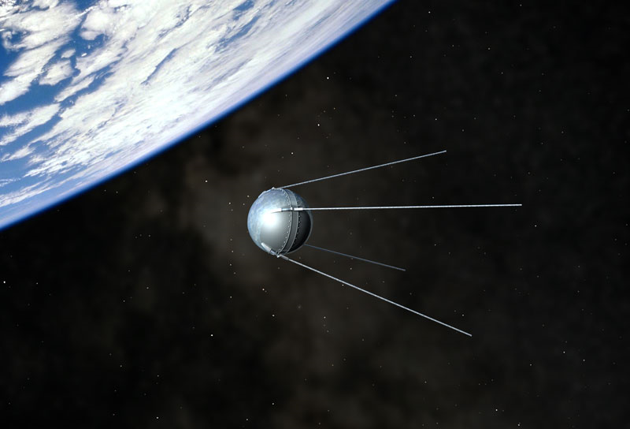
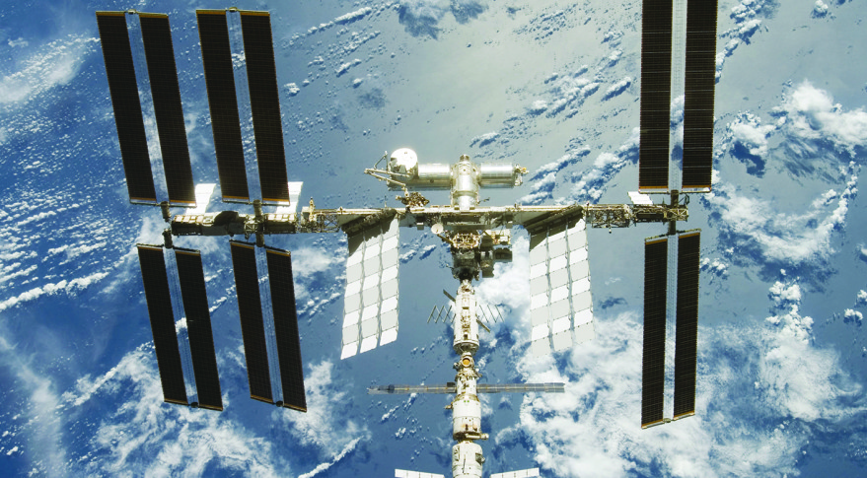
Space Race
https://www.youtube.com/watch?v=i5ROHWSFqfQ
During WWII German scientists made great leaps in rocket technology.
1957 U.S.S.R launched “Sputnik” first man-made (satellite) to be (launch)ed to outer space (orbit).
Sparked U.S. fears the Soviets had attained superiority in technology, Math and Science and later set off the “Space Race” to land first man on the moon.

Slide 22
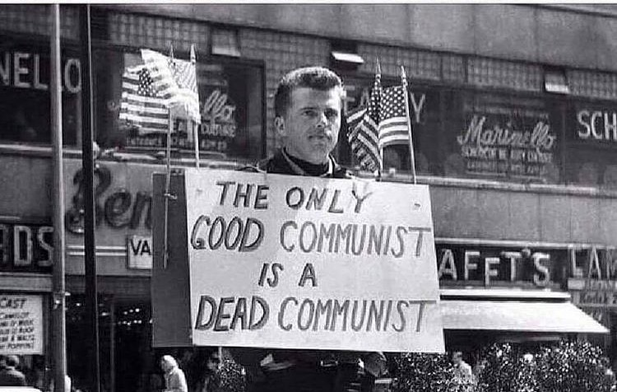
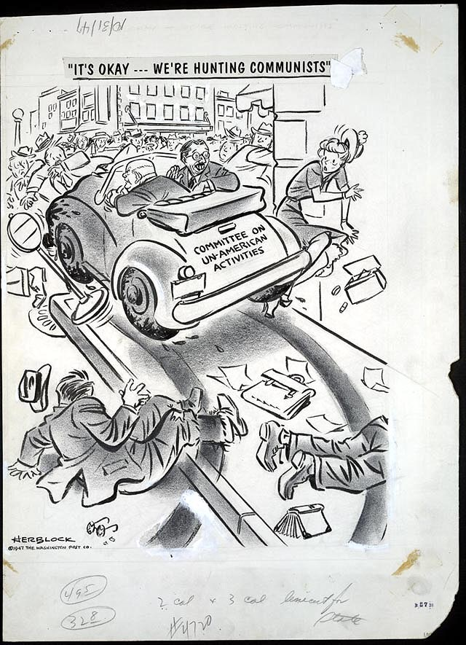
Second Red Scare
https://www.youtube.com/watch?v=shie_JD9qEs
After WWII Americans feared Communists inside America (espionage). Truman set up Loyalty Review Boards that investigated Communist sympathizers that were unable to defend themselves, violating their civil rights.
Congress set up the House Committee on Un-American Activities (HUAC) created to investigate alleged disloyal activities of private citizens, public employees, and organizations suspected of having Communist ties. Investigated Hollywood, “Hollywood Ten”
Those identified were “blacklisted” and lost their jobs. Those who cooperated were asked to inform on others.

Slide 23
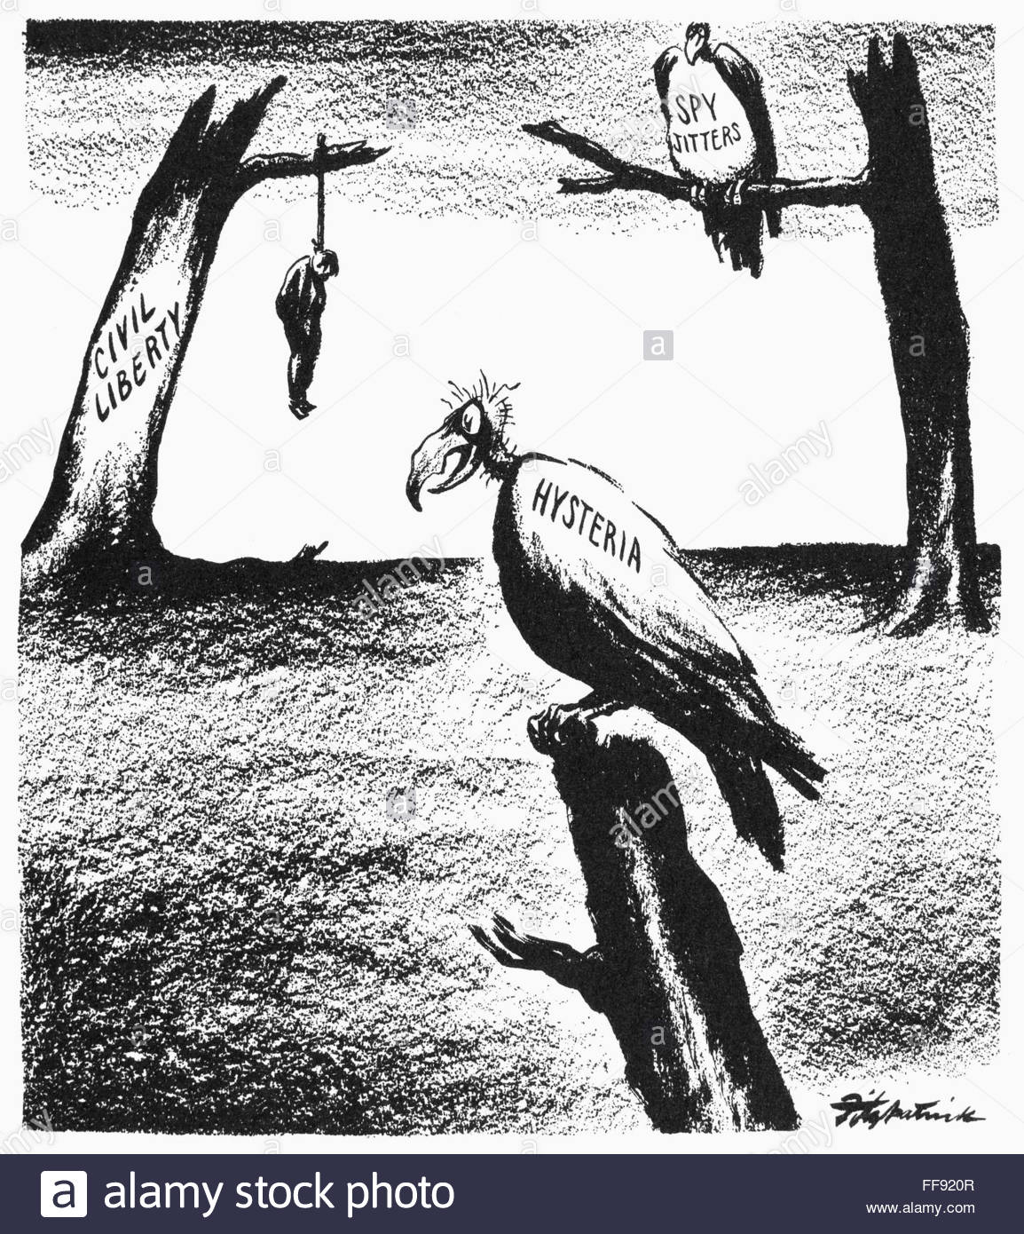
Political Cartoon over McCarthyism and the effects it can have on American “civil liberty”

Slide 24
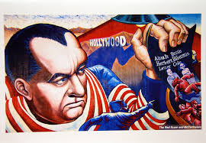
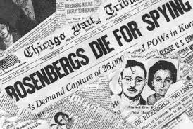
McCarthyism and the Rosenberg’s
McCarthyism - 1950 Senator Joseph McCarthy claimed he knew hundreds of Communist sympathizers which led to search for (subversion) in the U.S. based on flimsy evidence and irrational fears.
Julius and Ethel Rosenberg accused of leading a Soviet spy ring, found guilty and executed in 1953 against publics wishes.
Project Venona – 1997 Venona Papers confirmed the existence of spies in American government, science, and industry.

Slide 25
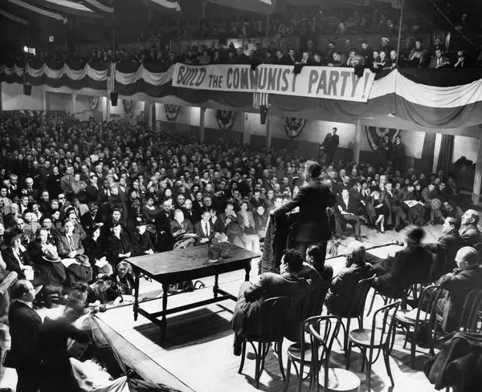
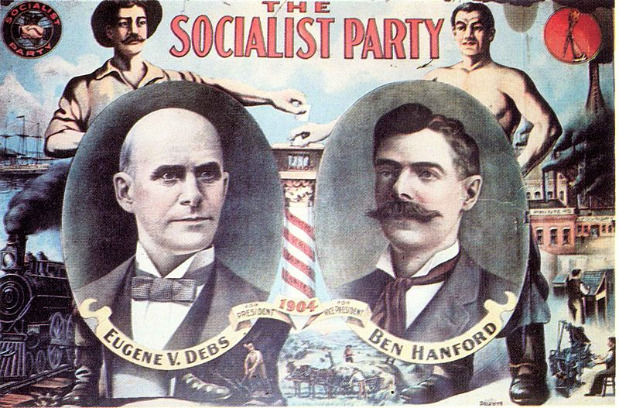
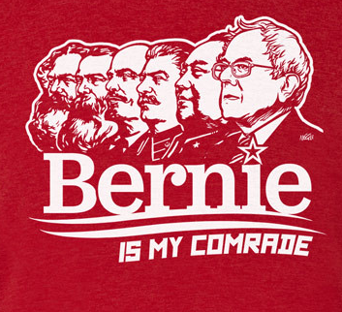
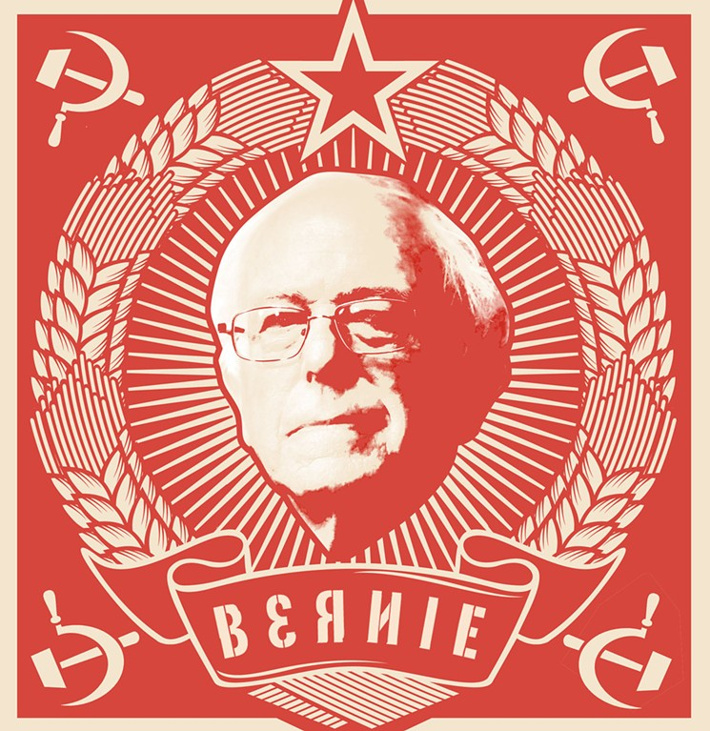
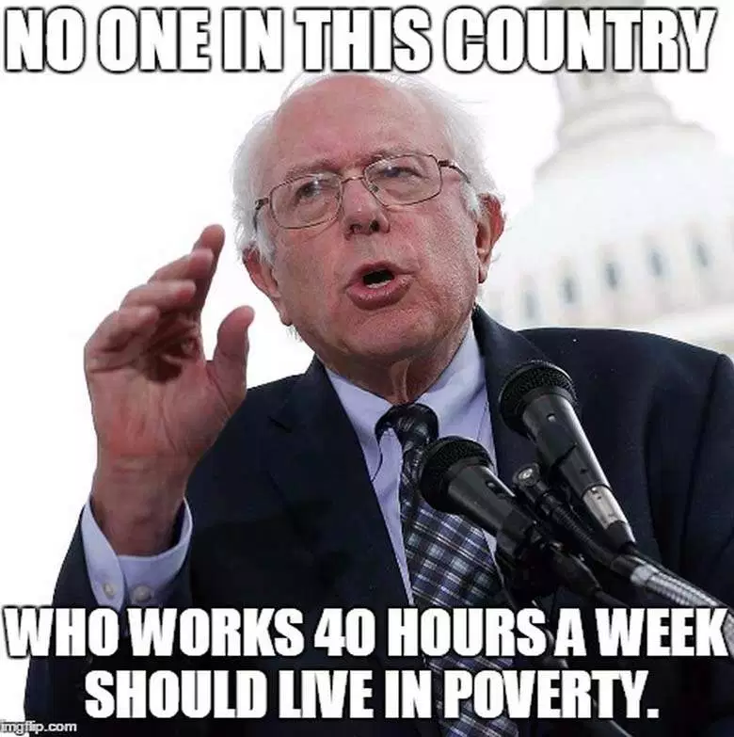

Slide 26
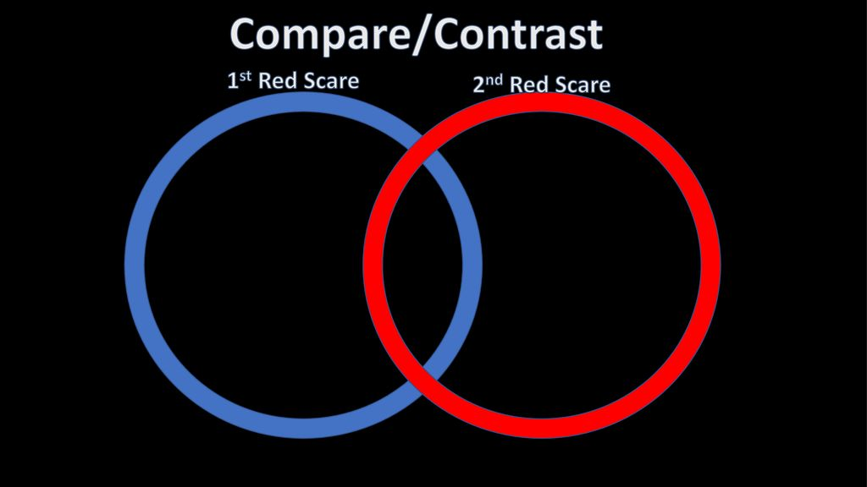
Checking Understanding
Create a Venn diagram comparing and contrasting the 1st and 2nd Red Scare

Slide 27
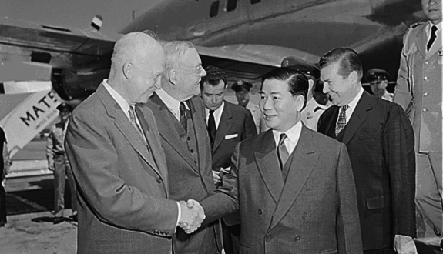
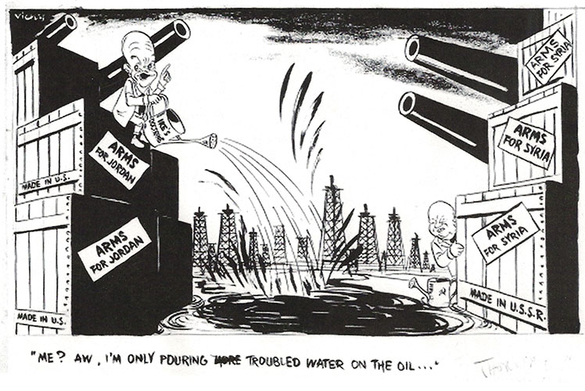
Eisenhower Administration 53’-60’
Eisenhower Doctrine sent military forces to the Middle East to support any nation that requested help in defending against Communism.
John Foster Doles – Secretary of State advocating an aggressive stance against Communism throughout the world. Pushed for support of French against Viet Minh in Indochina.

Slide 28
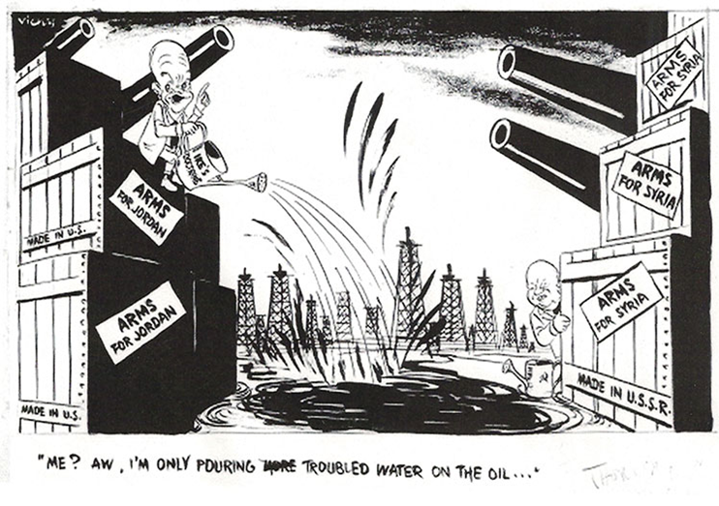
U.S. President Eisenhower and U.S.S.R. Premier Nikita Kruschev calmly battle over the Middle Eastern oil supply. Ex. Eisenhower Doctrine.

Slide 29
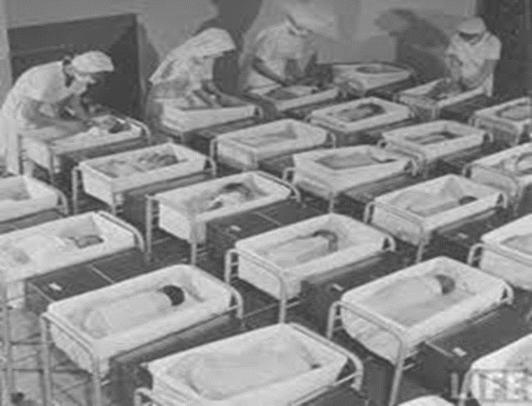
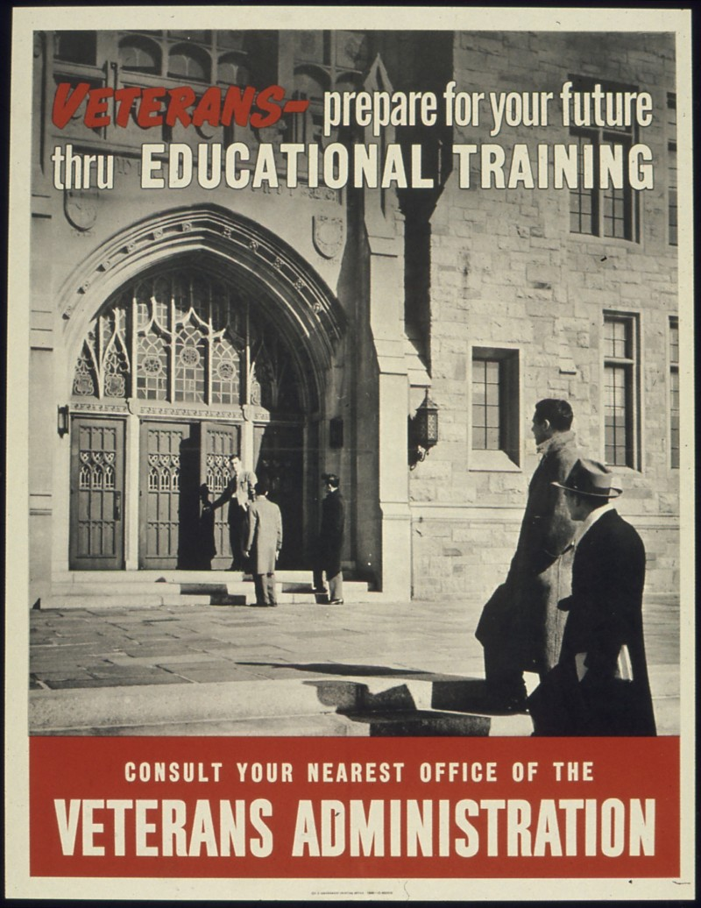
Eisenhower's Domestic Policy
GI Bill: Provided veterans funds for housing, education, and unemployment insurance. (boosted the economy).
Baby Boom: 75 million babies born 1946-1964 need for housing occurred.
Levittown - first truly mass-produced suburb (housing boom) and is the archetype for postwar (suburbs) throughout the country. (Private Ownership Housing)
Interstate Highway Act – allowed the construction of 41,000 miles of interstate Highways. Increased suburban growth.

Slide 30
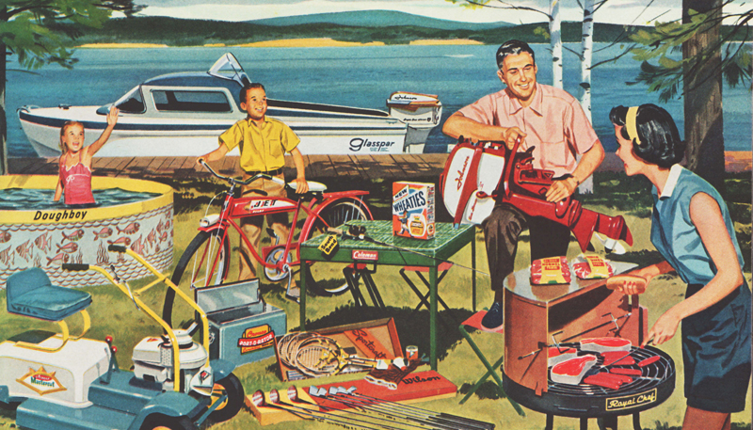
1950’s (Prosperity)
Business Consolidation - major corporations in America grew even larger. (Growth of Business)
Growth of Consumer Credit – End of war many Americans considered themselves part of the middle class. (economic prosperity)
Advertisements said new products were necessary for the good life. (consumption)
Military-Industrial Complex – alliance of financial relationships between legislators, national armed forces, and the military industrial base that supports them.

Slide 33
Technology and Medicine
Space Technology – revolutionized global communication by satellite technology
Quality of life improved thanks to home appliances (like the washer, freezer, vacuum, etc.) made life easier.
1957 over 40 million TVs in homes. (Helped Americans feel connected)
Jonas Salk – discovered vaccine for polio in 1957.
Researchers developed new antibiotics, first tranquilizer, birth control pill.

Slide 34
Effects of Prosperity
Increased consumption: demand for consumer goods, GDP doubled.
(Growth of Agriculture): baby boom = higher demand for food, businesses boomed to keep up with consumer demand.

Slide 35
The Arts
Beat (Generation): opposed the conventions of the 50’s and “lifeless materialism”. Believed in a sense of freedom and spirituality later known as the (Counter-Culture).
Challenged mainstream thinking and anti-war protesters.
Famous arties: Elvis Presley (King of Rock N’ Roll), Beatles, Motown. Greatest effect was on racial equality. (Cultural Movement)

Slide 36
Checking Understanding
What contribution did technology have on Americans during the 1950s?

Slide 37
This is a cross-sectional diagram of a major operation ordered by President Harry S. Truman in 1948. The flight pattern illustrated in the diagram was designed to allow an airplane to land every three minutes. Why was this operation undertaken?
To enable a rapid withdraw of troops from a war town city
To deploy a substantial invasion forces
To provide supplies to a blockade city
To rescue thousands of imprisoned political prisoners

Slide 38
John F. Kennedy
Democratic party, became youngest president ever elected as he defeated Richard Nixon. Held first ever televised debate, which propelled him past Nixon as he spoke and looked better than Nixon.
Attained a majority of the African American vote, this aided him to win election.
“Ask not what your country can do for you but what you can do for your country”; Sought to ignite the spirit of American idealism. Critics worried of his Catholic background.
https://www.youtube.com/watch?v=GMWQnoDA0o8

Slide 39
Space Race
https://www.youtube.com/watch?v=kwFvJog2dMw
To counter Soviet’s Kennedy authorized the formation of NASA/Apollo Program. He Challenged America to be first to the moon.
1962 John Glenn was first American to orbit space.
1969 America landed the first two men on the moon Neil Armstrong and Buzz Aldrin.
Space program has led to advancements in technology that has led to improvements in the quality of life.

Slide 40
Kennedys Foreign Policy
1959 Fidel Castro overthrew the brutal Cuban dictator General Batista.
Castro soon made agreements with the Soviet Union which led to American embargos. Any opponents to Castro were thrown in jail or exiled.
1961 Bay of Pigs - exiled Cubans landed in Cuba to overthrow Castro. The rebels were secretly backed by U.S. government; JFK failed to provide air support, the invasion was a disaster and a embarrassing foreign policy failure for Kennedy.
https://www.youtube.com/watch?v=fsQMwtOlNPw

Slide 41
Kennedys Foreign Policy
1961 Alliance for Progress, to meet Communist challenge in Latin America; Kennedy created a program of grants and loans to promote economic progress, land reform and trade.
After the failure of the Bay of Pigs and meeting with Soviet Premier Nikita Krushchev the Soviets began construction of the Berlin Wall. Cutting off access to the West for East Berliners.
Greene Barets were special units formed that worked for the CIA.
https://www.youtube.com/watch?v=ExOYvW5vCj4

Slide 43
Kennedys Foreign Policy
1962 Cuban Missile Crisis- Soviets placed medium range (missile sites) in Cuba in response to Bay of Pigs and U.S. missiles in Turkey.
Kennedy ordered a (naval blockade)
It was resolved when the U.S. and Soviets agreed to remove their missiles and America promised not to invade Cuba.
Marked closest the world has ever been to nuclear war.
https://www.youtube.com/watch?v=sp6FQvVLUos

