Slide 1
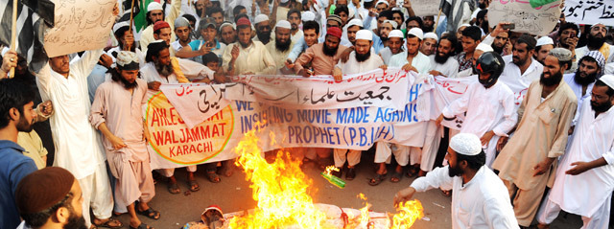
21st Century

Slide 2
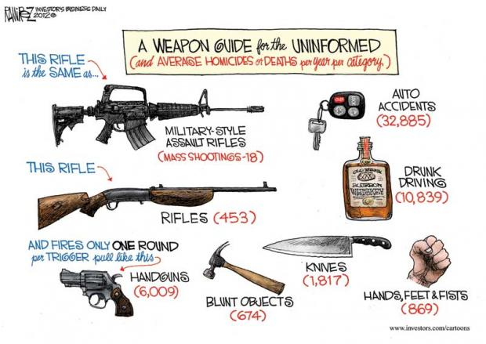
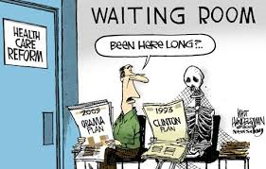
Clinton Presidency: Domestic Policy
Limited federal spending, increased income taxes to 40% on richest Americans, cut taxes for low-income Americans, and introduced federal gasoline tax.
Health Care Reform – Clinton promised reform in health care appointing his wife Hilary to develop a plan. Failure by Clinton to pass any health care reform in Congress was a major defeat for him.
Clinton did pass bills to increase funds for police department, waiting period for handguns, increased federal money for prisons, and banned sale of assault weapons.

Slide 3
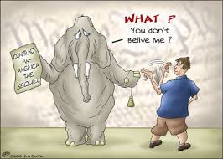
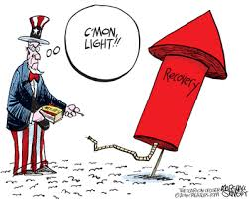
Clintons: Domestic Policy
Economic Recovery – Eliminated Cold War restrictions, unemployment was down, consumer spending was up, and business profits were at all time highs.
Contract with America – Republican Newt Gingrich proposed a series conservative principles that Republican candidates promised to the people. Stated federal government was too large and no longer responsive to the people it served. Aimed to restore the balance between government and its citizens.

Slide 4
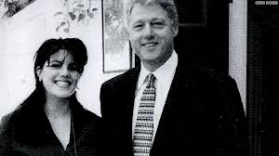
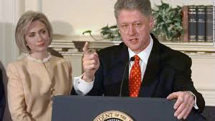
Clinton: Impeachment and Scandal
A sexual affair between Clinton and a White House intern was revealed.
After lying about the affair under oath the prosecutor recommended impeachment.
Clinton was not impeached as the Senate fell short of the 2/3 majority vote.
Once again, Americans felt they could not trust their elected leaders.
https://www.youtube.com/watch?v=HV7zqaKHY3Y

Slide 5
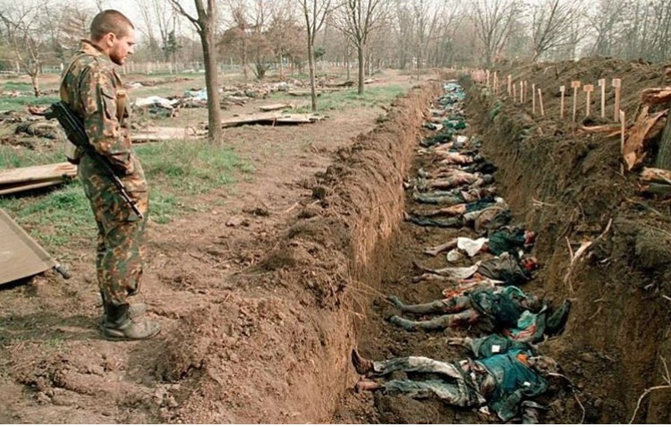
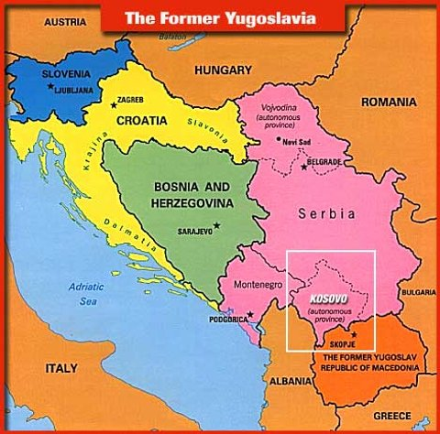
Clinton’s: Foreign Policy
The dissolution of Yugoslavia was accompanied by fierce fighting between Muslim Bosnians and Christian Serbs. (Balkans Crisis)
Some Serbs attempted to massacre Muslim civilians in parts of Bosnia and Kosovo in a policy of “ethnic cleansing” to regain areas for themselves.
1995 Clinton organized the Dayton Accords ending the war in Bosnia; in Kosovo NATO intervened with air strikes against Serbia ending the bloodshed and killing.

Slide 6
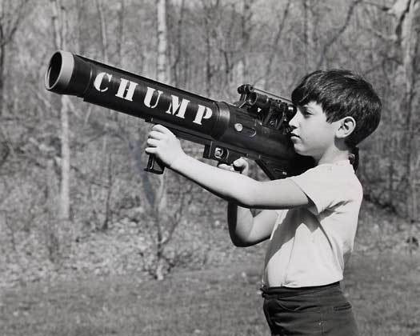
The

Slide 7
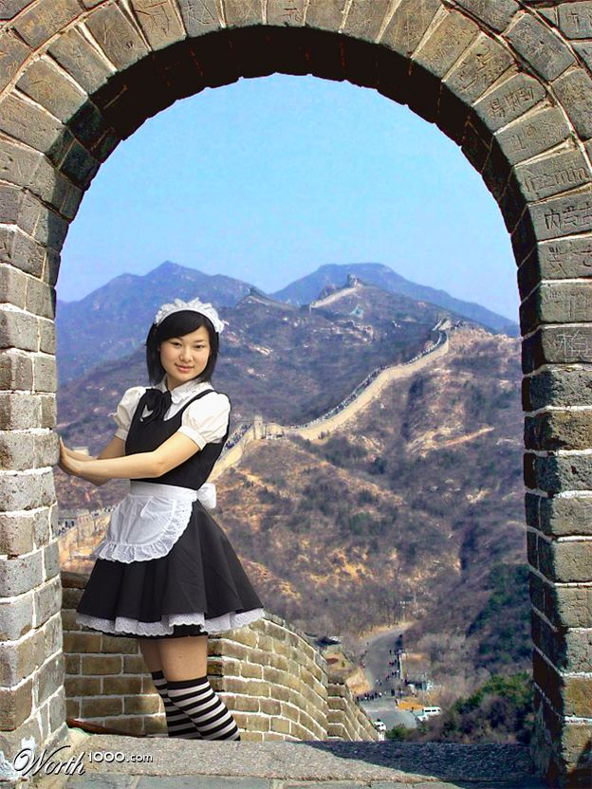

Slide 8
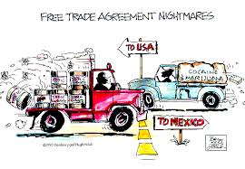
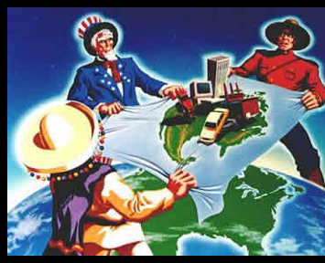
International Organizations
NAFTA (North American Free Trade Agreement) trade agreement gradually phasing out tariffs between the three countries of Canada, United States, and Mexico.
WTO (World Trade Organization) established rules for global trade and helps to settle trade disputes. Has accelerated globalization.

Slide 9
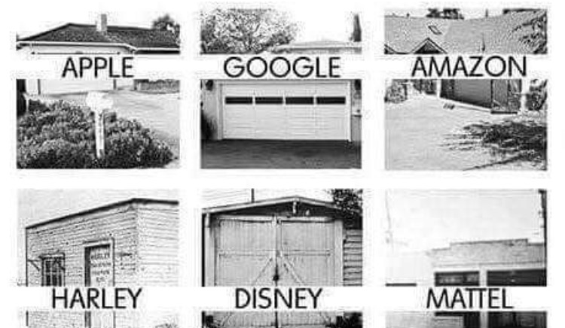
Achieving the American Dream
Bill Gates – co founder of Microsoft, today Microsoft software is part of nearly every personal computer in the world.
Sam Walton – Founder of Walmart and Sam’s Club became the worlds largest retailer bringing a large variety of products at a low price.
Estee Lauder – founded a cosmetics company, invested in larger marketing concepts such as using beautiful models to sell her product.
Robert Johnson – first African American billionaire, founder of Black Entertainment Television. Sold BET for $1.5 billion and bought Charlotte Bobcats.
Lionel Sosa – founded largest Hispanic advertising agency in the U.S.; has motivated many Latinos to “compete and win”

Slide 10
Checking for Understanding
Describe the impact of NAFTA on the American economy?

Slide 11
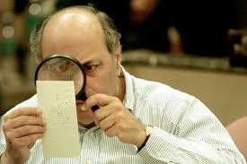
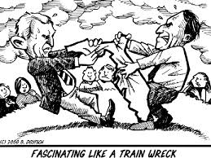
George W. Bush Election of 2000
Al Gore won the popular vote but lost the electoral college.
Election came down to Florida where Gore demanded a recount statewide.
Third party candidate Ralph Nadar took critical votes from Democratic candidate Al Gore; and weakened support lingering from Clinton scandal allowed Bush to gain support to win 2000 election in closest Presidential election in U.S. history.

Slide 12
The

Slide 13
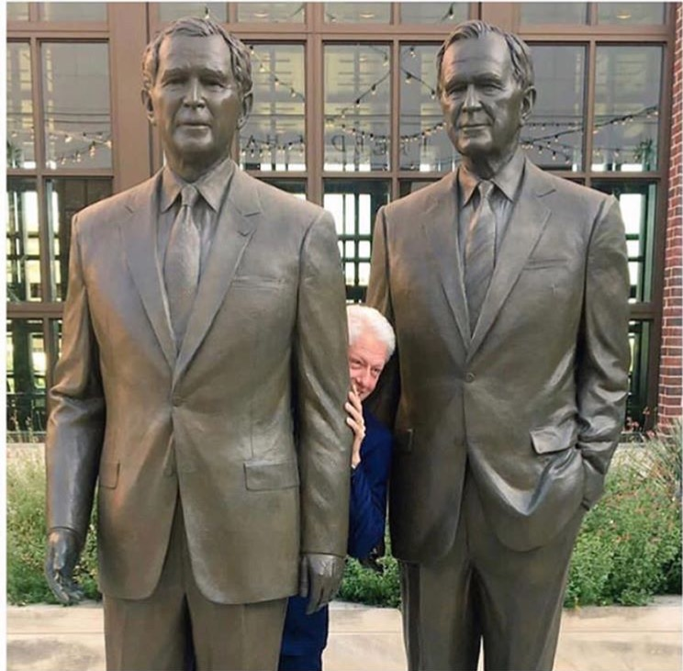

Slide 14
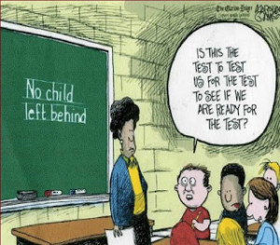
Bush’s: Domestic Policy
Issued tax cuts to revitalize the economy.
Introduced “No Child Left Behind Act” requiring states to test all students in English and Mathematics each year from 3rd-8th grade.

Slide 15
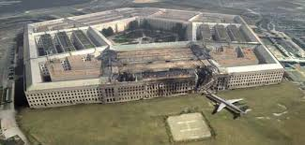
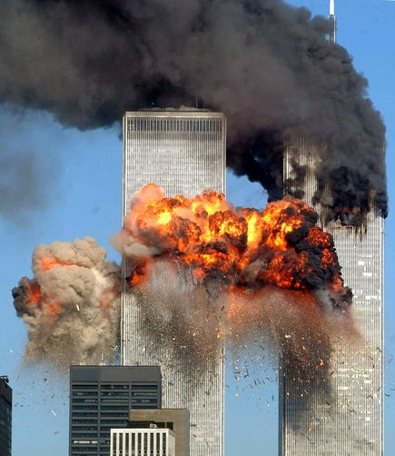
Terror comes to America
https://www.youtube.com/watch?v=YrEXibbXqUs
September 11th, 2001 Islamic Fundamentalist flew planes into the World Trade Center towers, the Pentagon, and a fourth plane crashed in Pennsylvania.
Osama bin Laden and his organization “al-Queda took credit for the attacks.
The Taliban a group of Islamic Fundamentalists controlling Afghanistan, sheltered and refused to surrender bin Laden to the U.S.

Slide 16
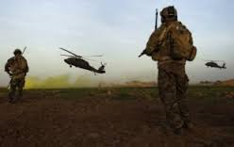
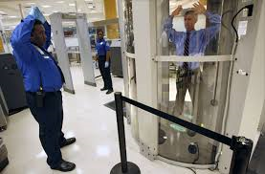
Global War on Terror
President Bush vowed to launch a global “War on Terror” against those nations that harbored terrorists.
Bush ordered air and ground assaults to topple the Taliban and capture Osama bin Laden.
Transportation Security Agency (TSA) took over security at U.S. airports; all passengers and luggage were subject to a thorough screening.
Bush created new cabinet post Department of Homeland Security – mission to keep the U.S. secure from all threats.

Slide 17
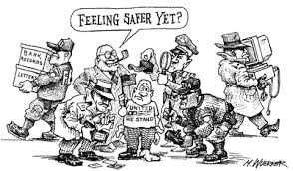
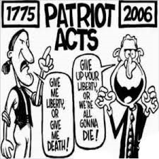
Global War on Terror
USA PATRIOT Act 2001- (Uniting (and) Strengthening America (by) Providing Appropriate Tools Required (to) Intercept (and) Obstruct Terrorism Act) passed by Congress, signed by President George W. Bush to help identify and stop further terrorist activities; any country that harbors enemies is considered a threat to U.S. safety. (Afghanistan)
Balancing individual rights and freedoms with the need for national security has been one of the biggest challenges created by international terrorism.

Slide 18
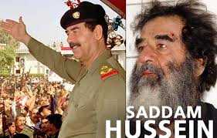
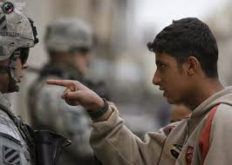
War in Iraq
Bush feared Iraqi dictator Saddam Hussein might provide weapons of mass destruction to Islamic terrorists like Osama bin Laden.
Bush gave Hussein 48hrs to leave Iraq or face invasion. Hussein rejected the ultimatum, and coalition forces took military action.
Hussein’s dictatorship quickly collapsed, and Hussein was captured soon after; tried for his crimes against the Iraqi people and executed in 2006

Slide 19
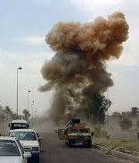
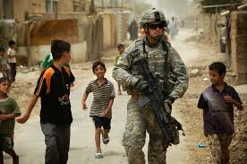
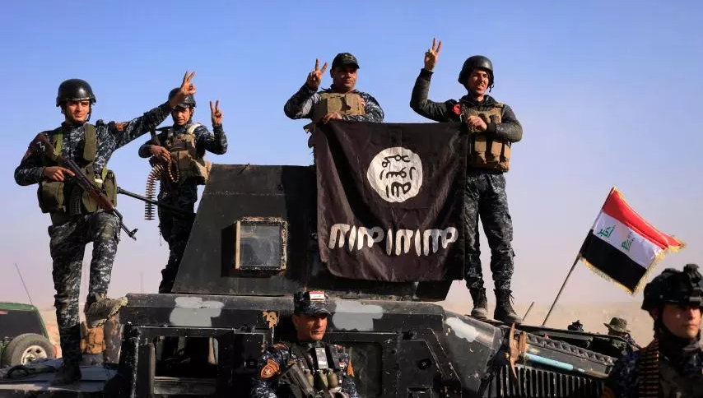
Aftermath of Iraq War
Coalition forces established a provisional government.
The war was over but an insurgency ensued.
Bush announced a new “surge” strategy sending 20,000 additional troops to make Iraq safe and combat al-Queda forces.
The surge greatly reduced violence in Iraq but Iraq became a central issue in the 2008 election.

Slide 20
Checking for Understanding
Describe how 9/11 effected domestic and foreign policy?
Describe the significance of third parties in Presidential elections over the period of 1890-2000?

Slide 21
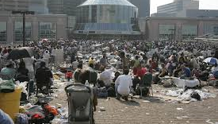
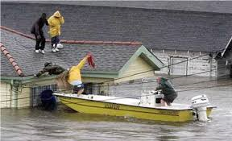
Hurricane Katrina
https://www.youtube.com/watch?v=DFYRBWII_DU
Caused the evacuation and flooding of almost 80% of New Orleans.
Katrina brought the highest storm surge and waves in American history causing its levee system to fail.
More then 1,800 people died, making it one of the deadliest natural disasters in American history.
Rescue efforts were so delayed people were stranded for days on rooftops and in attics. Almost 20,000 people were trapped in New Orleans’ Superdome in sweltering heat and unsanitary conditions.

Slide 22
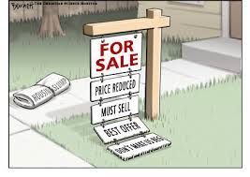
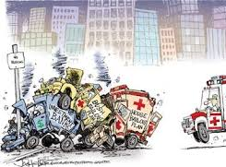
2008 Financial Crisis
2007 overbuilding led to falling house prices. When interest rates began to rise investors weren’t able to pay their mortgages which led to rising number of foreclosures.
In late 2008 major investment firms were showing signs of collapse.
Emergency Economic Stabilization Act authorized spending of $700 billon to buy distressed investments and provide funds to banks so they wont fail.

Slide 23
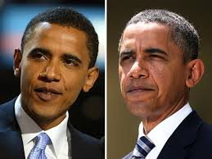
Obama Presidency
Barack Obama won the 2008 presidential election becoming the first African American president. Used the internet and celebrities like Oprah Winfrey to gather support.
Obama promised change, health care reform, closing of Guantanamo Bay, no new taxes, and immigration change; his campaign appealed to young people and African Americans.

Slide 24
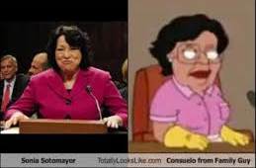
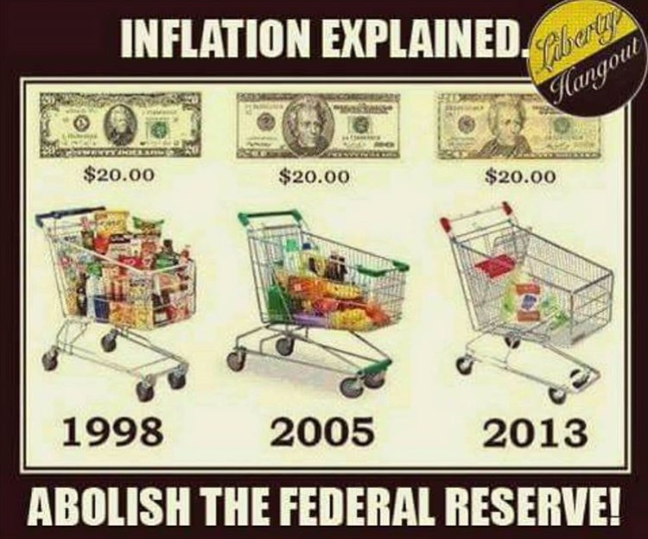
Obama: Domestic Policy
American Recovery and Reinvestment Act – More then $700 billion was to be spent in a bailout package to create new jobs, save existing ones, spur economic activity and invest in long-term infrastructure development.
Appointed Sonia Sotomayor to the U.S. Supreme Court, making her the first Hispanic justice.

Slide 25
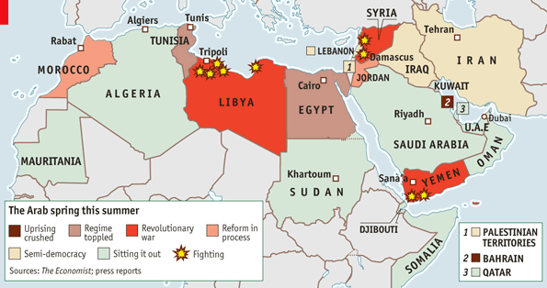
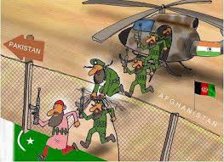
Obama: Foreign Policy
Pakistan – encouraged to fight terrorism, U.S. forces caught Osama bin Laden in Pakistan.
Iran – Despite economic and political sanctions Iran continues to develop its nuclear program. Considered sponsor of terrorism.
Iraq – Obama gradually withdrew U.S. troops, but remains challenging as terrorism continues.
Europe – remains close allies, and is going through financial crisis.
“Arab Spring” – Crisis in Tunisia, Yemen, Syria, and Egypt remain on Obamas crisis list.

Slide 26
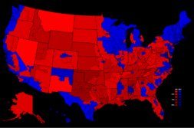
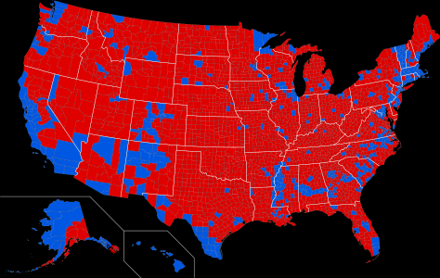
Checking for Understanding
Compare the significance in minority participation in the 2008 election to the 2016 election have on the outcome?

Slide 27
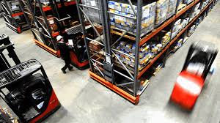
Technological Innovation
Technology has been at the forefront of American life the past half century leading to a more convenient way of life.
Technology can spur workplace production; many companies now use robotics to aid in manufacturing.
Just-in –time (J-I-T) production – parts arrive at the precise time for manufacturing process, eliminates the need for large inventory of parts.

Slide 28
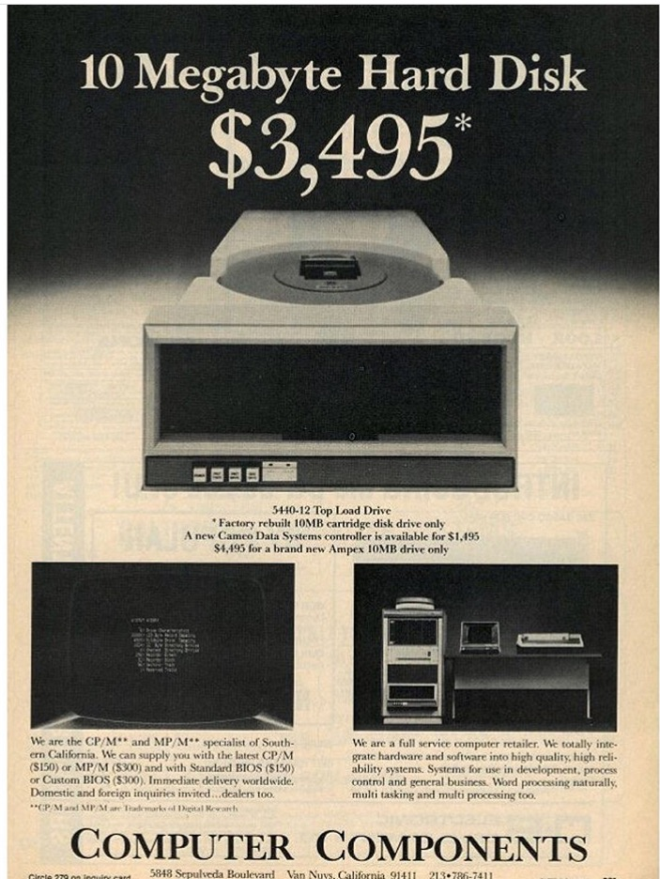
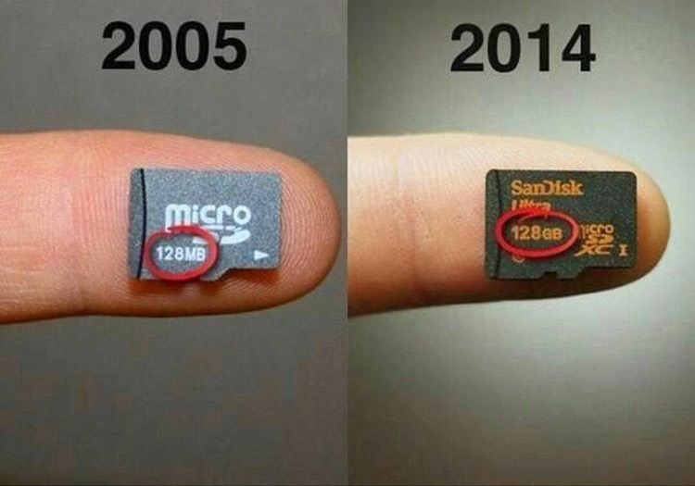

Slide 29
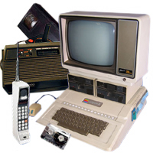
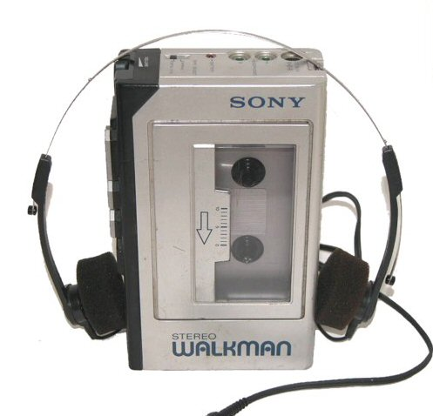
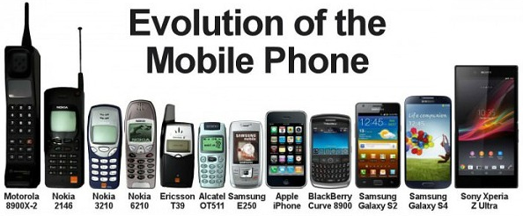

Slide 30
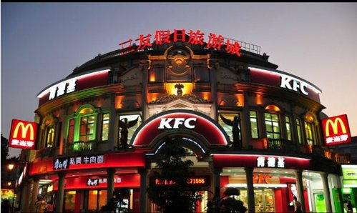
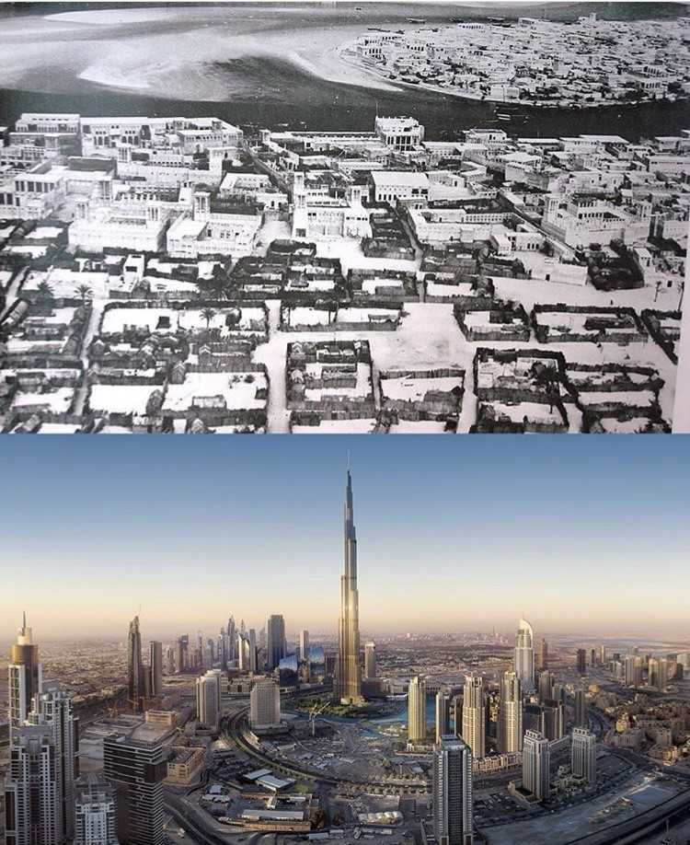
International Trade
Multinational Corporation - Corporation that has set up local companies, or subsidiaries in several countries. Today their products are sold in every corner of the world.
These corporations have led to Globalization - process of international integration arising from the interchange of world views, products, ideas, and other aspects of culture.

Slide 31
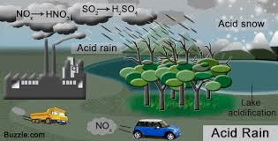
Managing the Environment
Global Warming – pollutants in atmosphere prevent heat from escaping into space. U.S. a leading offender causing 25% of the gases.
Acid Rain – pollutants released by industry and automobiles are washed out of the air when it rains causing highly toxic rain.
Erosion of the Ozone Layer – Ozone layer was being rapidly eroded by widespread of fluorocarbons which causes ultraviolent radiation to pass through Earth’s atmosphere.
Water Pollution – Population increases have made it hard to handle increased sewage and waste. Leading to raw sewage being dumped in surrounding areas contaminating drinking water, killing wildlife, and threatening health of society.

Slide 32
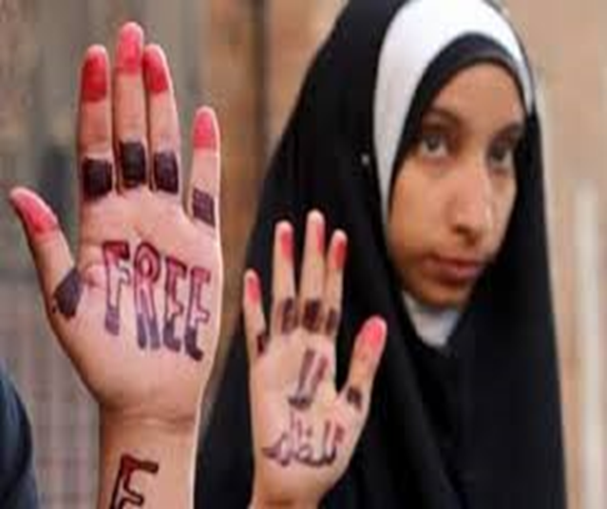
Global Reach of American Pop Culture
The revolution of listening to music and visual arts have transformed American culture over the years. The internet has played a large role in spreading these arts.
Hollywood studios produce films shown around the world; these films and TV shows depict American culture and way of life which influences people around the world and Americans themselves.
The internet with the help of Google, Facebook, and Wikipedia have also helped spread American culture to all corners of the world; which also influences other cultures and their views of the U.S.

Slide 33
Changes in Demography
Demography is the study of population. Example the U.S. population has doubled since the end of WWII. Most moving from Rust Belt to Sun Belt region.
Much of recent population growth is due to immigration; both legal and illegal. Estimated 15 million illegal aliens now living in the U.S.
Debate has arose how to handle the illegal alien issue, poses an important social issue.

Slide 34
Checking for Understanding
Describe the significance of “Globalization” to the world, and the role America plays in influencing other cultures?

