Slide 1
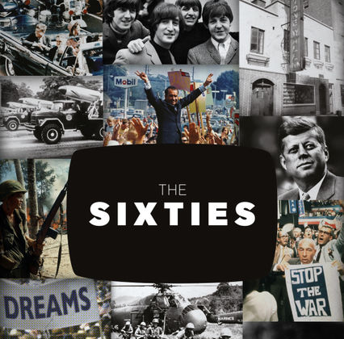
The 60’s, Vietnam and the Civil Rights Movement

Slide 2
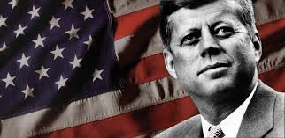
John F. Kennedy
Democratic party, became youngest president ever elected as he defeated Richard Nixon. Held first ever televised debate, which propelled him past Nixon as he spoke and looked better than Nixon.
Attained a majority of the African American vote, this aided him to win election.
“Ask not what your country can do for you but what you can do for your country”; Sought to ignite the spirit of American idealism. Critics worried of his Catholic background.
https://www.youtube.com/watch?v=GMWQnoDA0o8

Slide 3
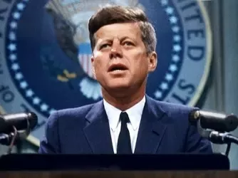
Kennedy’s Domestic Policy
New Frontier - increase aid to education, provide health insurance, and help achieve Civil Rights .
Peace Corps organization that sends American volunteers to perform humanitarian services in developing nations such as Africa, Asia, and Latin America. Kennedys program is still active today.

Slide 4
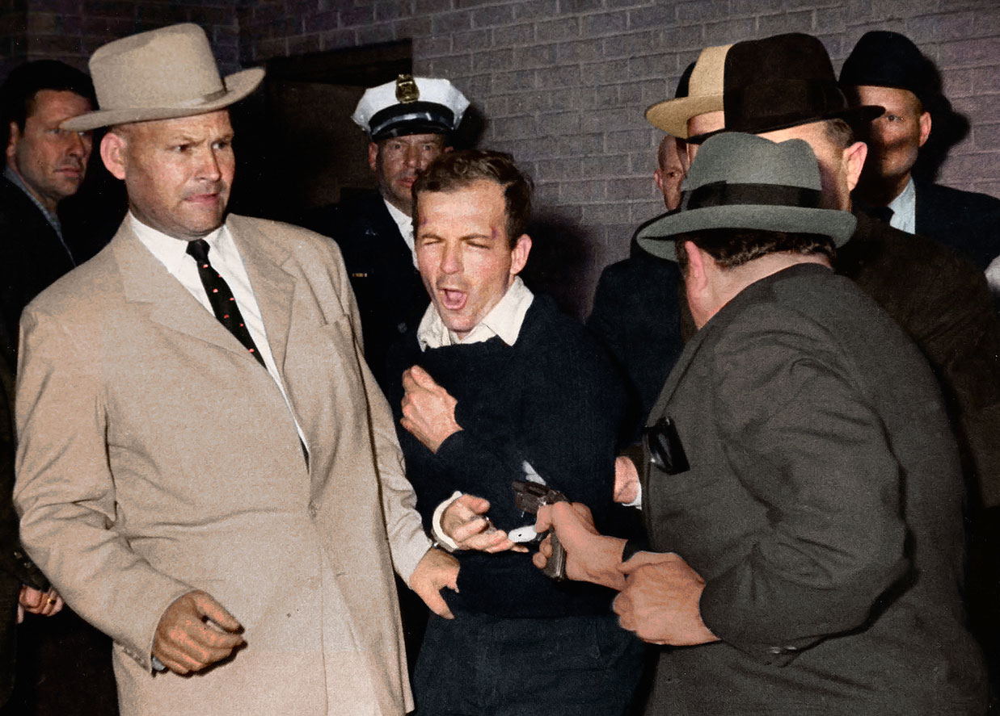
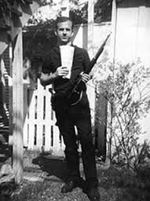
JFK Assassination
John F. Kennedy was assassinated in Dallas, Texas on November 22nd, 1963.
Lee Harvey Oswald was the lone assassin accused; Oswald didn’t even make it to the County prison as Oswald himself was assassinated by Jack Ruby.
Warren Court confirmed the assassination by Oswald with the “magic bullet theory”.
https://www.youtube.com/watch?v=PfSXkfV_mhA

Slide 5
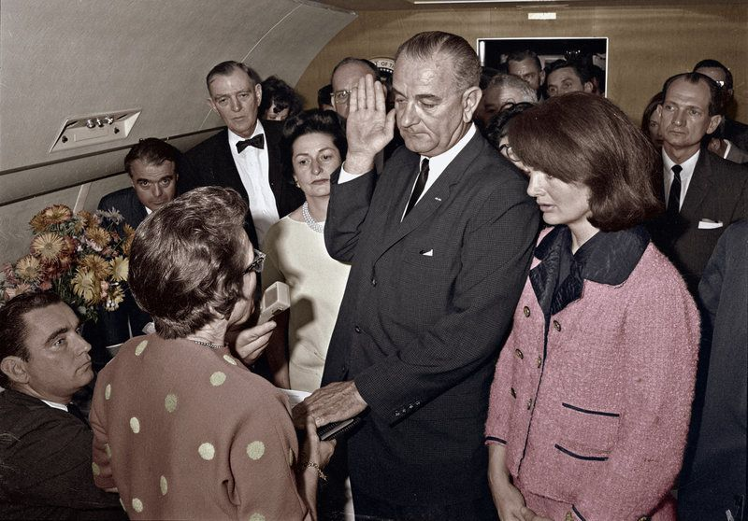
President Johnson being sworn in on Air Force One as the former First Lady Jackie Kennedy stands at attention moments after President Kennedy was assassinated.

Slide 6
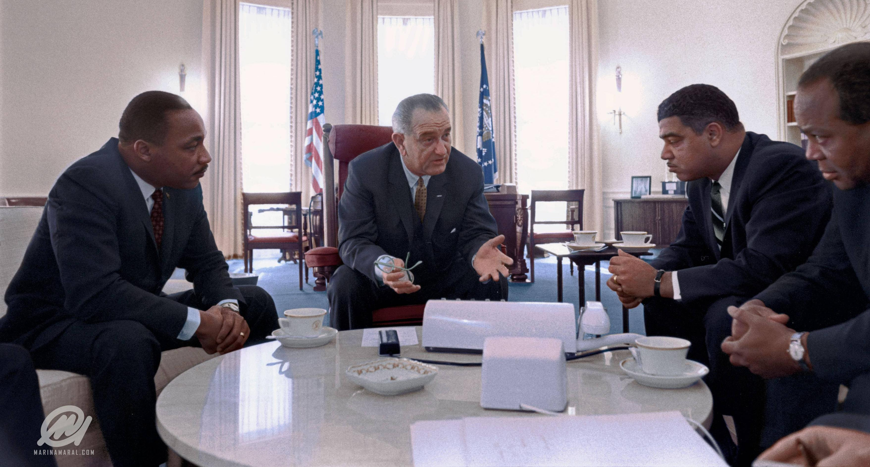
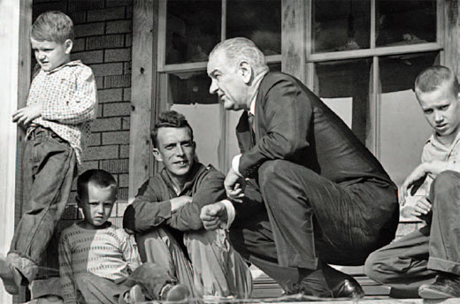
Johnsons Great Society
Vice President Lyndon B. Johnson assumed presidency after Kennedys assassination.
Johnson designed federal legislation to improve American quality of life, Johnson passed new Civil Rights legislation passing the (Civil Rights Act of 1964), (Voting Right Acts of 1965), Economic Opportunity Act, and (Affirmative Action) assisting (minorities)
Johnsons “Great Society” planned to wage a “War on Poverty” creating the Job Corps : train underprivileged youth and Peace Corps: help depressed areas. Gave aid to cities, created a new cabinet position to help the nation's cities as people were moving out of cities to suburbs.
Medicare Act of 1965 – Extended healthcare and insurance for people over 65.
https://www.youtube.com/watch?v=kx0K637mBVE

Slide 7
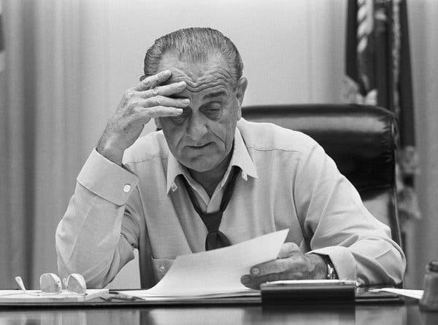
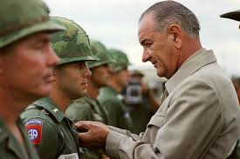
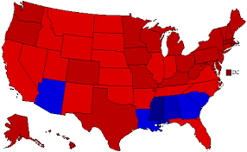
Johnson’s Presidency
Johnson won in a landslide election in 1964 against Barry Goldwater as Americans saw him as an extremist that might lead America into a nuclear war with the Soviets.
Johnson’s “Great Society” turned out to be a failure as the growing cost of the Vietnam War caused him to withdraw funding.
The unpopular war of Vietnam caused Johnson not to run for re-election in 1968
President Johnson anti-Goldwater commercial
https://www.youtube.com/watch?v=dDTBnsqxZ3k

Slide 8
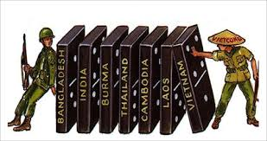
(Vietnam War)
Eisenhower stressed the (Domino theory) – if Vietnam fell so to would Laos, Cambodia, and all of Asia
After 1954 (Geneva Conference), the U.S. replaced France as South Vietnams main supporter.
Kennedy felt that a successful democracy would help other developing countries in Asia (South East Asia), Africa, and Latin America.
Causes
https://www.youtube.com/watch?v=Fd8wKKfN7sM

Slide 9
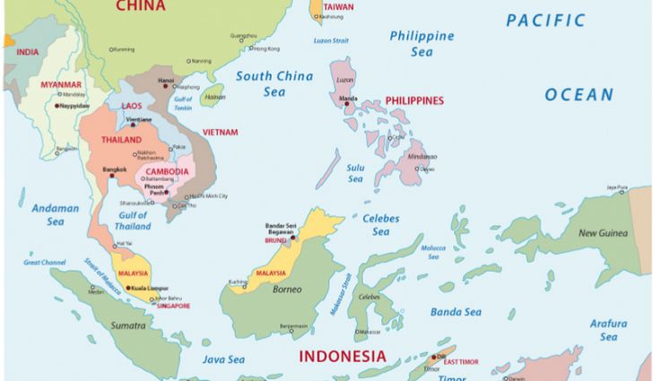

Slide 10
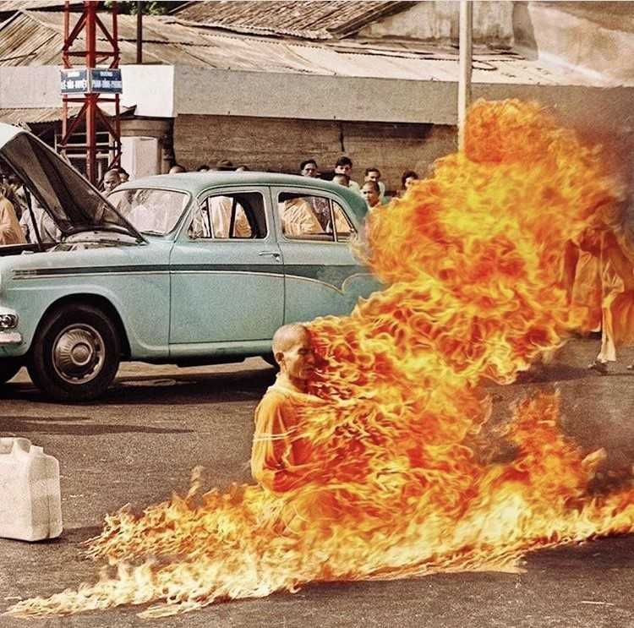
America in Vietnam (Involvement)
U.S. would greatly influence the politics in South Vietnam
United States was forced to become more involved in Vietnam in order to prop up the weak South Vietnamese government (underdeveloped nation).
1963 Diem is assassinated in South Vietnam
Monk protesting Diem’s unjust policies

Slide 11
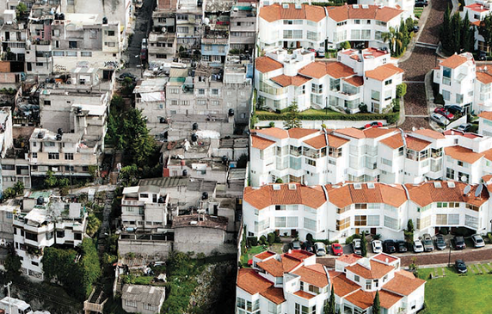
Underdeveloped
Developed

Slide 12
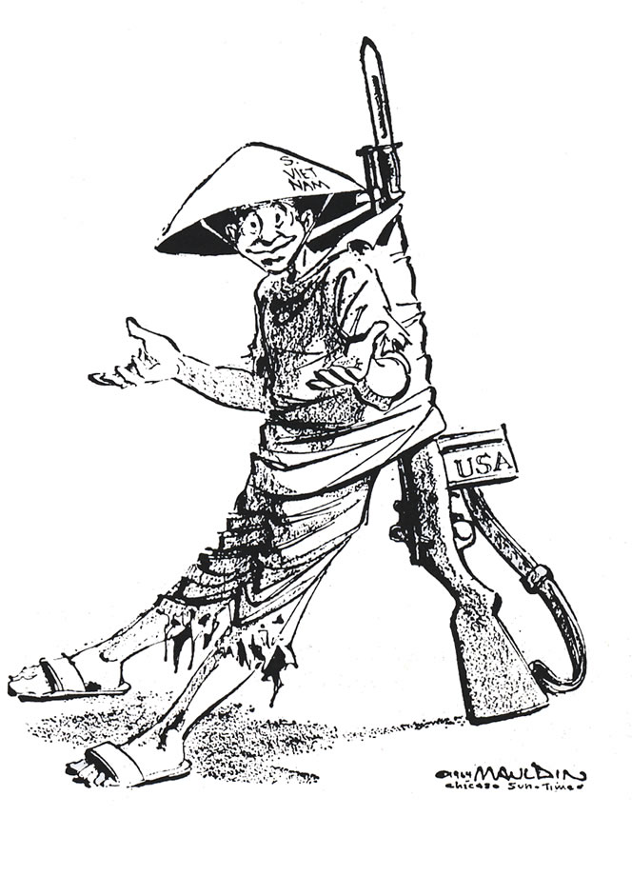
Political Cartoon representing the U.S. military propping up the weak and unstable South Vietnamese country.

Slide 13
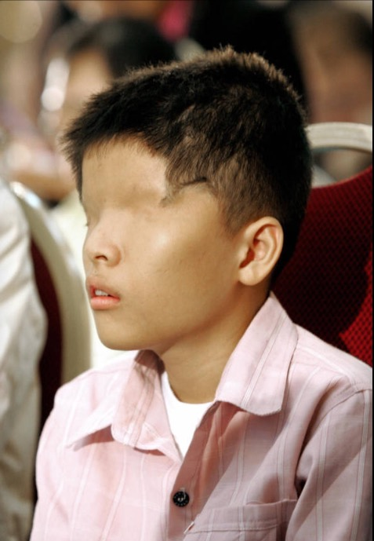
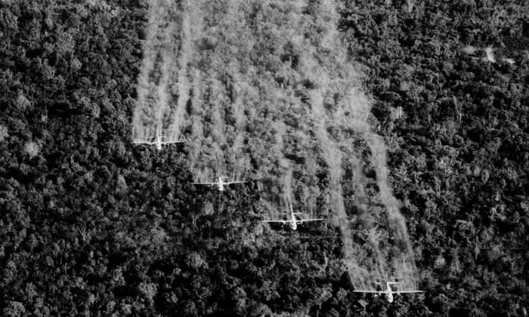
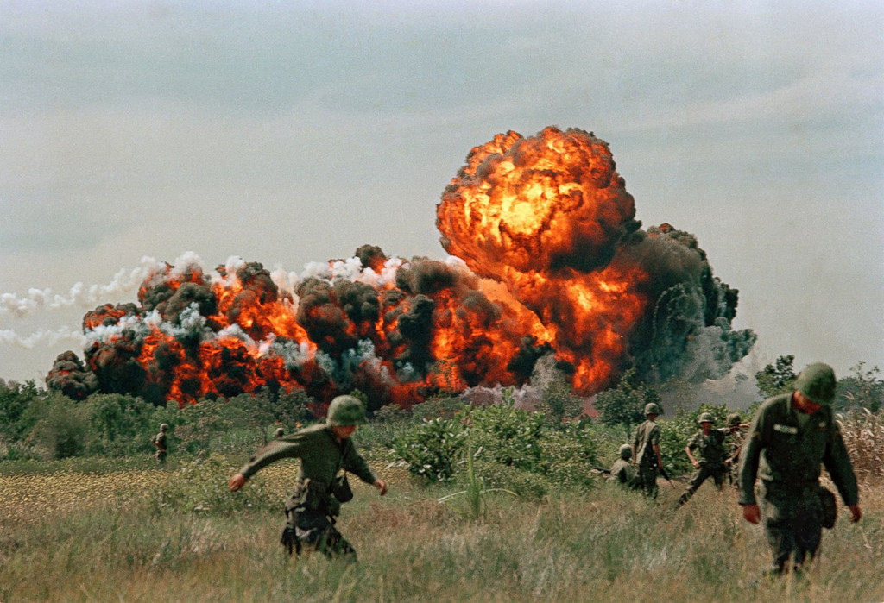
Vietnam War Under Johnson
1964 (Gulf of Tonkin Resolution)- gave the president war powers to handle and repel armed attacks against U.S. forces.
Johnson used the Resolution to escalate the war without congress officially declaring war (deployment).
1965 Operation Rolling Thunder (effects of escalation) - a sustained bombing campaign against North Vietnam, believed killing large numbers would destroy the enemies morale.
New weapons napalm and Agent Orange.

Slide 14
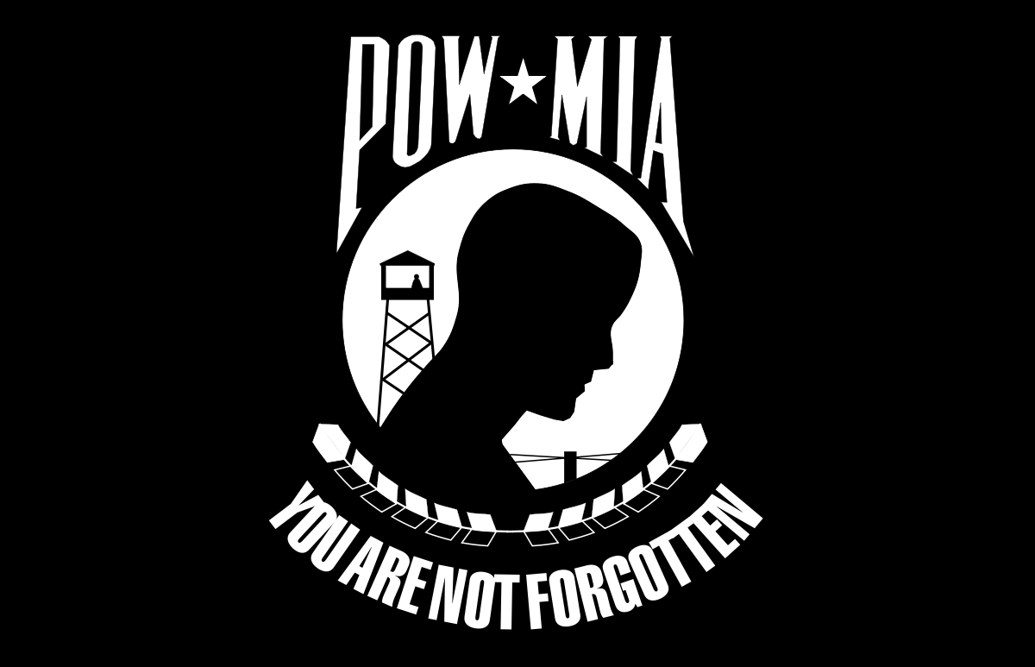
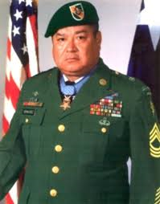
Roy Benavidez
Carried wounded members of his platoon to rescue helicopters. Mortally wounded he refused to stop gathering survivors.
Awarded (Congressional Medal of Honor) by President Reagan in 1981.
(Prisoners of War) (POW) is a person, who is held captive. Vietnam (Veterans) suffered greatly after the war as continue to suffer today.
Roy Benzvidez https://www.youtube.com/watch?v=fvlAHUur5eg

Slide 15
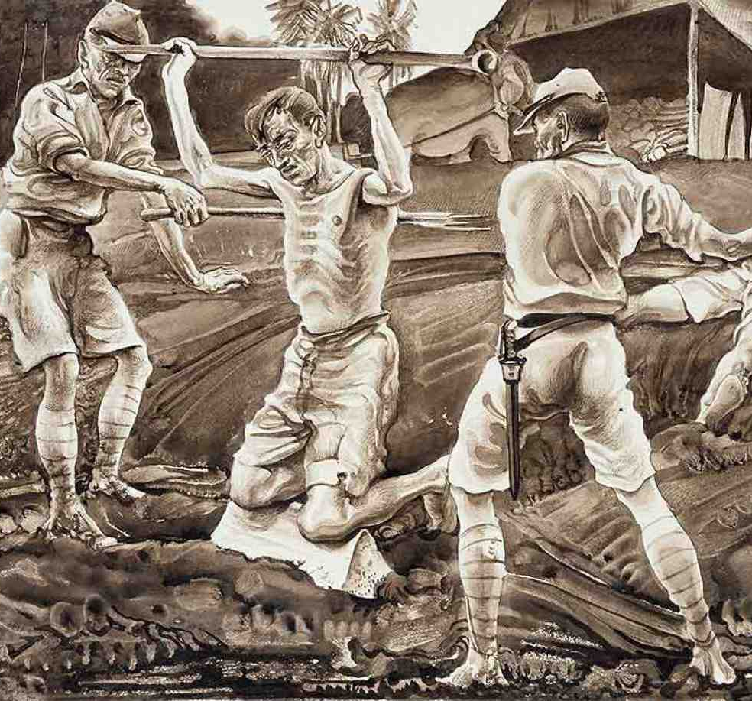
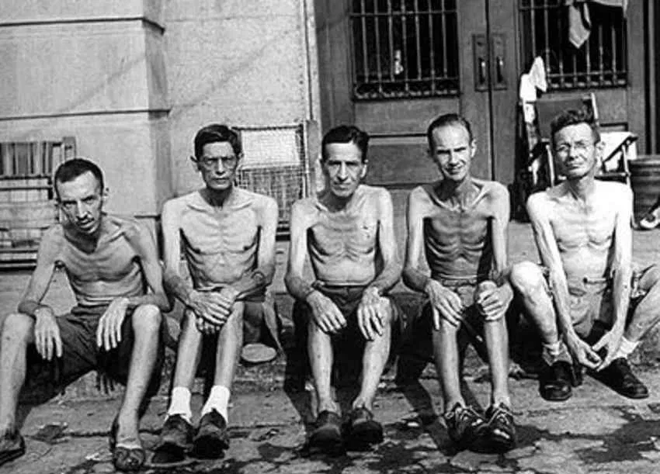
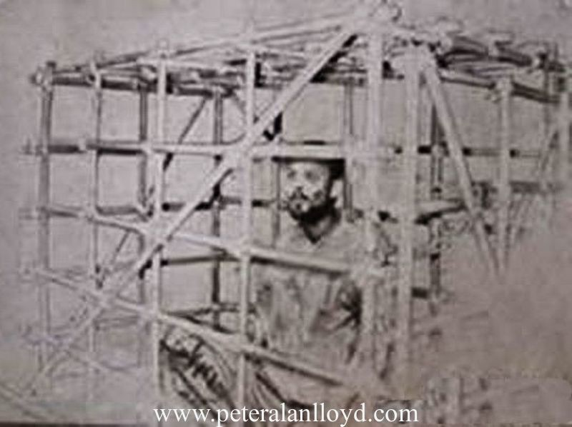

Slide 16
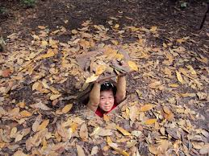
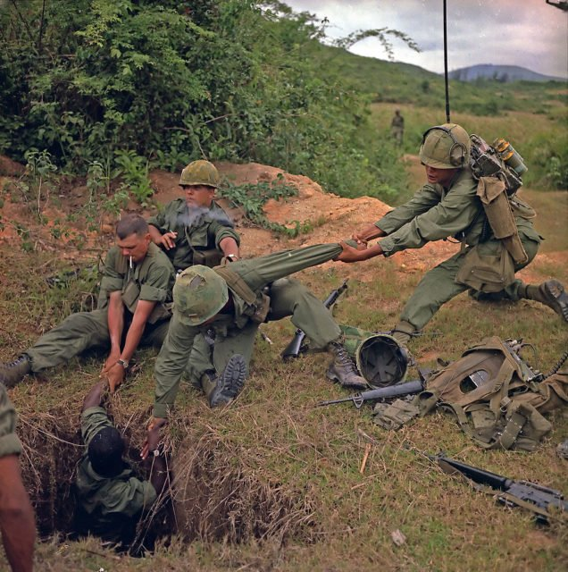
Increasing Difficulties (Setbacks) in Vietnam
War was costing $25billion a year. (military spending)
North Vietnamese and many South Vietnamese felt they were fighting for their independence and were willing to suffer large losses.
Guerilla (Tactics) Warfare dense jungles made it ideal for the Vietcong to easily hide and surprise attack the South Vietnamese and American troops.
Vietcong used the Ho Chi Minh trail to transport a steady stream of supplies to the South to supply their troops.

Slide 17
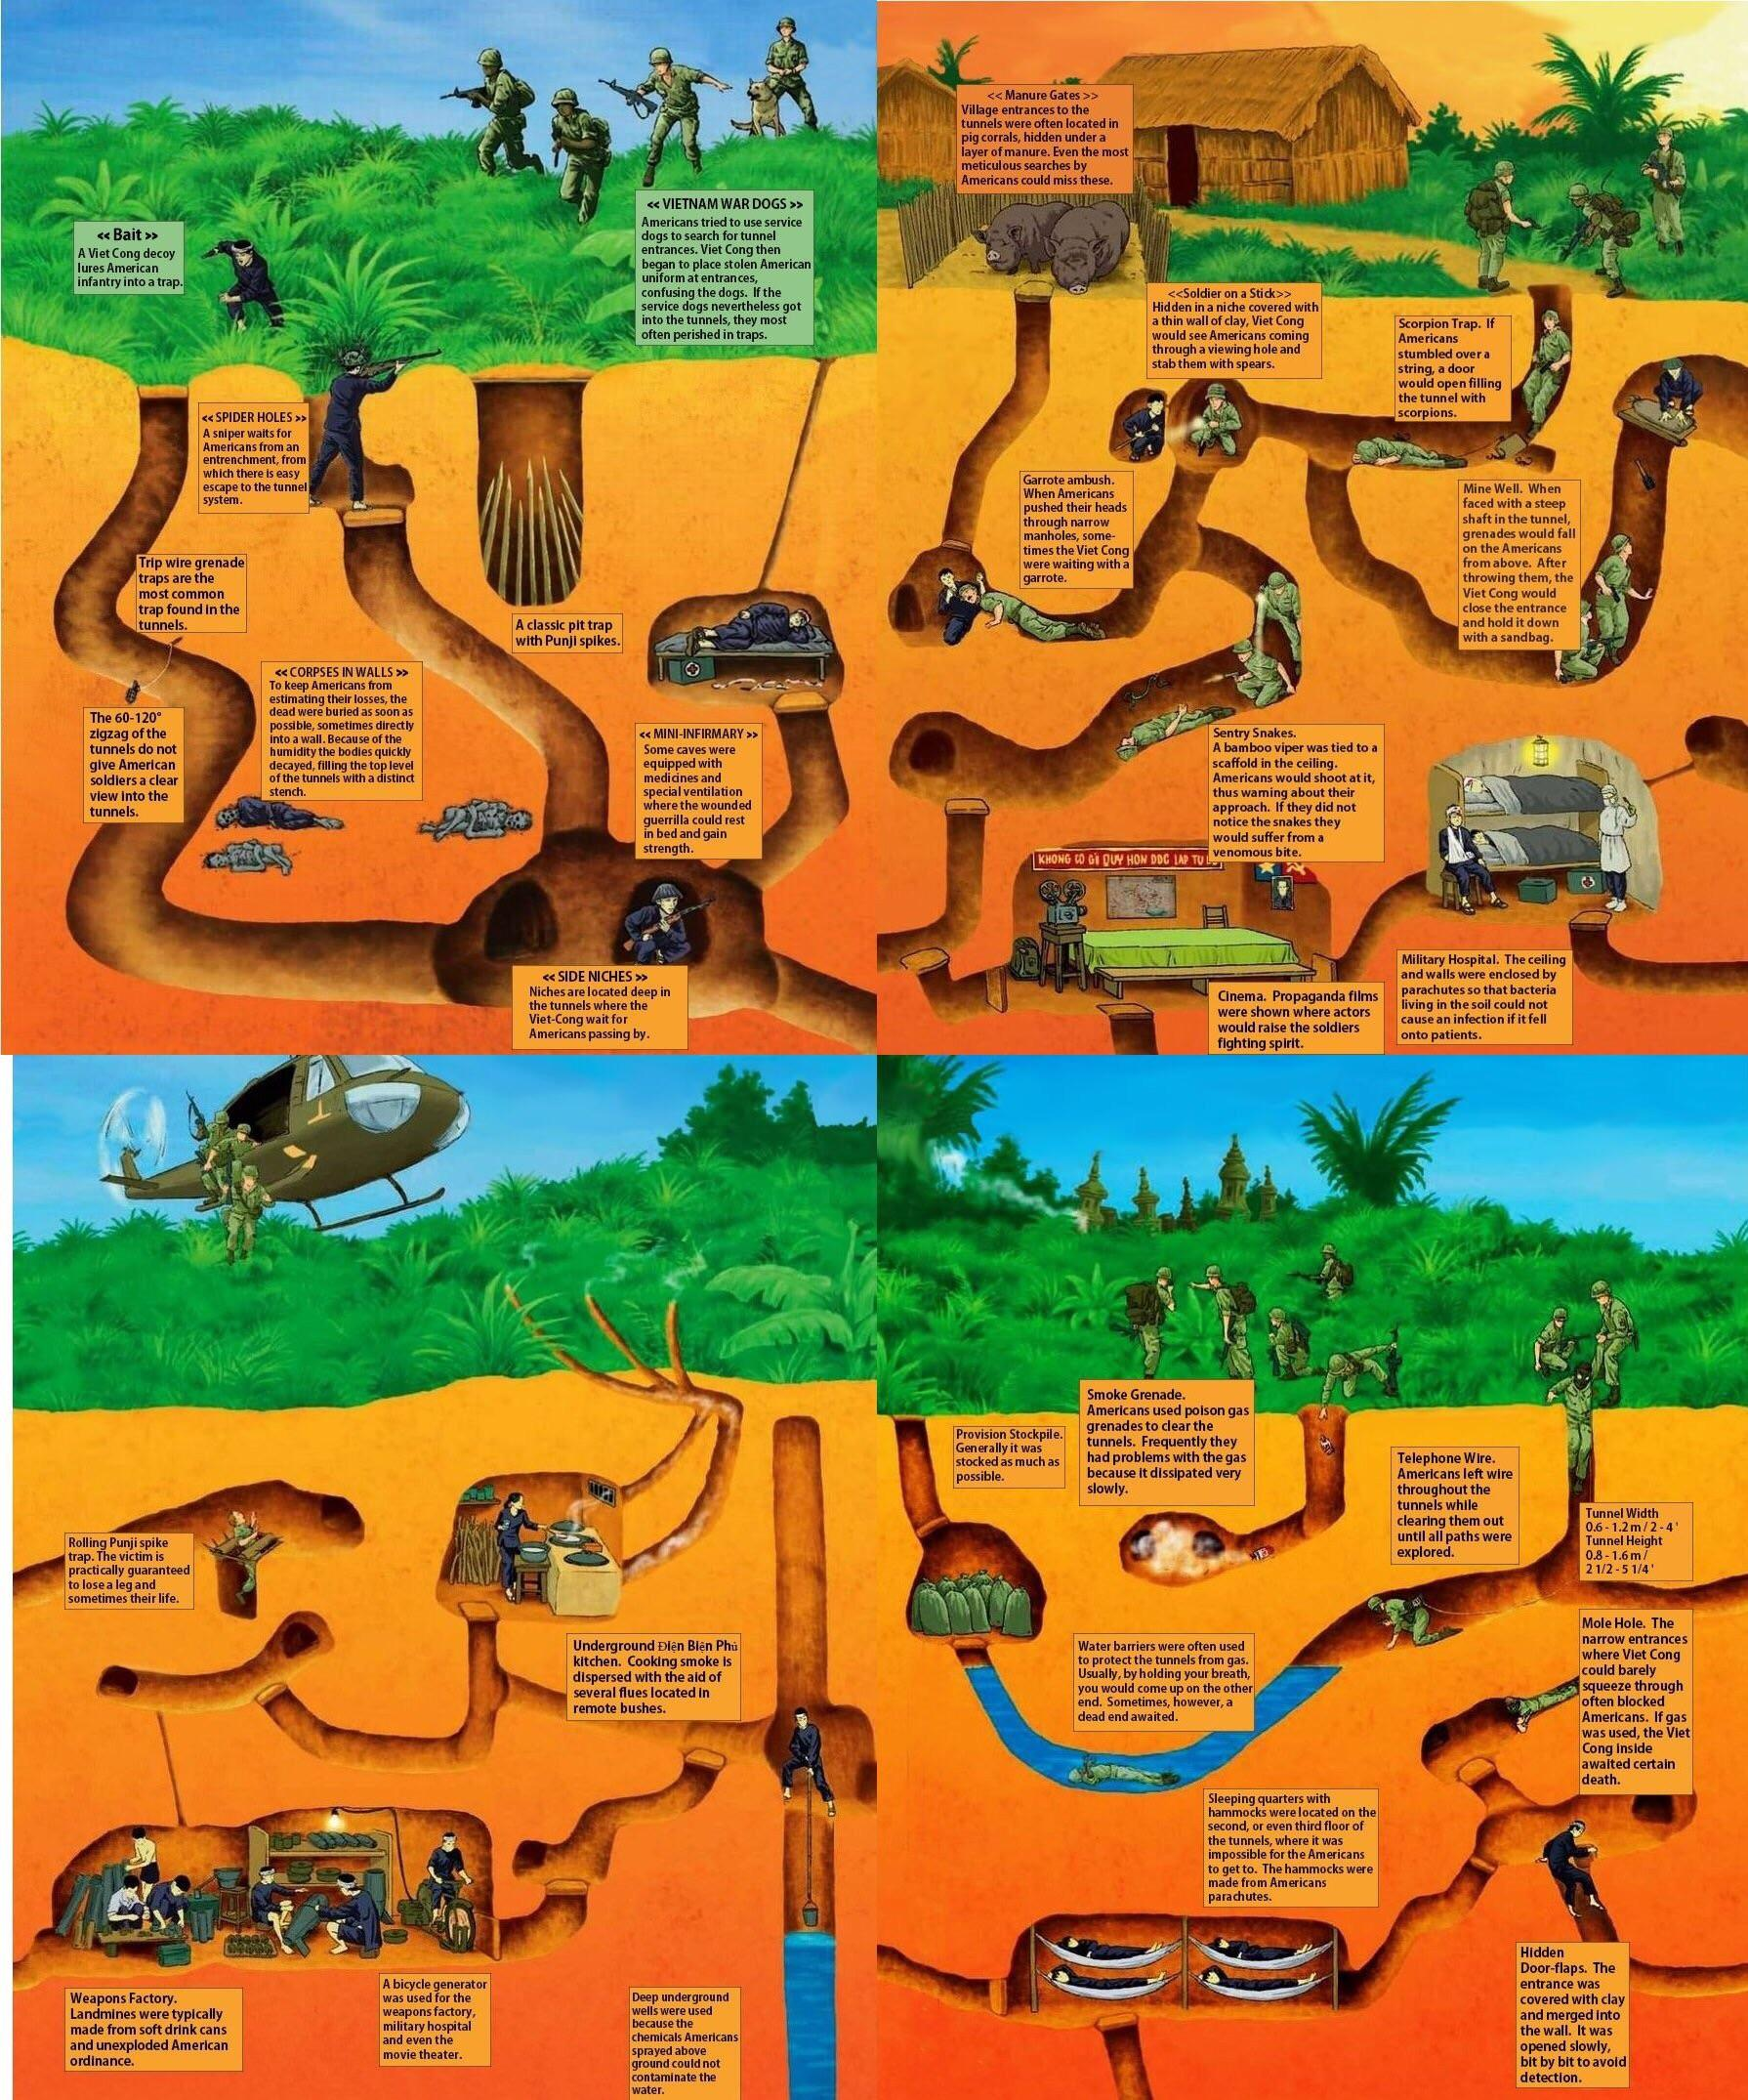

Slide 18
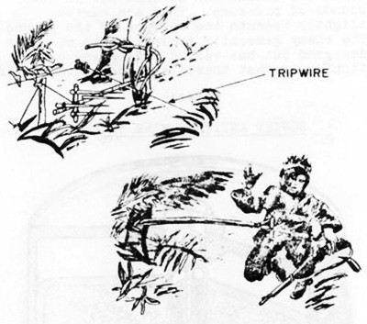
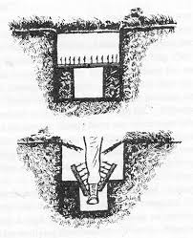
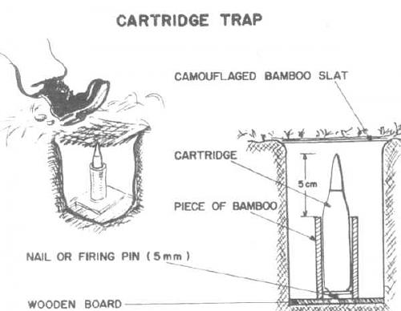
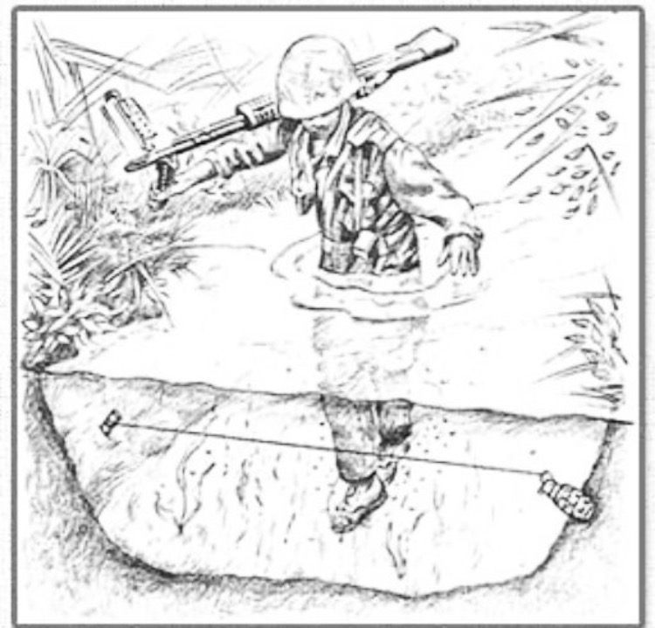
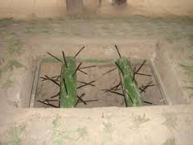
https://www.youtube.com/watch?v=K4cLiV_o8Go&disable_polymer=true

Slide 19
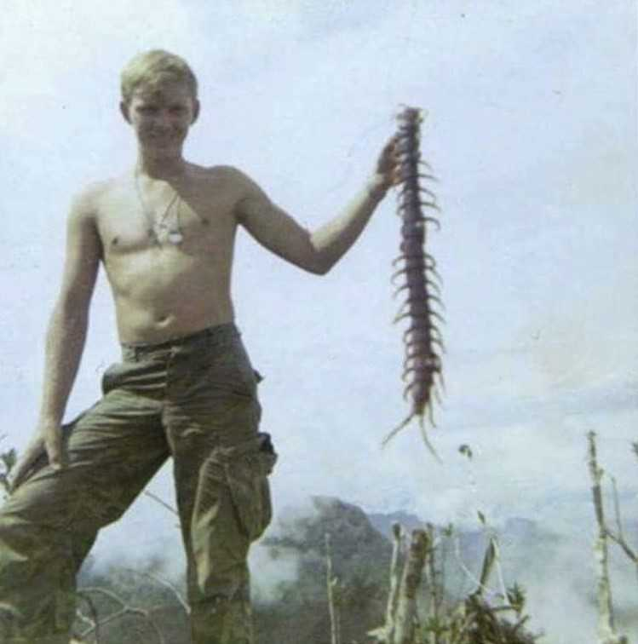
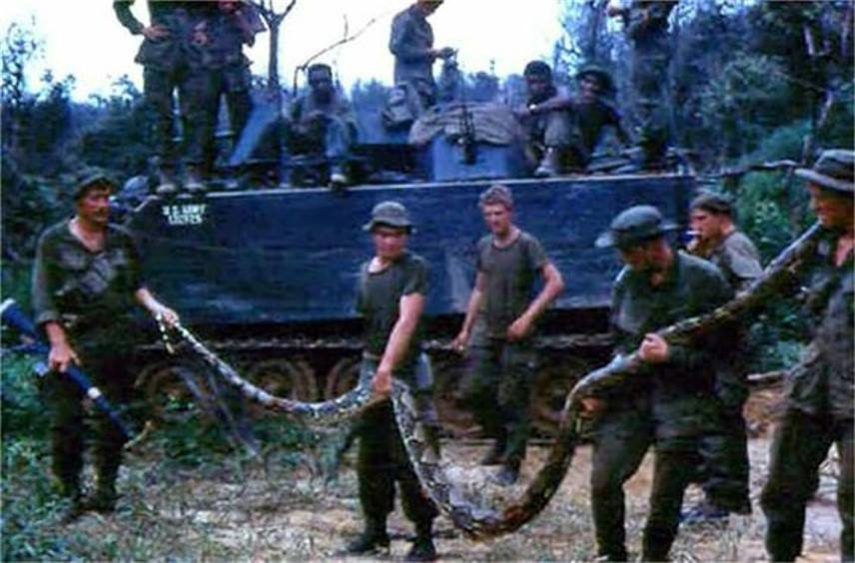
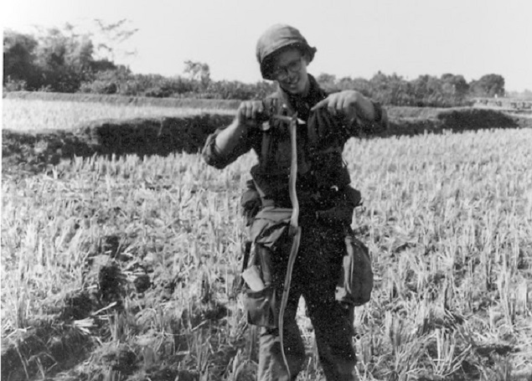

Slide 20
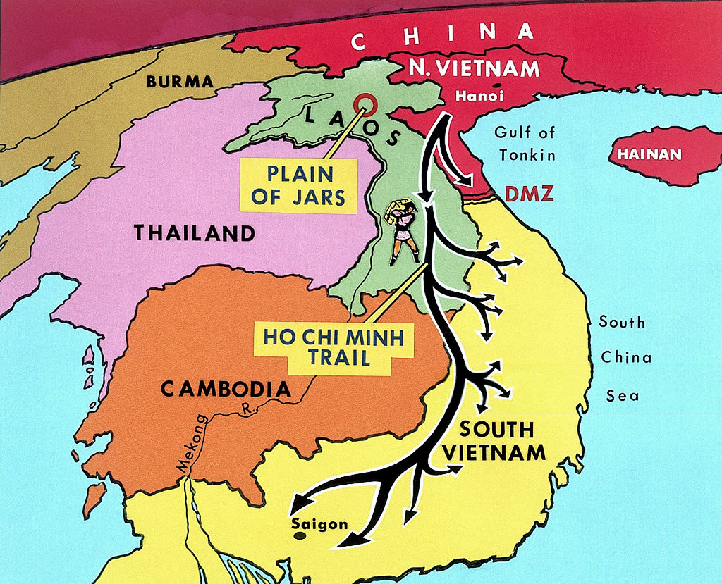
Ho Chi Minh Trail

Slide 21
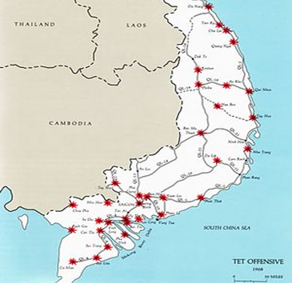
Tet Offensive
1968 Tet Offensive Vietcong launched a massive surprise attack throughout South Vietnam, (Military setback) seizing major cities.
Demonstrated that American victory was far away.
Disapproved the rhetoric of American government that the Vietcong were weak, undersupplied, disorganized, and low in morale.
https://www.history.com/topics/vietnam-war/vietnam-war-timeline

Slide 22
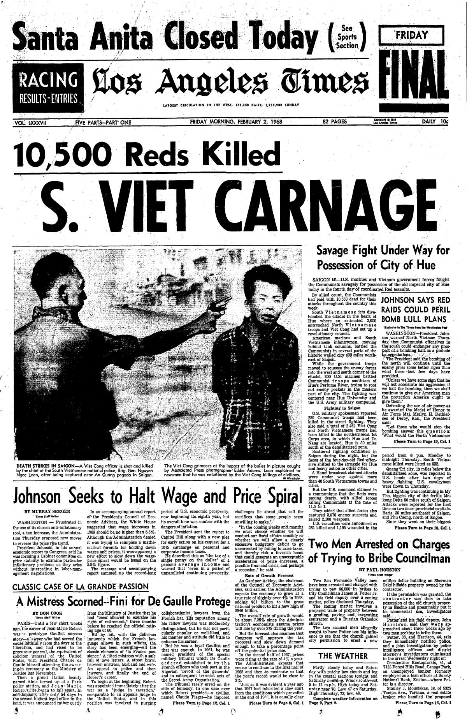
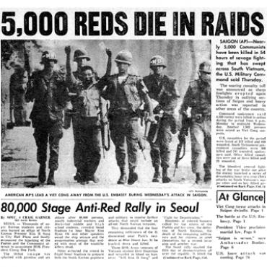
Headlines during the Vietnam War

Slide 23
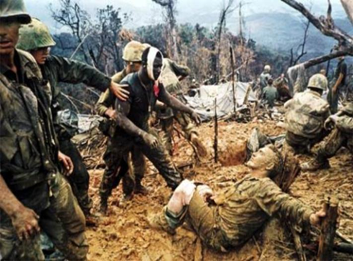
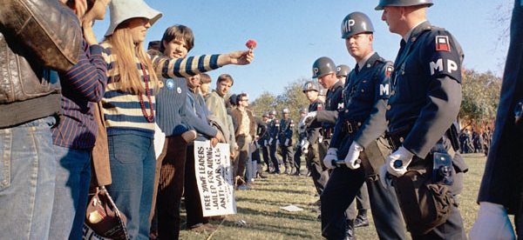
Loss of Trust
Johnson lost major political support, (Credibility gap) as the media openly criticized the effort in Vietnam.
Television (media) was broadcasting almost live images daily of the war; bringing war home for the first time.
Anti-War Protest Kent State Massacre https://www.youtube.com/watch?v=9Pwro3vCUdU

Slide 24
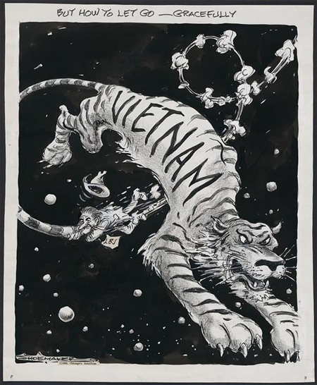
Political Cartoon showing President Lyndon Baines Johnson trying to gain control over the situation in Vietnam and leave with honor.

Slide 25
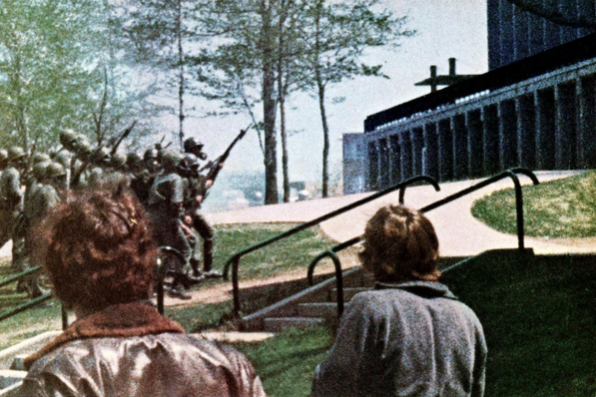
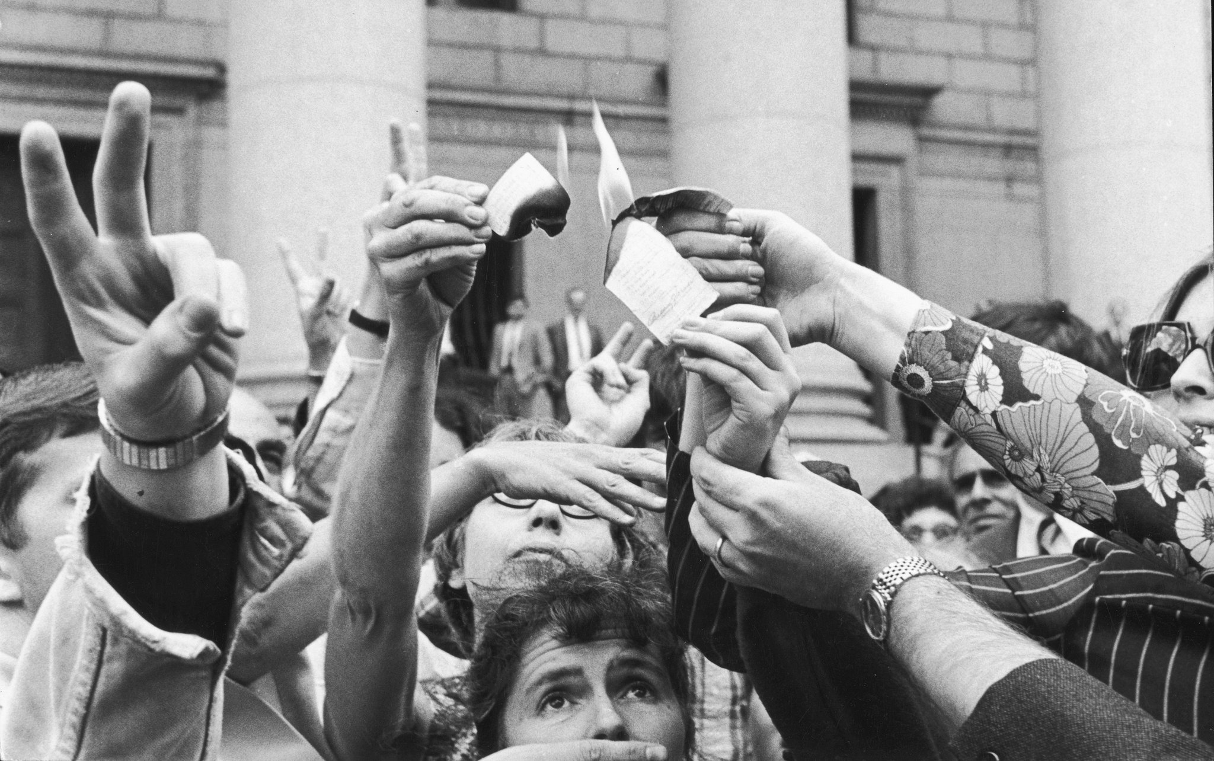
Opposition of War at Home
(Anti-war movement) increased at home when U.S. bombed Cambodia.
1971 Pentagon Papers – study of Americas involvement in Vietnam; revealed that the U.S. had secretly enlarged the scale of the Vietnam War with the bombings of nearby Cambodia and Laos. Cambodia invaded 1970.
Student (Protest)(demonstration); Over 500,000 (draft)ees (conscription) refused to go to war. 1970 Kent State Massacre.
Supporters of the war known as “Hawks” people opposed came to be known as “Doves”
Vietnam Protest https://www.youtube.com/watch?v=G3slnPIh_oU

Slide 26
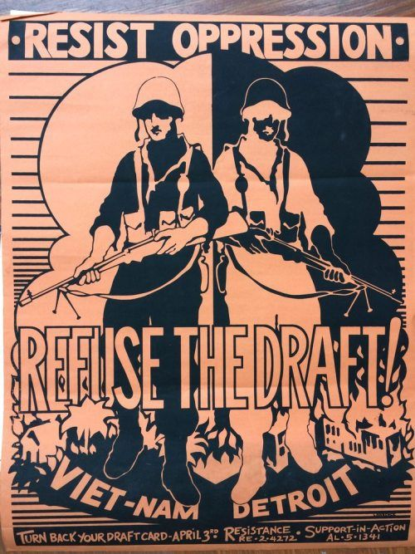

Slide 27
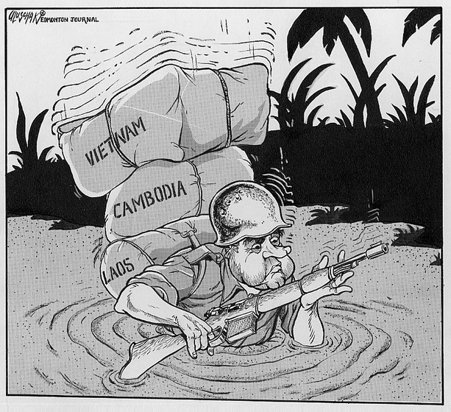
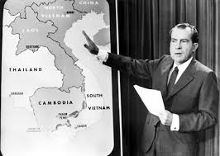
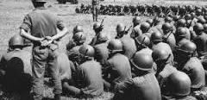
War Under Nixon
1968 Nixon elected on promise of “peace with honor”.
Adopted (Vietnamization), increased bombing and diplomacy.
Under Vietnamization the South Vietnam army would be trained by U.S. troops and would gradually take over the brunt of the fighting; allowing the end of (deployment) of U.S. forces.
Looked to (silent majority) those who don’t openly support the war nor condemn it; to support the war
History Brief Vietnam War https://www.youtube.com/watch?v=XPJ8qoQ3MhE

Slide 28
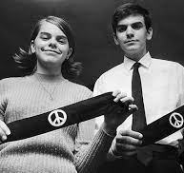
Nixon’s Domestic Policy
Protected First Amendment Rights in 1969 (Tinker v. Des Moines) students were suspended for wearing armbands protesting the war. 1972

Slide 29
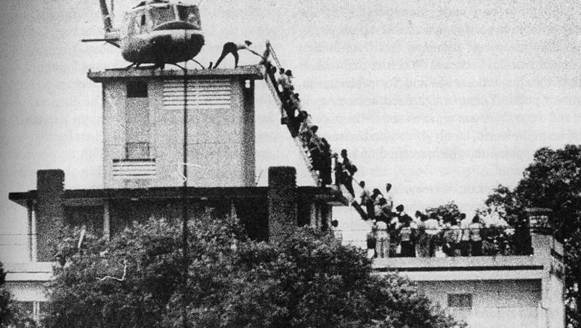
American Withdrawal
https://www.youtube.com/watch?v=hz276uryS4s
(Fall of Saigon) - the capture of Saigon, the capital of South Vietnam, on April 30, 1975. Marked the end of the Vietnam War
War Powers Act federal law intended to check the president's power to commit the United States to an armed conflict without the consent of Congress.
Countered the Gulf of Tonkin Resolution.

Slide 31
Youth Culture and the Sixties
Youth(Counter) culture was affected by rock music and Motown Sound (The Beatles, Elvis Presley, Jimmy Hendrix and the Supremes)
Woodstock
Experimented openly with drugs and sex.
Adopted new fashions and became symbols of new culture (Hippies)
https://www.youtube.com/watch?v=1f7_aSkfnoY War on Drugs

Slide 33
26th Amendment
During Vietnam War 18 year-olds were drafted for the war to fight and die but told they were not old enough to vote.
1971 26th amendment ratified lowering voting age to 18.
https://www.youtube.com/watch?v=PD14okrChfo

Slide 34
The

Slide 36
Origins (Civil Rights Legislation)
13th Amendment – abolished slavery
14th Amendment – granted citizenship to those born in the U.S. and promises equal protection under the law
15th Amendment – Right to vote can’t be denied because of race
(Minorities) faced disfranchisement (Poll taxes, Literacy tests, Violence)
19TH Amendment – (Suffrage Movement) Granted women the right to vote

Slide 37
Reaction and Discrimination
Jim Crow Laws – Southern race (segregation laws) that encouraged discrimination against African-Americans.
https://www.youtube.com/watch?v=nje1U7jJOHI

Slide 39
Influences on Civil Rights Movement
Great Migration – allowed for the spread of African American culture.
NAACP (W.E.B. DuBois)- Fought for equal rights of African Americans and minorities
World War II – Contribution of African Americans in WWII and previous wars led to recognition of achievements.

Slide 40
Truman Years 1945-1953
1947 – Jackie Robinson brakes color barrier and joins the major leagues.
1948 – Executive Order 9981 abolished racial discrimination in the United States Armed Forces and eventually led to the (desegregation) in the services.
Truman proposed civil rights legislation, but it did not pass, but set precedent for later civil rights legislation.
https://www.youtube.com/watch?v=jqa_ztWy40I History of braking MLB barrier
https://www.youtube.com/watch?v=gpv5pAE8AdM&list=PLTKFI7ZRAYPpekawu7B_hy5NfAwF2HsUC

Slide 41
Overturning Segregation
1950 - Sweatt v. Painter - Separate law school for AA’s at the University of Texas was unequal.
1953- Brown v. Board of Education – Overturned Plessy v. Ferguson and ruled that “separate but equal” schools were unconstitutional.
- Key turning point in Civil Rights movement.
Thurgood Marshall attorney for Brown worked for NAACP.
1889 - Plessy v. Ferguson – upheld segregation (Separate but equal is ok)

Slide 42
(Little Rock Crisis)
1957 - Group of nine African-American students that was integrated to an all white school.
Governor (Orval Faubus) in favor of segregation ordered Arkansas National Guard to blockade the school, and refused to protect the students from angry mobs.
President Eisenhower responded to ensure federal law will be followed by sending troops to enforce Federal Law!
https://www.youtube.com/watch?v=oodolEmUg2g

Slide 44
Checking Understanding
What significant changes to segregation in schooling occurred during the 1950s?

Slide 45
The Fight Begins
Montgomery Bus Boycott 1955 – Cause: Rosa Parks (NAACP member) arrested for refusing to surrender her seat to a white passenger.
Lead by MLK Jr. Effect: Shows African Americans can unite successfully to oppose segregation.
https://www.youtube.com/watch?v=SZsOZSrcjfw

Slide 46
March to Equality
Civil Rights Act 1957 – Gave federal courts the power to register African American voters. Set the pattern for later civil rights legislation.
Congressional Bloc of Southern Democrats – throughout the 50’s and 60’s Southern Democrats banded together to obstruct federal legislation of civil rights laws.

Slide 47
March to Equality
Sit-ins movement where sitting in all white restaurants until they were served participants were punched, kicked, beaten, burned with cigarettes, and hot coffee not fighting back.
(Freedom Riders) – interracial groups who traveled to the south to protest the South’s refusal to integrate bus terminals. Faced violence and death

Slide 49
The

Slide 51
Political Organizations
CORE (Congress of Racial Equality) – Organized sit-ins and worked on desegregating public accommodations in the North. (Participated in the Freedom Rides).
SNCC (Student Nonviolent Coordinating Committee) - Coordinated student sit-ins and led the charge against segregation and discrimination in the U.S.
SCLC (Southern Christian Leadership Conference) - sought to attack inequality and injustice with the use of nonviolent direct action (Led by MLK Jr.).

Slide 52
March on Washington
1963 Dr. King and other civil rights leaders organized the March on Washington to pressure Congress members to pass Civil Rights legislation.
250,000 people attended the march making it the largest human rights demonstration in U.S. history.
King and other civil rights leaders met with President Kennedy to discuss proposed legislation.
https://www.youtube.com/watch?v=qjL1E3R9dF4

Slide 53
Black Panther and Black Power
https://www.youtube.com/watch?v=h36wbRHInhs
Group of African American activists founded in Oakland, California by Huey Newton and Bobby Seale. Demanded reparations, greater opportunity and benefits for African Americans.
Black Power – believed African Americans should use their votes to win concessions, control their own communities, patronize their own businesses to free themselves from the domination of whites.

Slide 54
Martin Luther King Jr.
Emerged as the leader of Civil Rights Movement. Like Ghandi before him he believed in (non-violent) passive resistance to unjust laws could change the attitudes of oppressors.
He preached (civil-disobedience), if the government were to pass an unjust law people should oppose it using non-violent tactics such as peaceful marches, boycotts, picketing, and demonstrations.
Television revealed the violence used on peaceful protesters in Birmingham, Alabama. King was arrested and wrote his “Letter from a Birmingham Jail” explaining why African Americans can no longer patiently wait for Constitutional rights.

Slide 55
Malcolm X
Leading black Muslim, questioned King’s use of non-violence, believed you should meet violence with violence. Assassinated in 1965.
Malcom X and MLK Debate
https://www.youtube.com/watch?v=h4PqLKWuwyU

Slide 56
Civil Rights Act of 1964
Passed under President Johnson; prohibited discrimination based on race, color, religion, or ethnic origin in hotels restaurants, and all places of employment doing business with the federal government.
Cut off federal aid to school districts with segregated schools.

Slide 57
Struggle for Voting Rights
1964 24th Amendment - eliminating poll taxes
https://www.youtube.com/watch?v=x6t7vVTxaic
1965 Selma Marches – Dr. King went to Selma, Alabama to organize a march demanding the right to vote for African Americans. When demonstrators were attacked President Johnson introduced a voting rights bill.
Voting Rights Act of 1965 – ended poll taxes, suspended literacy tests which prevented many African Americans from voting.

Slide 58
The Ghettos Erupt
Many African Americans were confined to decaying inner city life. Land lords and city officials failed to keep up with living standards resulting in three summers of riots.
1968 Martin Luther King Jr. was assassinated sparking race riots across the nation. Costing dozens of deaths and hundreds of millions of dollars in damage.
Investigation showed lack of jobs, urban poverty, and white racism were at the cause of the riots.

Slide 59
Women’s Liberation (Feminist) Movement
Causes
Dissatisfaction – dissatisfied with their roles as housewives and sought freedom to express themselves.
Sexual Revolution – Sex ed. Classes, birth control, and rejection of being treated as a sex object.
Influence on Civil Rights Movement – Many women took the same techniques to promote their rights.
Dynamic Leadership – New highly educated and talented women provided leadership. (Betty Friedan and Gloria Steinem).
https://www.youtube.com/watch?v=VnJ9GHZ1dl0

Slide 60
Achievement of Feminist Movement
Boston Marathon (First Women Runner)
Betty Friedan wrote The Feminine Mystique, her book galvanized women and wrote that women were as capable as men; helped form National Organization of Women (NOW)
Women saw greater education and employment opportunities as well as new attitudes.
Roe v. Wade – Gave women the right to privacy and end their pregnancy in the first three months.
Title IX – banned sex discrimination in educational institutions. Promoted gender equality and led to more women competing in sports and leading to higher education opportunities.
https://www.youtube.com/watch?v=fOGXvBAmTsY

Slide 61
Affirmative Action
President Johnson signed an Executive Order requiring employers with federal contracts to make positive steps to raise the number of minority employees to correct past imbalances.
Later women were added.
Also increased minorities representation in colleges, professions and many businesses.
Critics challenged the program as a form of reverse discrimination Regents of University of California v. Bakke.
https://www.youtube.com/watch?v=DDOyTQPOCjg

Slide 62
Equal Rights Amendment
First proposed by Alice Paul in 1923 to congress, for 50yrs the amendment failed to pass.
1972 amendment finally approved by congress but failed to be ratified by states. Has been reintroduced into every Congress since.
Phyllis Schlafly outspoken critic of the Women’s Liberation Movement; believed it would reduce the rights of wives and harm family life. Ex. Unisex restrooms and women to serve combat roles.

Slide 63
Chicano Movement
Mexican Americans (Chicanos) faced discrimination, racism, and exploitation. Movements main focus issues such as farm workers’ voting and political rights.
Hector Perez Garcia – Organized the GI Forum and advocated for fair treatment of Mexican American veterans. (Big deal with Valley Vets)
Dolores Huerta – helped Cesar Chavez form United Farm Workers; was awarded “Medal of Freedom” in 2012 by President Obama for her efforts to expand civil rights, women's rights, environmental protection, and immigration policy.

Slide 64
Cesar Chavez
Started a group (United Farm Workers) to support farm workers’ rights in California; demanded higher wages and better working conditions. Used nonviolence protests to achieve his goals, strikes, pilgrimages, and fasts.
https://www.youtube.com/watch?v=Wznw9TA2jXk

Slide 65
LULAC – League of United Latin American Citizens founded 1929 in Corpus Christi Texas by World War I veterans. Fought for Latino Civil Rights
https://www.youtube.com/watch?v=xU-zQBvgn-k

Slide 66
The

Slide 68
Chicano Mural Movement
https://www.youtube.com/watch?v=tQToB2fx-MY Chicano Murals in Los Angeles
Mexican-American artists began painting murals in neighborhoods throughout the Southwest expressing their appreciation for their culture.
Provided a visual presence for people who lacked representation in public life; with few voices in city councils and school boards.

Slide 69
American Indian Movement
Federal funding on reservations switched to State funding which led to a lack in sufficient services.
Under slogan “Red Power” they formed the American Indian Movement.
Slogan term “Native American”.
Occupied Alcatraz Island and Wounded Knee, South Dakota to dramatize their plight.
History of Native American Struggle
https://www.youtube.com/watch?v=aS2zavkC47w

Slide 70
Changes From the Courts
1947 Mendez v. Westminster School District – Challenged California's rule of segregation in schools. Ruled it was illegal to segregate students based on race without specific state laws.
1948 Delgado v. Bastrop ISD – In Texas court ruled that segregation of Mexican-American children was illegal.
1954 Hernandez v. Texas – Hernandez was accused of murder and convicted by an all white jury. Violated his 14th amendment “equal protection under the law”. Ruled Mexican-Americans had the right to be tried by other Mexican Americans.

Slide 71
Changes From the Courts
1950 Sweatt v. Painter NAACP won a case arguing that separate law school for African Americans at the University of Texas was unequal due to differences in facilities and isolation from experienced lawyers.
1953- Brown v. Board of Education (Warren Court) – Overturned Plessy v. Ferguson and ruled that “separate but equal” schools were unconstitutional.
https://www.youtube.com/watch?v=TTGHLdr-iak

Slide 72
Changes From the Courts
Edgewood ISD v. Kirby – State funding of a dominate Mexican American school district resulted in a major difference in poor and rich districts violating Texas Constitution which promised a fair and efficient school system.
White v. Regester – Ruled school districts had to be made smaller to ensure representation of minorities on school boards.
Miranda v. Arizona - Detained criminal suspects, prior to police questioning, must be informed of their constitutional right to an attorney and against self-incrimination. (5th Amendment)

